Slide 1
Thurs 4th March 2021
Teresa Micallef
Belonging Matters
Email Teresa: facilitator@belongingmatters.org
Web: www.belongingmatters.org
Phone: 03 97398333
©
2018

Slide 2
About Belonging Matters
Notes:
Deb

Slide 3
Belonging Matters is a disability and family driven, grass roots organisation.
Our vision
A community strengthened by the inclusion of all
Our aim
To prevent the exclusion of people with a disability from their communities

Slide 4
What we do
We provide capacity building resources that focus on
Belonging and community inclusion,
Typical opportunities and pathways,
Valued roles & freely given relationships
Individualised lifestyles and supports Supported decision making,
Notes:
Deb

Slide 5
Our Resource Hub
Events - Workshops, conference, presentations
Publications – books, periodicals, tip sheets
Web site
Personalised consultation and mentoring
Leadership development
Facilitate Circles of Support

Slide 6
TALKS THAT MATTER www.talksthatmatter.net
Total Free Clips: 236
Subscription available from $10

Slide 7
Circles of support
Notes:
Deb

Slide 8
What is a Circle of Support?
Not new
Originated in Canada over 25 years
A practice to intentionally invite people to come together in friendship and support of a person with a disability
Unpaid
Are unique around each person
Vary tremendously
[More info: Periodical Issue 26, Circles of Support]

Slide 9
Circles of Support are NOT a
social gathering
team meeting of staff or professionals
service response
way to fix people and focus on deficits
chance to talk ABOUT the person (but rather with the person)
(More info: Periodical Issue 26, Circles of Support)

Slide 10
Belonging Matters Periodicals. Issue 26

Slide 11
Books - Belonging Matters

Slide 12
Belonging Matters’ Building Community Networks
Combines Circles of Support and Roles Based Practice
Roles Based Practice focuses on creating and maintaining valued social roles for people who are often marginalised and not offered the same opportunities as other citizens in the community
Valued roles give us access to the good things in life
Are an important part of our identity
How we see ourselves and how others view us

Slide 13
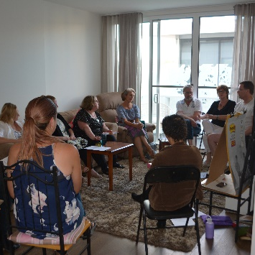
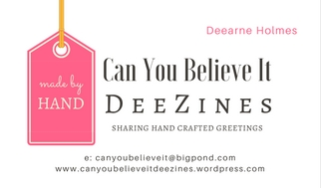
Dee
Fund run
Business Owner - DeeZines
Own home - Host and organiser of “Meet your Neighbours” BBQs
Cake baking competition entrant Melbourne Show (Won a 1st and 2nd prize).
Fundraiser:
Volunteer at Hamer Hall, Myer Music Bowl Christmas Carols and Royal Children’s Hospital’s Good Friday Appeal
“Pamper Night” & “Girls Night In” Host, at her home. Selling her cakes and biscuits and raising money for charity.
Notes:
Teresa – Selling her cards…

Slide 14
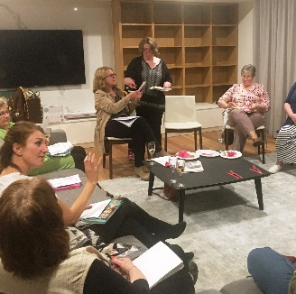
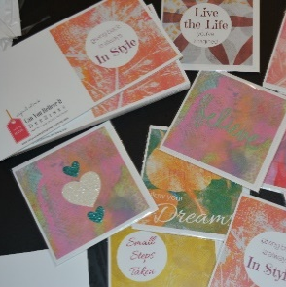
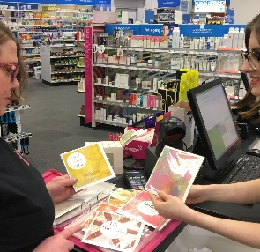
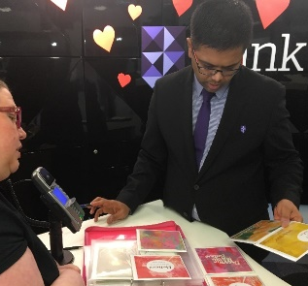
Thinking about valued roles
Interest
Art & people
Idea
Make & sell greeting cards
Role
Business Owner
Positive
Appearance
Valued
Activities
Valued
Settings
Other People in Valued roles
Valued
Images
Deezines- View at www.talksthatmatter.net
Notes:
Couch in terms of Dee’s decision making at each stage

Slide 15
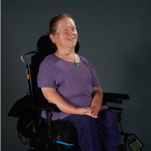
Judith Snow
Image from internet courtesy of
Green Mountain Support Services

Slide 16
Brodie’s Circle View at: www.cosam.org.au www.talksthatmatter.net

Slide 17
Benefits – Brodie’s Roles
Student - hospitality, music, personal training
Class mate and friend
Employee - Assistant landscaper, sporting stadium, food outlets
Church member
Gym member – Body builder
Tenant, housemate
Leader – Presenter, Board member
Notes:
Describe benefits of Brodies Circle and how decisions where made about all these things

Slide 18
Benefits (BCN review)
People with disabilities
left day programs, set up business, found employment
became more involved and engaged in their own life
Enjoyed the meetings or had more comfort with them!
Families
afraid to ask but people came!!
Siblings glad to be included and have the conversation
Emergence of a safeguard for the future
Circle members
Bonded together on the vision and journey
Shared ideas, connections and practical assistance
Had fun together and created relationships
Felt privileged
Notes:
Teresa – embed in context of decision making

Slide 19
Other benefits
On ongoing structure and facilitation
helps hold the vision for an inclusive life
and keep on track
Some Circles have taken on more interest
in the detailed work of such things as NDIS
pre planning
A very real way for people to be assisted with making day to day and big life decisions
Notes:
Teresa – e.g. Dee decision to have more control of money, e.g. Mike, coming to the table, signing Team Mike association with team and the good things in life.

Slide 20
Making Unique Choices and being respected
Notes:
Deb

Slide 21
Being respected
I’m seen as a unique/whole person not just for my disability
Others consider that I’m worthy of attention and inclusion
I have purpose and a full, meaningful and inclusive life
I have valued roles and I’m not treated as a second class citizen or devalued
My roles align with my chronological age and interests
My Circle of support puts me at the Centre of the conversation and decision making
People who love me and are in my life by choice, help me make decisions and uphold my vision for a good life

Slide 22
Making Choices
I’m informed about choices through supported decision making
Listening – said and unsaid
Trying, tasting and reflecting
High expectations for growth, development and inclusion
I learn to make choices, and am empowered
Valued
Activities
Valued
Settings
Other People in Valued roles
Valued
Images
Positive
Appearance

Slide 23
A quote to ponder
“Support circles are a very powerful strategy for inviting ordinary people to walk alongside, focus on and make a commitment to people with a disability and their families, as they dream, plan and achieve the lives that they want”
Margaret Rodgers,
Community Resource Unit
Notes:
Tim Costello – take the next step article

Slide 24
Tips on getting started
Notes:
Deb

Slide 25
Considerations…
Is a Circle of Support the right idea for me or someone I know?
Educating people about Circle’s of Support
Empowering people to set up a Circle
Notes:
We run 2 day workshops on Circles of Support

Slide 26
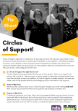
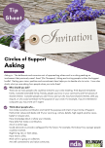
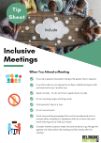
www.belongingmatters.org/resources/tipsheets
Notes:
Talk about other Circle resources

Slide 27
Facilitation
Notes:
Deb

Slide 28
Facilitation
Keeps the person at the Centre
Listens to and engages people
Enables and encourages voice of focus person
Checks in with focus person about decisions
Helps the Circle figure out ways to enable
decisions to become actions

Slide 29
LIMITATIONS
Notes:
Deb

Slide 30
Cautions
Just having a Circle for the sake of it
Loosing sight of the person, talking about the person
Poor values and vision – not building member knowledge
Service driven (Circle becomes staff/team meeting)
Thinking the Circle can meet every need
Dominance by one member
Willingness of members to take on tasks and challenges,
Organising left to one person
Takes commitment, energy (but worth it)
Lack of succession planning – people come and go
Giving up instead of redesigning
Notes:
Agency driven – conflict of interest; dependence if no longer involved

Slide 31
Resources and acknowledgements
New guide coming soon!
Community Living Project, SA http://communitylivingproject.org.au/circles-initiative/
Community Resource Unit, Queensland http://thegoodlife.cru.org.au/including-others/
Resourcing Inclusive Communities , NSW www.ric.org.au/learn-about/building-support-networks/circles-of-support/
Building Community Networks www.belongingmatters.org/building-community-networks
Thinking about Circles (Periodical Issue 26) http://www.belongingmatters.org/periodicals
The Shouted Goodbye (Jeremy Ward) http://www.belongingmatters.org/books
Building Circles of Support and Friendship – A Guidebook for Parents (Jan Burke-Gaffney, Hamilton Family Network, Canada)
Circle of Support and Microboard (COSAM) www.cosam.org.au
In the Company of Friends, Manitoba
Resource list

Slide 32
Questions to Audience
Do you feel you know more about Circles of Support as a result of this session?
Have you gained skills and knowledge in this session?
Will you consider sharing information with people about Circles of Support?

Slide 33
Like a further conversation

Slide 34
Questions

