Slide 1
DARU Advocacy Sector Conversations Forum
28 June 2018

Slide 2
Welcome
Colleen Furlanetto

Slide 3
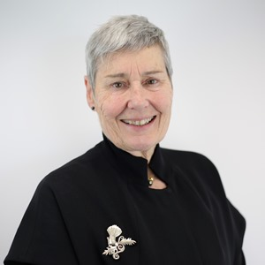
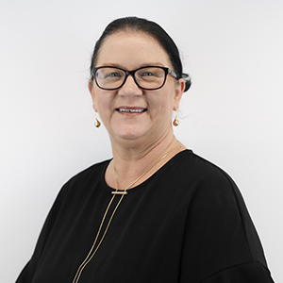
Our Commissioners
Yehudi
Blacher
Chair
Monique
Conheady
Janet
Dore
Colleen
Furlanetto

Slide 4
Disability Commissioner
Role
Engagement
Government initiatives
Colleen Furlanetto

Slide 5
Our Vision
‘A commercial passenger vehicle industry that is customer focussed, safe, accessible and competitive.’

Slide 6
Transport for Victoria – structure
Victorian Government
Transport for Victoria
Department of Economic Development, Transport, Jobs and Resources
Public Transport Victoria
VicRoads
V/Line
Taxi Services Commission
Victorian Ports Corporation (Melbourne)
Victorian Regional Channels Authority
Port of Hastings Development Authority

Slide 7
TSC – structure
Commission
Chief Executive Officer
TSC Directors
Human Resources and Marketing Communications and Stakeholder Engagement
Legal and Regulatory Services
Strategy and Innovation
Operations
Corporate Services
Human Resources:
learning and development
change management
employee relations and OH&S
Stakeholder Engagement:
Local Government
country/regional operators or users
government agencies
disability sector and advocacy groups
community transport
cpv service providers
Commissioner for Senior Victorians
prosecutions
disciplinary processes
freedom of information
equal opportunity
human rights
policy development
environmental scanning
research
Accreditation and Licensing
Accessible Transport Services
Compliance Services
Investigations
IT support
procurement
finance
planning, performance and risk

Slide 8
What we do
We regulate Victoria’s commercial passenger vehicle industry.
Implement Victorian Government reforms to the industry.
We accredit drivers and Booking Services Providers, and license vehicles.
We administer the Multi Purpose Taxi Program, which supports people with disabilities.

Slide 9
The industry is changing
There is new legislation governing the industry – the Commercial Passenger Vehicle Industry Act 2017.
Since new laws took effect and reforms began, there has greater interest in, and demand for, driver accreditation and vehicle licensing.
It’s now easier to enter the industry and provide different services to consumers.
There is now more choice, improved safety, and consumer protections, providing better outcomes for passengers, drivers and the community.

Slide 10
And so are we!
From July, the second stage of reforms take effect, bringing in new legislation and new regulations.
As part of this, the Taxi Services Commission will be changing its name to Commercial Passenger Vehicles Victoria.

Slide 11
New name, new focus and new powers
In addition to a new name, we will have a new focus on safety and new regulatory powers.
We will continue to work in partnership with industry to provide a better, safer and fairer services for all.
Fares are being deregulated and we will monitor these, while drivers will be required to give passengers with a fare estimate before a trip begins.
Commercial passenger vehicle service providers will be able to brand their vehicles as they choose to.

Slide 12
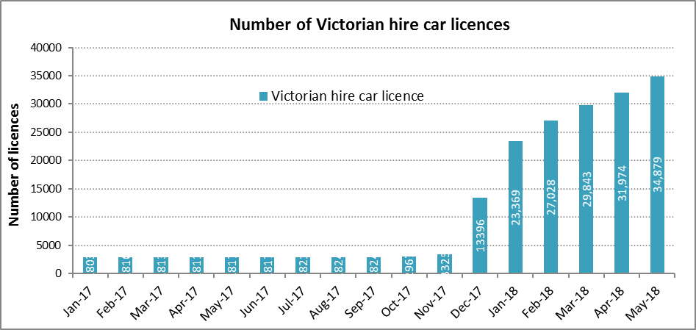
Industry statistics
Number of Victorian hire car licences
Increase in CPV licences
Increase in accredited drivers

Slide 13
Key changes from July
Replace vehicle licensing with ‘registration’.
Replace Booking Service Provider accreditation with ‘registration’.
Introduce the safety duties framework.
Introduce fare monitoring.
Consumer protections.

Slide 14
How we will introduce these
Improve engagement with stakeholders and industry.
Develop stronger relationships with major service providers.
Increased industry and community education.
Look at collaborative and partnering opportunities.

Slide 15
Accessibility related activities
Point-to-point transport review.
Expanding the MPTP scheme beyond taxis.
National Disability Insurance Scheme (NDIS) Transition.
State Disability Plan.
Inclusive communities – I feel included
Health, housing & safety – I live well
Fairness & safety – I get a fair go
Contributing lives – I contribute.

Slide 16
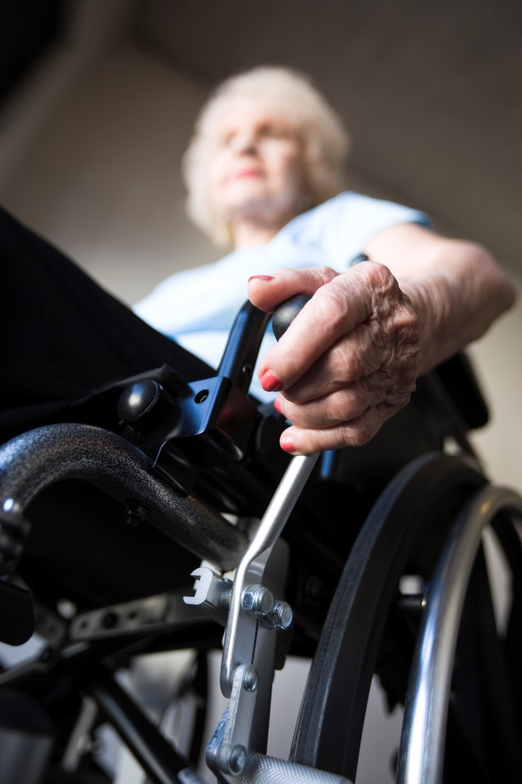
The Multi Purpose Taxi Program (MPTP)
Provides subsidised taxi travel.
More than 220,000 members.
On average, more than 20,000 applications are received each year.
5 million MPTP trips were taken in 2017.
More than 1 million of these trips were wheelchair trips.
In 2016-17, the MPTP budget was in excess of $70 million.

Slide 17
MPTP continued
Lifting fee
The lifting fee recognises the time it takes drivers to load and unload wheelchair and scooter users.
This fee is covered under your MPTP membership.
The lifting fee for Wheelchair Accessible Taxis is $20.
The lifting fee for conventional taxis in outer-suburban, urban and country zones is $10.

Slide 18
Questions

