Slide 1
The NDIS and housing
Penny Paul and George Taleporos
Notes:
What I'm thinking would be helpful for advocates is some help around how to advocate for SDA and how to navigate the SDA pathway. We have some great resources around this and we can talk through them as well as having a bit of a discussion about policy issues that require some systemic advocacy work. Therefore, what I'm thinking is that my colleague Penny Paul and I could do a joint presentation with her focusing on the SDApathwayand the broader pathway to housing and I will could lead a discussion around the policy issues that are emerging. It would be really valuable to hear from each other about the range of issues that advocates are encountering around the NDIS, housing and SDA.
50 minutes
pp talk for 30 minutes
George policies 5 minutes
individual advocates
how to get housing for their clients

Slide 2
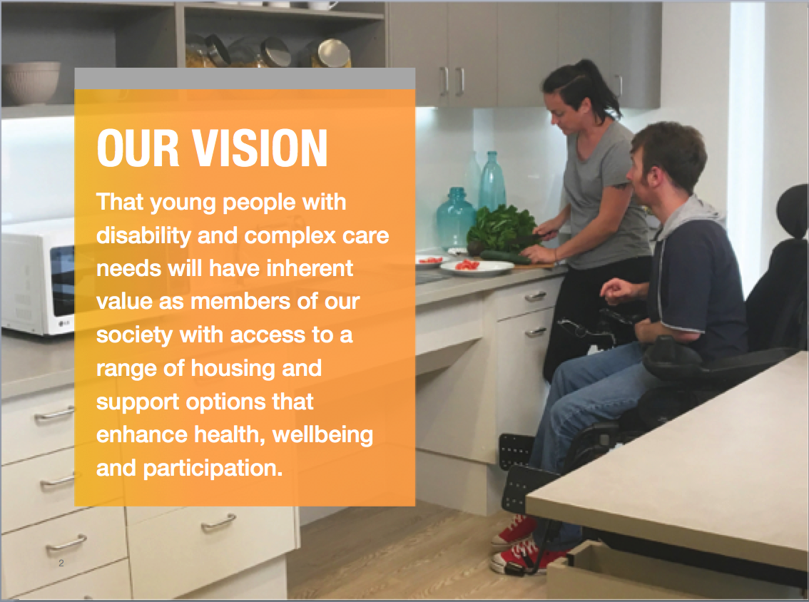
About Summer Foundation
Notes:
Established in 2006, the mission of the Summer Foundation is to resolve the need for young people with disability to live in nursing homes. The Summer Foundation is focused on developing integrated housing models underpinned by four key areas:
Our research underpins our work and provides an evidence base for policy and practice change.
Enabling young people with disability and their families to tell their stories and disseminating these stories is a powerful and effective tool for influencing the general public, decision makers and politicians.
We prototype potential solutions. This is an iterative process which involves: designing, building, evaluation and learning.
We capture, document and disseminate the knowledge generated from our research and prototypes in order to encourage others to replicate and scale our work.

Slide 3
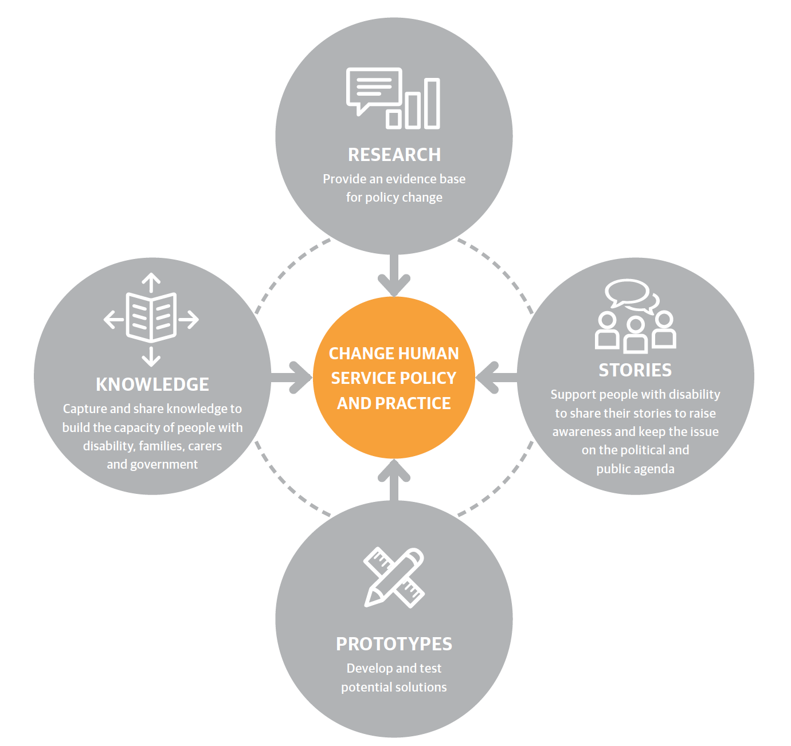
About Summer Foundation
Notes:
Established in 2006, the mission of the Summer Foundation is to resolve the need for young people with disability to live in nursing homes. The Summer Foundation is focused on developing integrated housing models underpinned by four key areas:
Our research underpins our work and provides an evidence base for policy and practice change.
Enabling young people with disability and their families to tell their stories and disseminating these stories is a powerful and effective tool for influencing the general public, decision makers and politicians.
We prototype potential solutions. This is an iterative process which involves: designing, building, evaluation and learning.
We capture, document and disseminate the knowledge generated from our research and prototypes in order to encourage others to replicate and scale our work.

Slide 4
Today’s presentation
How can the NDIS assist with housing?
Looking for housing (Mainstream)
Specialist disability accommodation (SDA)
Tools to help participants and providers search for housing
Emerging policy issues

Slide 5
NDIS’ Approach to Housing
127,000
?
28,000
57,000
88,000
Notes:
LUKE:
Housing is the key to citizenship and an ordinary life and

Slide 6
Looking for housing (Mainstream)

Slide 7
Notes:
Most people will live in a Mainstream housing option –
Participants testing their eligibility for SDA will need to demonstrate that they have exhausted their mainstream housing options not suitable – see the living more independently living guide for information on mainstream housing
This resource is a really good way to evidence a persons search for a mainstream housing option and to learn more about them, their hopes and dreams and the supports that work best for them.
You can cut and paste information from the participant and their family recorded here into their Housing Plan.

Slide 8
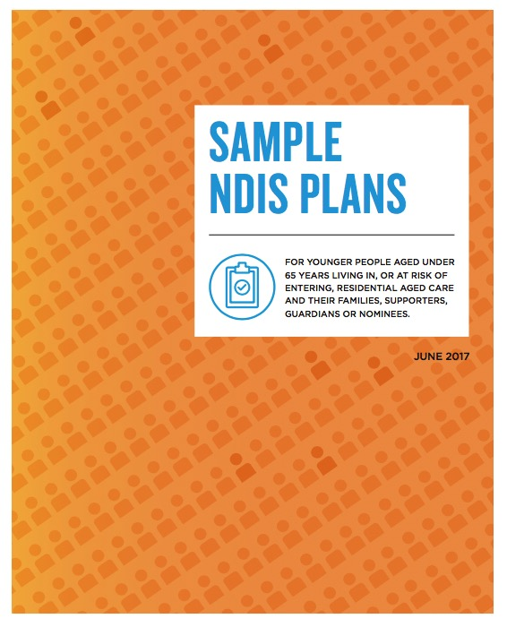
Housing Goal

Slide 9
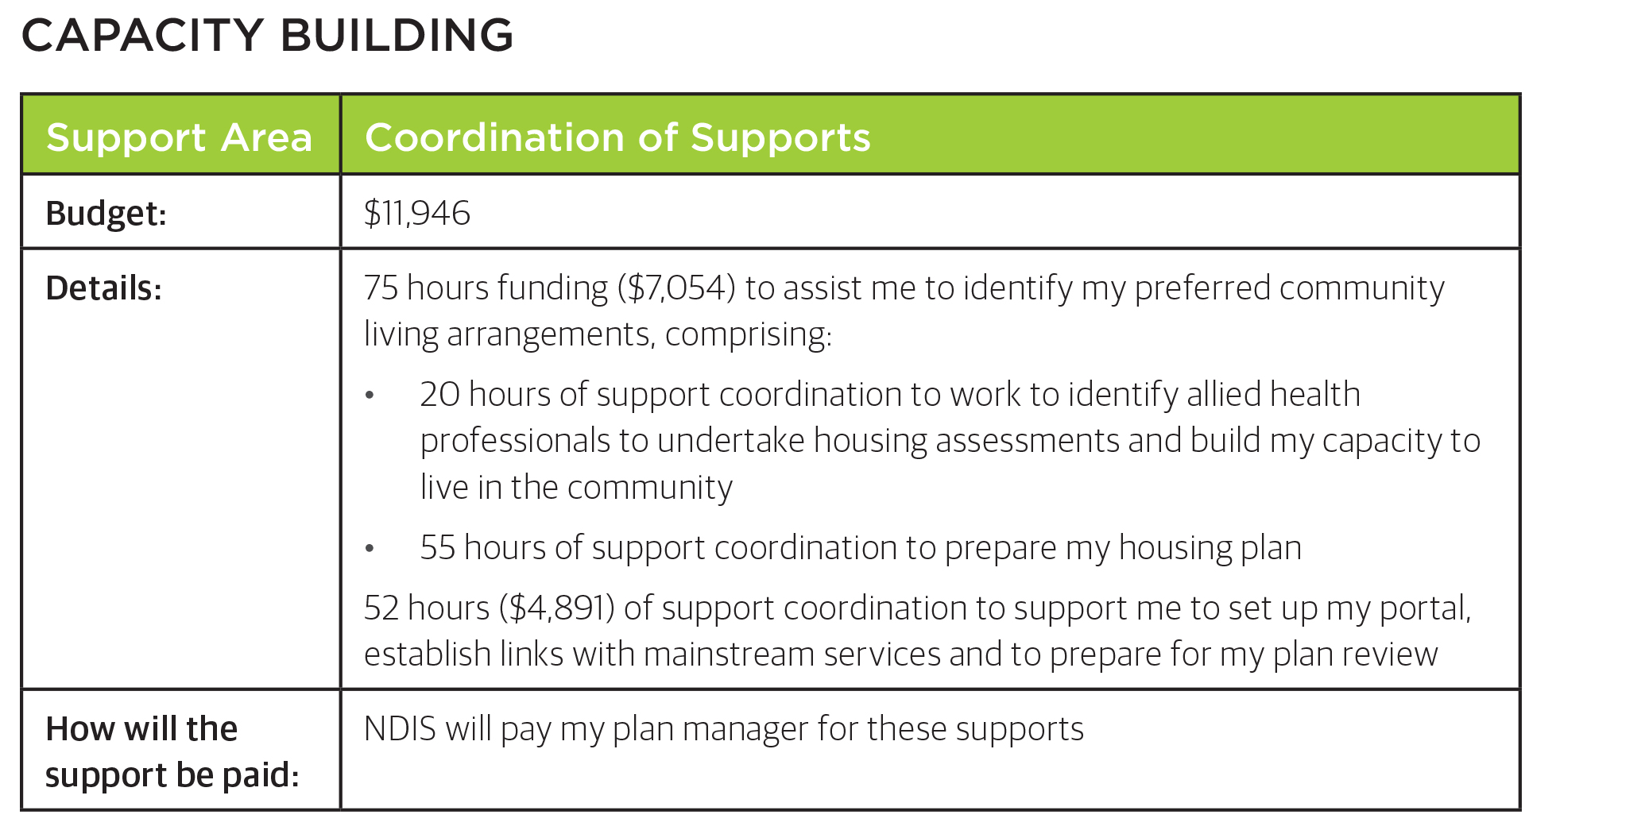
NDIS funded supports to assist people meet their housing goals
Notes:
Manage provider conflicts

Slide 10
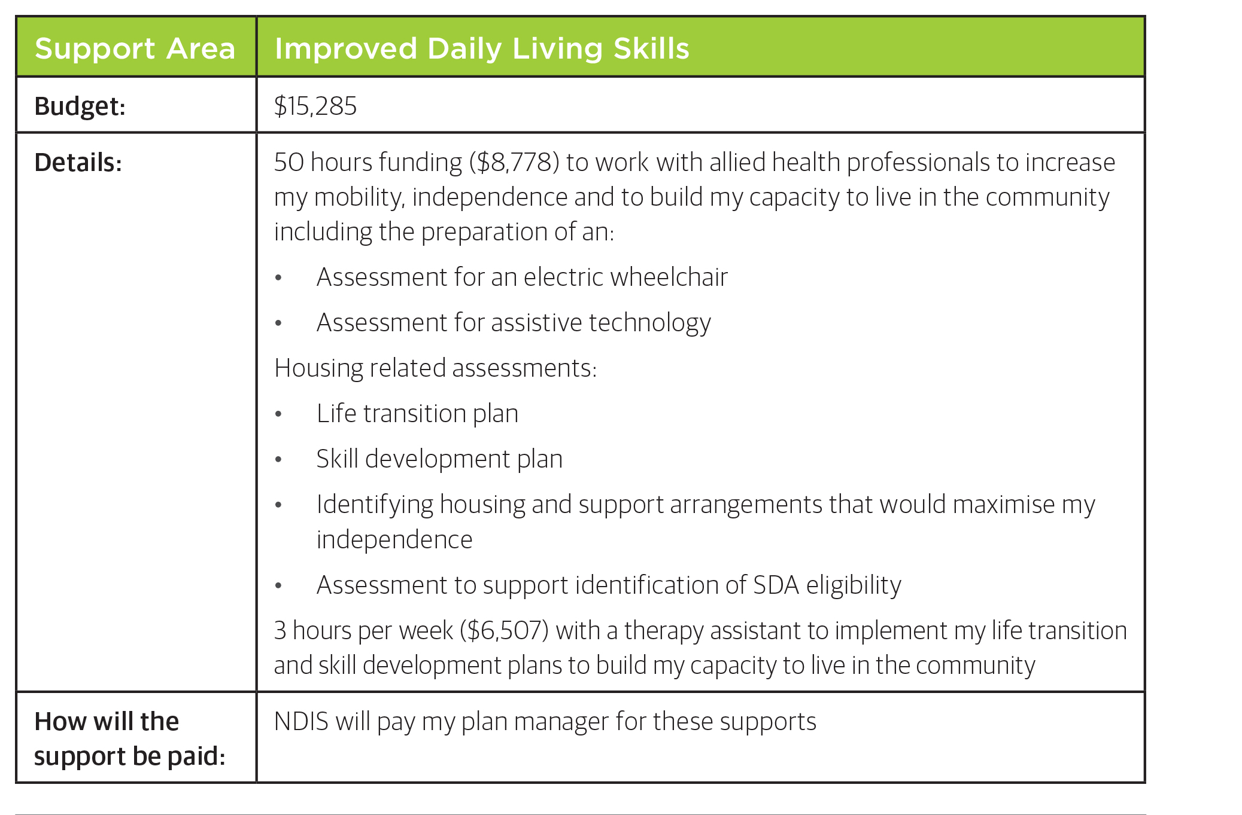
NDIS funded supports to assist people meet their housing goals
Notes:
Manage provider conflicts

Slide 11
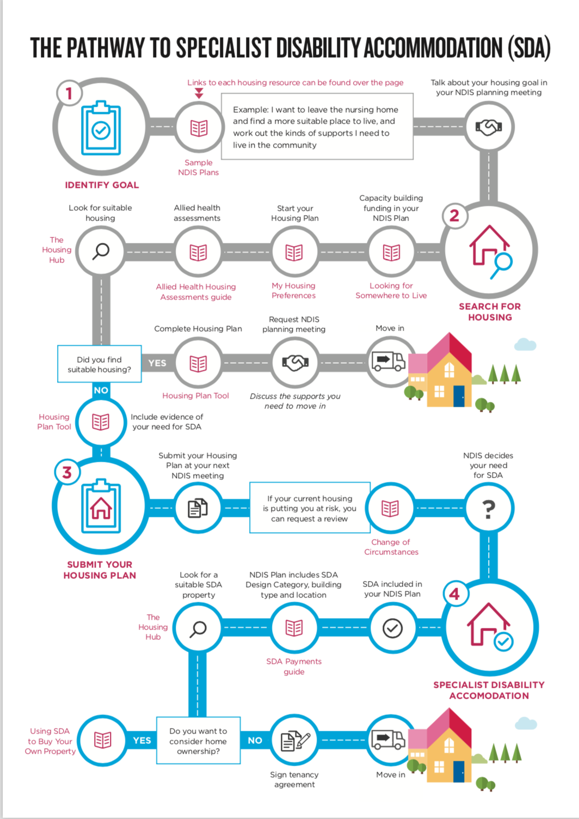

Slide 12
Mainstream housing options
Community/social housing: Housing that is managed by a not-for-profit organisation, which may also own the property.
Cooperative housing: A Housing co-operative is formed by a group of people with a common interest to work together to maintain and manage housing. For example: http://www.silc.coop/faq
Private rental: Renting a house from a private landlord. This guide to renting in the private market is written for all Victorians but contains useful checklists and templates: http://bit.ly/2nedYmO
Shared equity: When buying a home is shared between the resident and a silent partner – usually a government or not-for-profit agency. For example: Buy Assist http://www.buyassistaustralia.com.au/homebuyers/
Sharing with friends: Share houses generally rent in the private rental market. Watch Adam’s story of moving out of home for the first time at the age of 25 at this webpage, which also has a range of excellent resources on all aspects of living independently: https://adammovesout.wordpress.com/
Notes:
12

Slide 13
Mainstream housing options
Homesharing: An arrangement where unrelated people share a house, and each has access to private space. My Place operates homesharing in WA. Here is a link to a video about My Place:https://www.youtube.com/watch?v=Ox-G4m67zpA
A moveable unit or bungalow: Movable units are self-contained and can be set up in the backyard of a friend or relative allowing the resident to live independently. They are available through public housing: http://bit.ly/2AfoYoX
Public housing: Housing, that is owned and managed by government directly. Strict asset tests apply and there are long waiting lists. If you’re eligible it’s worth joining the queue.

Slide 14

Notes:
14

Slide 15
NDIS funded supports to assist people meet their housing goals
Capacity building supports
Assistance with daily living supports
Developing and/or sustaining the participant’s informal support network
Home modifications
Assistive technology
Notes:
Manage provider conflicts

Slide 16

Mainstream housing
Notes:
Manage provider conflicts

Slide 17

If a patrician's disability prevents them from accessing mainstream housing, they should test their eligibility for SDA

Slide 18
Specialist disability accommodation (SDA)

Slide 19
Who is SDA for?
127,000
?
28,000
57,000
88,000
Notes:
LUKE:
Housing is the key to citizenship and an ordinary life and

Slide 20
Demand: NDIS View
28,000 people
  16,000
  Existing Supported Accommodation
  6,200
  Residential Aged Care
  5,800
  Unmet Demand

Slide 21
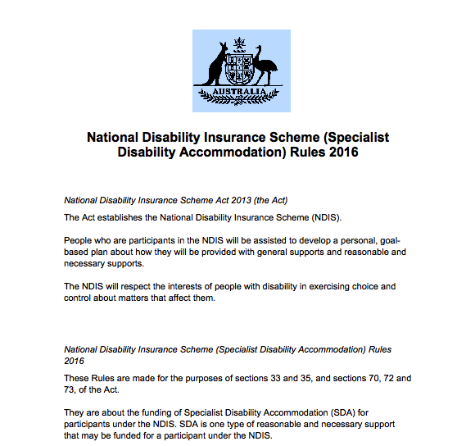
Notes:
NDIA has developed SDA Rules.
A decision maker in the NDIA will get the housing plan and make a decision on eligibility against the criteria set out in the SDA Rules.
I want you for a moment to put yourself in the position of the decision maker
You may not have any expertise in disability, you may have been employed because you have expertise in making decisions.
You may have KPIs around how many decisions you have to make, not the outcome of the decision, i.e. not Yes or no.
As a support coordinator its No good talking about ‘common sense’ Or what’s happened in the past or trying to appeal to reason.
The NDIA has developed a set of Rules to ensure public money is appropriately targeted. They are under pressure from:
Australian taxpayers
Politicians
Treasury
The NDIA
To make decisions that are:
Fair
Transparent
Consistent

Slide 22
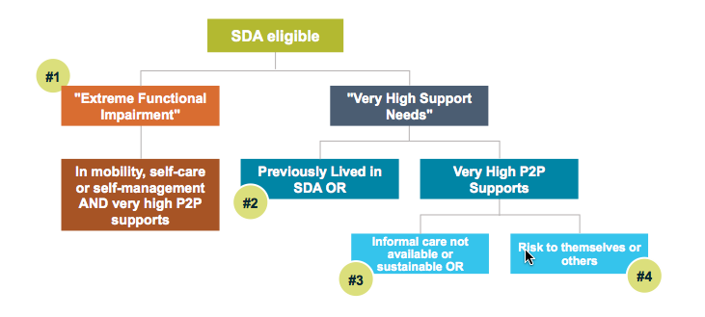
Who gets SDA?

Slide 23
SDA: Design categories
SDA category | Minimum Requirements
Basic | Available for Existing Stock only.
Improved Livability | Livable Housing Australia ‘Silver’ level
Fully Accessible | Livable Housing Australia ‘Platinum’ level
Robust | Livable Housing Australia ‘Silver’ level Resilient but inconspicuous materials: high impact wall lining, fittings and fixtures; secure windows, doors and external areas, laminated glass; sound proofing Retreat for staff and other residents to avoid harm
High Physical Support | All requirements listed in the ‘Fully Accessible’ design category, plus: Structural provision for ceiling hoists, assistive technology ready; Heating/cooling and household communication technology; emergency power solutions; 950mm minimum clear opening width doors to all habitable rooms

Slide 24
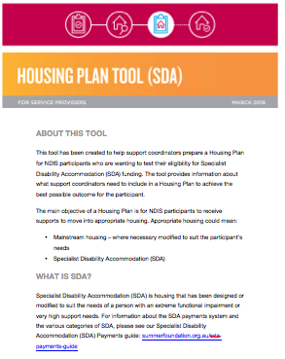
Housing Plan Tool
Template for submitting your NDIS housing plan:
Matches up your evidence with the Reasonable and Necessary assessment
Covers all the information NDIS requires

Slide 25
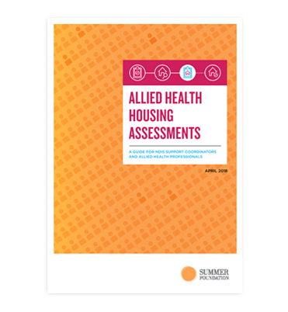
Notes:
25

Slide 26
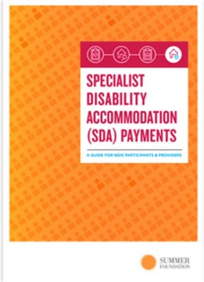
Notes:
26

Slide 27
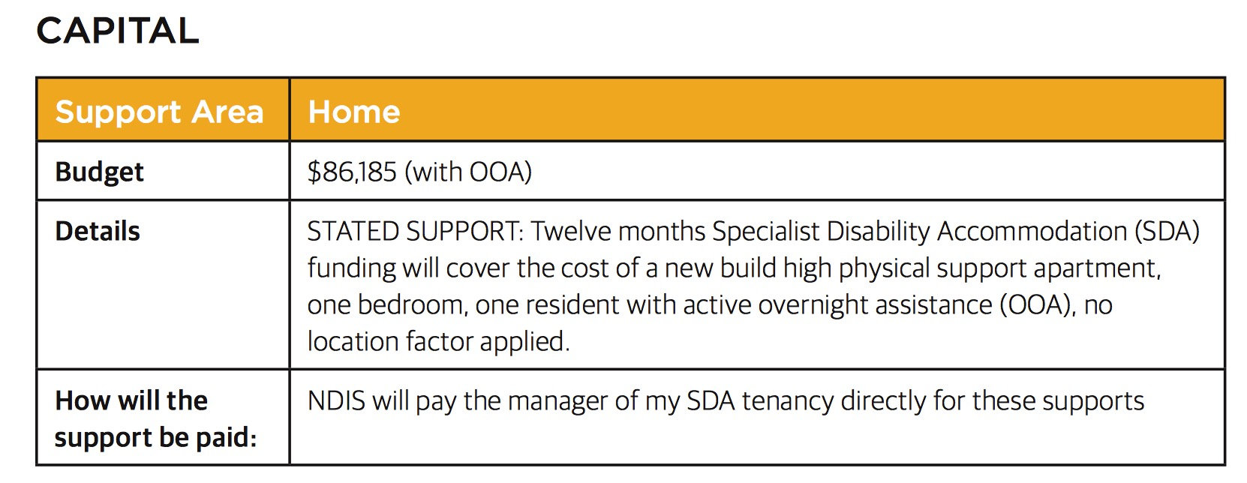
SDA in an NDIS Plan
?
Notes:
LUKE:
Housing is the key to citizenship and an ordinary life and

Slide 28
SDA & In-kind
“No participant is required to live in an in-kind SDA property if they do not wish to” – David Bowen
“Victoria has an agreement with the NDIA to ensure that this does not impact on choice and control of accommodation. No participant who would prefer a non-government place will be required to accept or stay in a government place if there is a suitable place available in the non-government sector” – Jenny Mikakos
In-kind up sides
Consider individual preference
Wide range of basis for requesting non-in-kind
10 business day cap for States to advise on availability
Commonwealth position – no in-kind post 1 July 2019

Slide 29
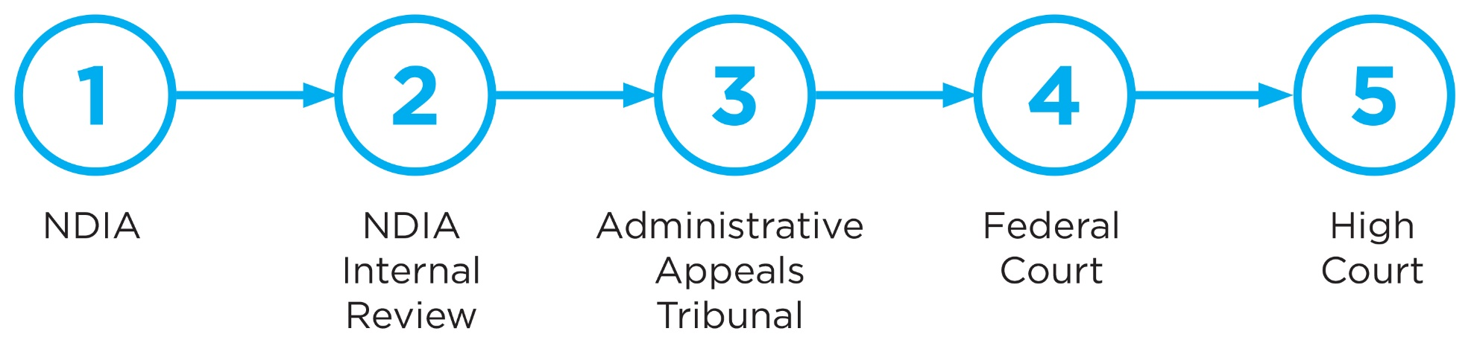
Appealing an SDA decision
Notes:
Manage provider conflicts

Slide 30
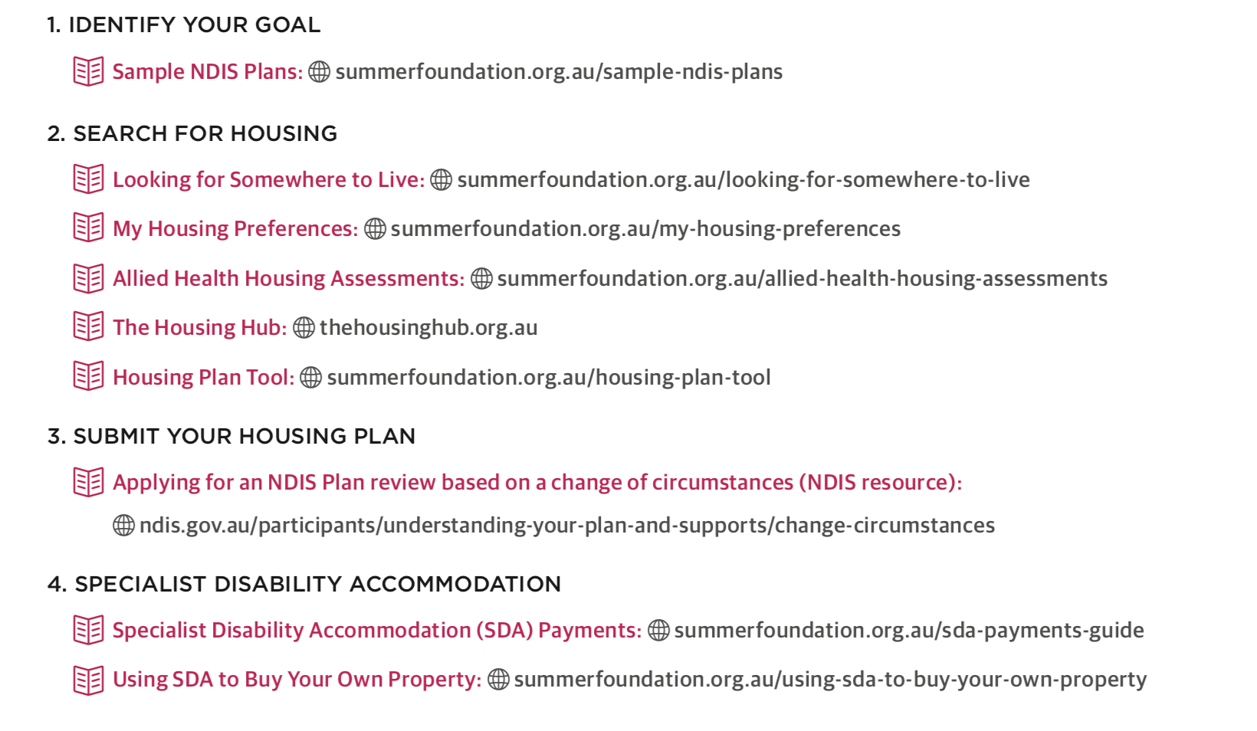
Summer Foundation Housing Resources

Slide 31
Tools to help participants and providers search for housing

Slide 32
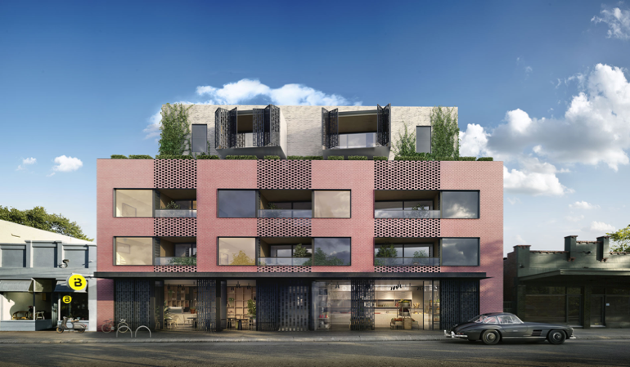
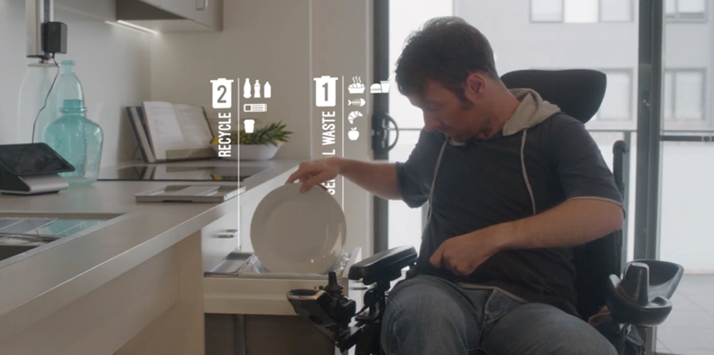
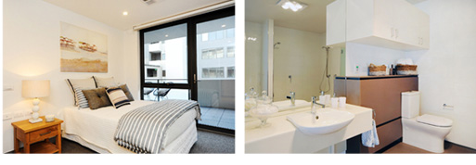
New forms of disability housing in the NDIS
High quality options are being created

Slide 33
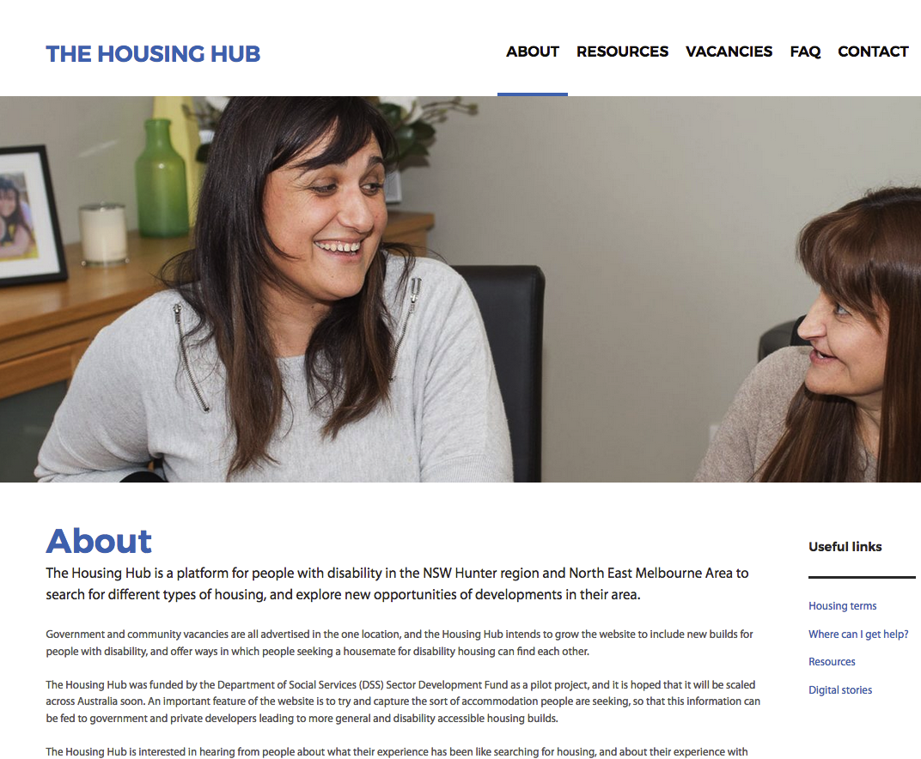
Housing Hub: Connecting Participants & Providers

Slide 34
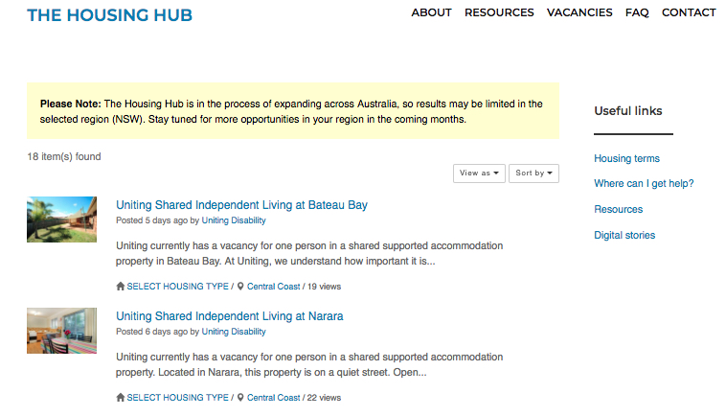
The Housing Hub – Vacancies

Slide 35
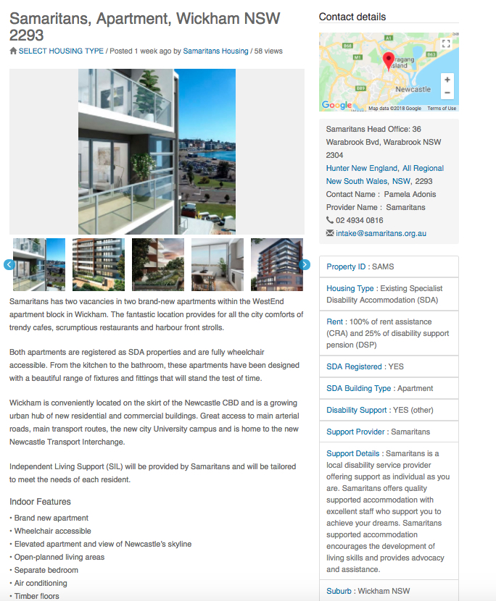
The Housing Hub – Vacancies
Vacancies

Slide 36
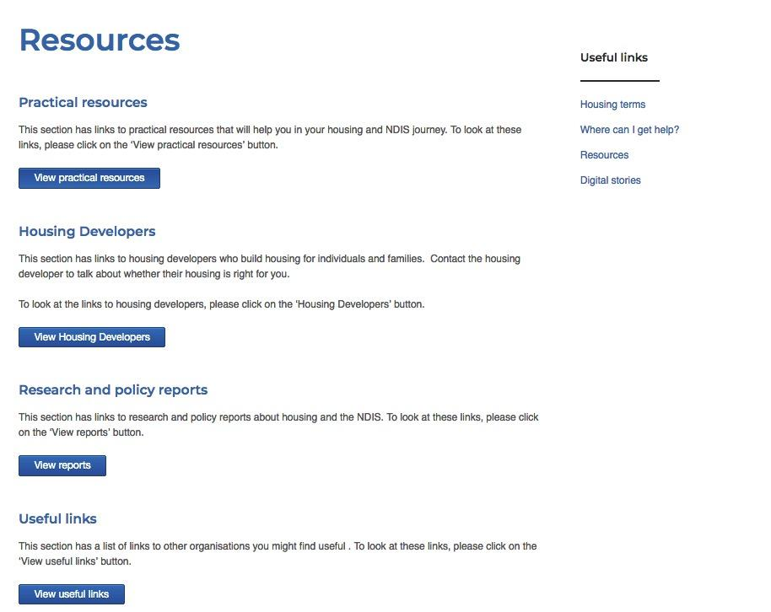
The Housing Hub – Resources

Slide 37
Emerging policy issues

Slide 38
SDA: Policy features
Framework
  Funding attached to individual NDIS participants
  Payment made directly to provider
  Vacancy risk sits with providers
Pricing
  Per person subsidy (currently $12,419 - $107,236 pa)
  Pricing structure favours new, more accessible housing
  Intention for 20+ years subsidy period
Market regulation
  Open to many providers – NFP, private, individual
  Participant can rent or own; providers can headlease or own
  No tendering for supply or quotas – all market driven

Slide 39
SDA: Policy problems and solutions
SDA Framework favours shared housing / support arrangements over living alone.
  This assumption underpins the SDA Rules and how the NDIA has implemented the Framework - clearly reflected in the messages in the SDA Provider and Investor brief. This assumption is very pervasive through the documents and operation of the Framework.
  Solution: The Framework document be amended to remove this assumption and all other SDA documents amended to reflect this change. This includes documents for the operation of related support funding.
NDIA controls the decisions about type, location & size
This underlines choice and control and can leave people with insufficient funding for their preferred home and living arrangement.
Solution: Change Part 4 of the SDA Rules to have the building type and location decision determined by the participant. They should be approved for a funding range which would enable them to look for a home within the design category the NDIA has approved on the basis of need.
SDA Framework assumes only people with SDA funding will live together
This means the Rules, price guide and NDIA operations restrict the ability of participants to share their house with spouses/partners, children, other family and friends, anyone who is not SDA-funded or even a NDIS participant.
Solution: Clarify at a policy and operational level that participant funding under the SDA framework will enable diverse living arrangements at the choice of participants. Remove any impediments to this in the Rules, pricing and operational guidance.

Slide 40
SDA: Policy problems and solutions
NDIA decisions are slow and inconsistent
NDIA processes are not transparent - there is no clarity about process steps for eligibility and funding determinations and no clarity about evidentiary requirements when being assessed for SDA. (For comparison, see guidance provided in the AT).
Solution: NDIA needs to establish operational documentation about the SDA assessment process and make this information public. It should include guides, FAQs, checklists etc for participants, support coordinators, allied health professionals. A benchmark timeframe for decisions should be set so participants know how long the process will take.
NDIA says that participants should not expect to be funded at the relevant base price level published in the Price Guide;
The change in language in the FDA provided brief from Price benchmarks to price ceilings demonstrates that participants could be funded at less than what is stated in the price guide and may need to negotiate prices on SDA housing with providers.
Solution: NDIA must cease this practice. The Framework and Rules are clear that funding is to be set at base prices; otherwise providers cannot afford to deliver new SDA onto the market.

Slide 42

Notes:
42

Slide 43
Penny Paul
Penny.Paul@summerfoundation.org.au
Dr George T
George.Taleporos@summerfoundation.org.au
03 9894 7006
info@summerfoundation.org.au

