Slide 1
Violence, discrimination, bullying and community attitudes
Professor Anne Kavanagh
Melbourne Disability Institute
Melbourne School of Population and Global Health
The University of Melbourne
DARU conference, 2018

Slide 2
Overview of talk
Description of a range of studies on violence, discrimination, bullying and community attitudes
Used a range of data sources:
  ABS surveys: Personal Safety Survey (2012) (n=30,200) and 2016) (n=36,000); Survey of Disability, Aging and Carers (2015) (n=70,000)
  Longitudinal Study of Australian Children (n=5000)
  Community Attitudes survey :
    3 co-researchers with disability
    Stakeholder interviews (10 informants)
    National survey of 2,069 Australians

Slide 3
For
Violence
People with disability are 2-3 times more likely to experience violence
Notes:
For women, the pattern over the life course is quite different – with the most experiencing being stalking and harassment (55% disability and 45% no disability).
Next most common is physical violence, with 43% of women with disability and about 30% of those with no disability

Slide 4
Disability and Violence (PSS 2012)
Violence in the last 12 months
Compared to people without disability, people with disability:
  2 x physical violence
  3 x sexual violence
  2 x partner violence
  2 x partner emotional abuse
  2 x stalking and harassment
Gender
Similar pattern to general population:
  Men more physical violence
  Women more sexual violence, partner violence, stalking and harassment
(Krnjacki et al. 2016)
Notes:
These are age adjusted

Slide 5
Violence: Impairment type (PSS 2016)
(Unpublished analysis, 2018)
Notes:
This is combined physical and sexual violence. These are not adjusted for age. Once adjusted for age there is at least:
2 x the risk for SHS, Physical, ABI and Other
3 x risk for intellectual and phycological
(rounded and approximate)

Slide 6
For
Discrimination
14% of people with disability reported ‘disability-based discrimination’

Slide 7
Discrimination: Severity of disability (SDAC 2015)
(Krnjacki et al. 2017)

Slide 8
Discrimination: Impairment type (SDAC 2015)
(Krnjacki et al. 2017)

Slide 9
Discrimination: Impact on wellbeing
For those experiencing discrimination in the last 12 months:
Poor self-rated health was 1.6 times more likely
Psychological distress was 2.5 times more likely
(Krnjacki et al. 2017)

Slide 10
For
Bullying
Nearly hald of the poor mental health of teenagers with disability is due to bullying

Slide 11
Bullying: among adolescents (LSAC)
  Adolescents with disability had lower levels of wellbeing, higher levels of psychological distress, and high levels of suicidal ideation (King et al. under review)
  Adolescents with disability were more likely to be bullied, particularly social bullying (e.g. exclusion, name calling) (Kavanagh et al. 2018)
  Higher levels of bullying explains 46% of the differences in social and emotional wellbeing (King et al. 2018)
Take home message: Reducing exposure to bullying among disabled adolescents will improve their wellbeing and probably their longer terms educational outcomes

Slide 12
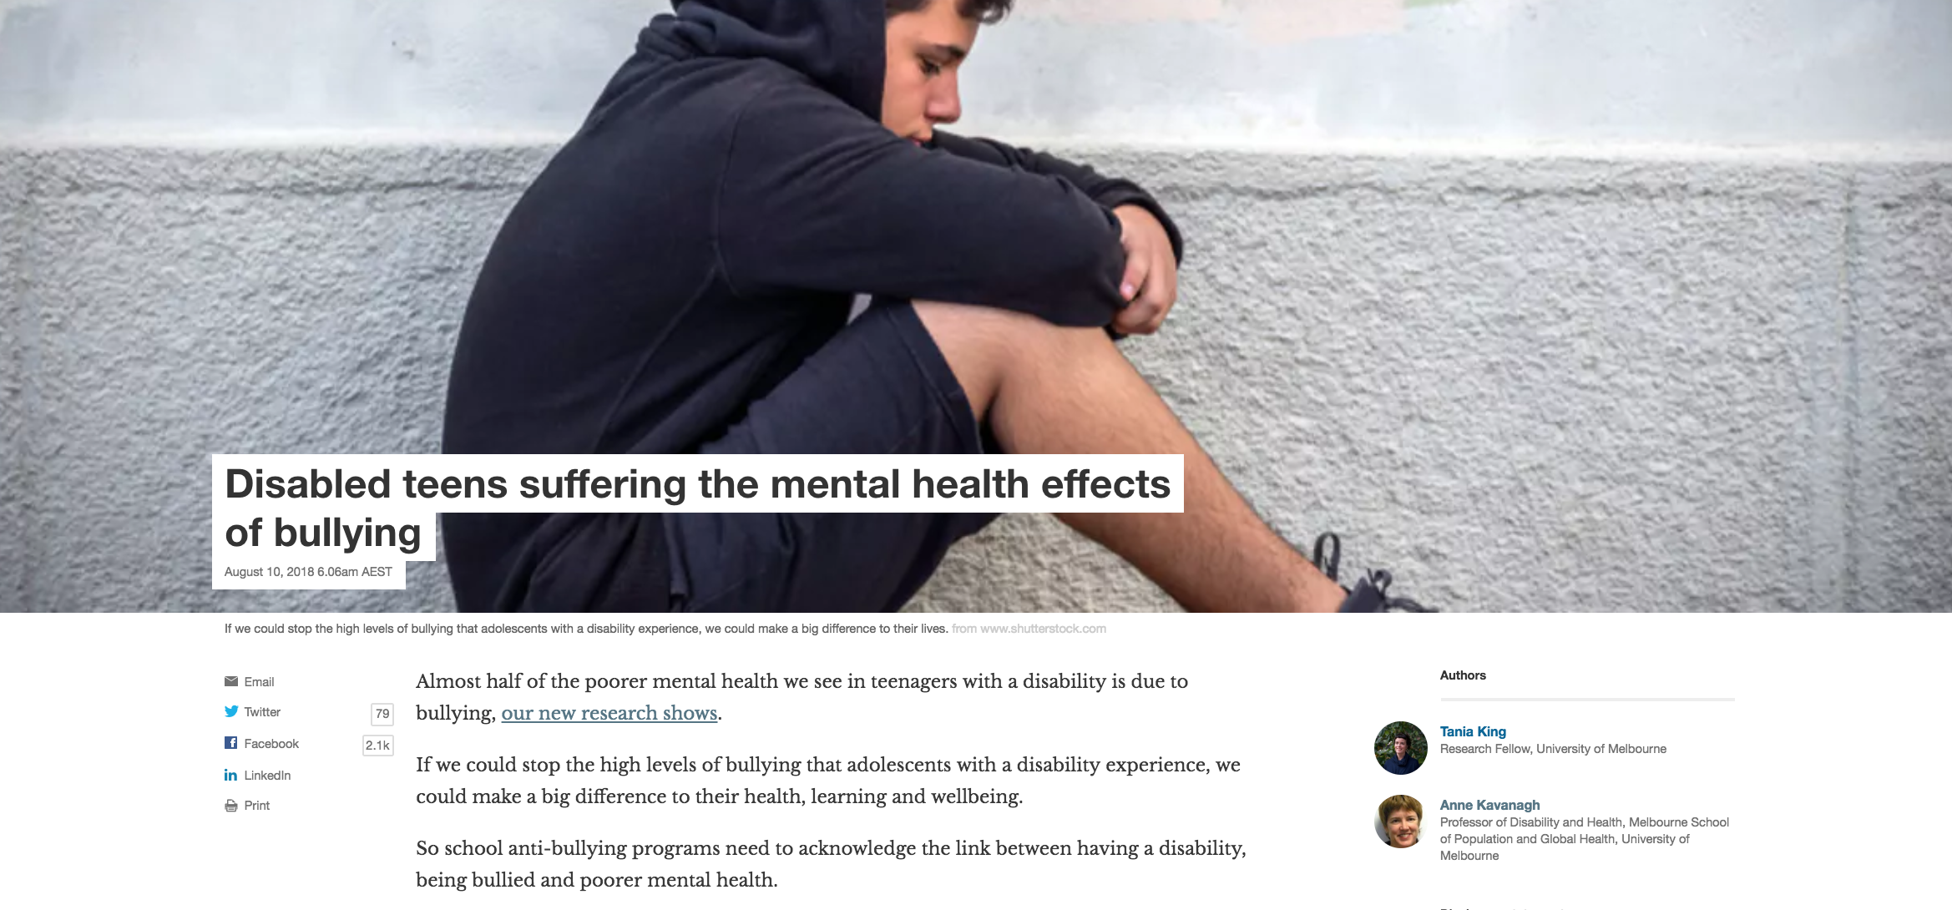

Slide 13
For
Community Attitudes
80% of Australians say that people are unsure how to act around people with a disability

Slide 14
Co-researchers
Jasmine Ozge
Vasiliky Kasidis
Georgia Katsikis

Slide 15
Community Attitudes: preliminary findings
People with a disability are easier to take advantage of compared to other people.
Proportion of respondents who:
disagreed/strongly disagreed 14%
neither agreed nor disagreed 25%
agreed/strongly agreed 61%

Slide 16
Notes:
About 80% agreed that people are unsure how to act toward people with disability,
yet only 40% agreed that people are uncomfortable asking people with disability what supports they need

Slide 17
Community Attitudes: preliminary findings

Slide 19
Community Attitudes: Supplementary findings
For
40% of people with disability are praised for doing ‘unremarkable things’

Slide 20
Community Attitudes: Supplementary findings
Experiences of people with disability

Slide 21
Community Attitudes: Supplementary findings
Experiences of people with disability
“Do you think the unfair treatment was because of your disability?”
49% of PWD said ‘yes’
percent

Slide 22
Overview of talk
Disturbing outcomes across all domain: violence discrimination, bullying and community attitudes
Our work demonstrates how discrimination and bullying that these experience significantly affect mental health
Other research has shown that discrimination, violence and bullying are detrimental to physical health
Is this information helpful for advocacy? How? How can work with you to achieve better outcomes?

Slide 23
Collaborators
University of Melbourne
External
Lauren Krnjacki
Anne-Marie Bollier
Dr Allison Milner
Dr Tania King
Zoe Aitken
Professor Tony Blakely
Dr Naomi Priest (ANU)
Professor Gwynnyth Llewellyn (Usyd)
Professor Eric Emerson (USyd)
Women with Disabilities Victoria
Co-researchers
Jasmine Ozge, Vasiliky Kasidis, Georgia Katsikis

Slide 24
Funding sources
Australian Research Council Linkage project
National Health and Medical Research Council Centre of Research Excellence
Hallmark Disability Research Initiative
Department of Human Services and Health Victoria

