Slide 1
housinghub.org.au
Summer Foundation
SDA & SIL: Your home, Your Life, Your Choice DARU Advocacy Sector Conversations, October 2021
Belinda Aitken, Jamie-Lee Dwyer & Cathy Bucolo

Slide 2
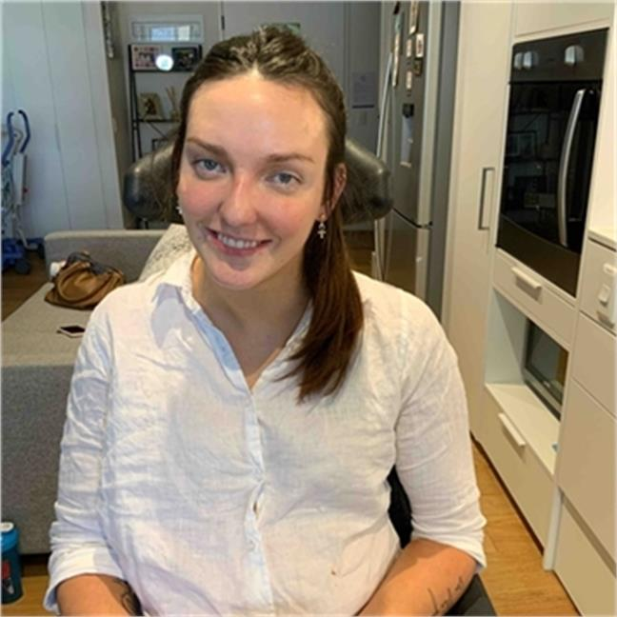
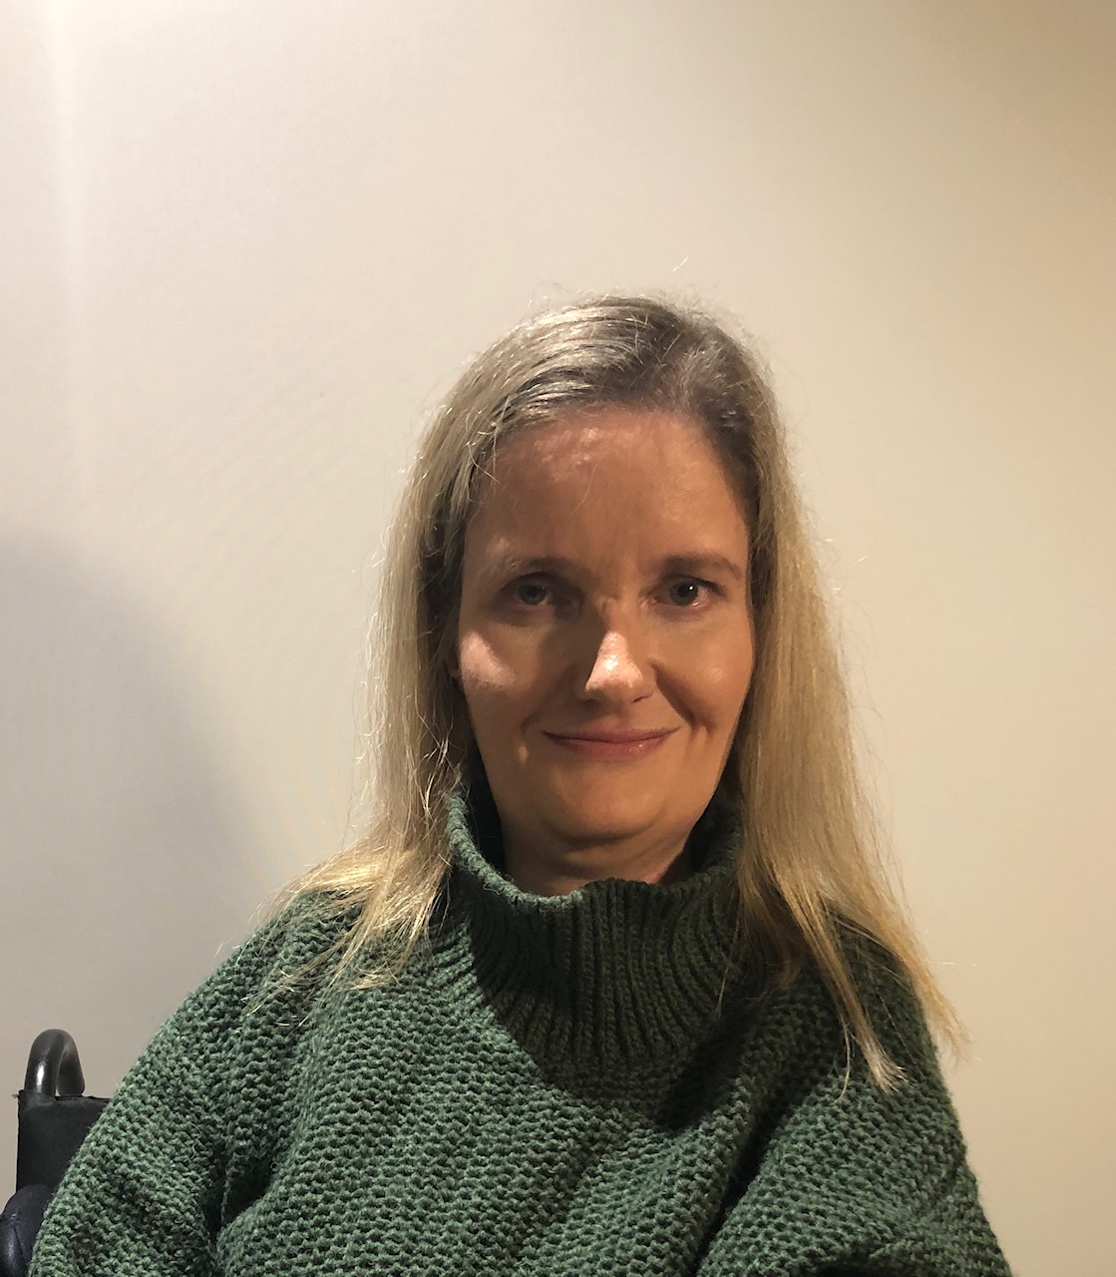
Welcome
Jamie-Lee Dwyer
Lived Experience Associate Housing Hub
Cathy Bucolo
National Clinical Practice Lead Summer Foundation
Belinda Aitken
Lived Experience Facilitator Housing Hub

Slide 3
Today
What is the Summer Foundation & Housing Hub?
Housing and Support - changing the way we think
SDA and SIL - NDIA policy
SDA and SIL - what we’ve learnt so far
Question and Answer time

Slide 4
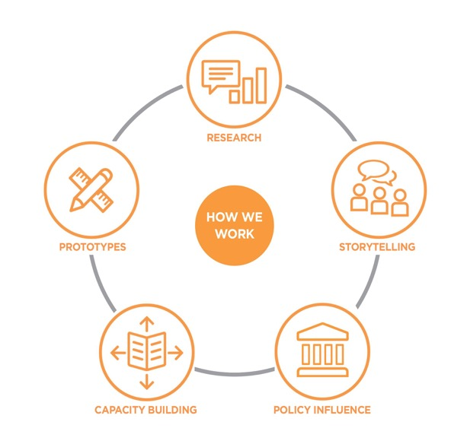
About the Summer Foundation
Mission
To create, lead and demonstrate long-term sustainable systems change that stops young people from being forced to live in Residential Aged Care because there is nowhere else for them.

Slide 5
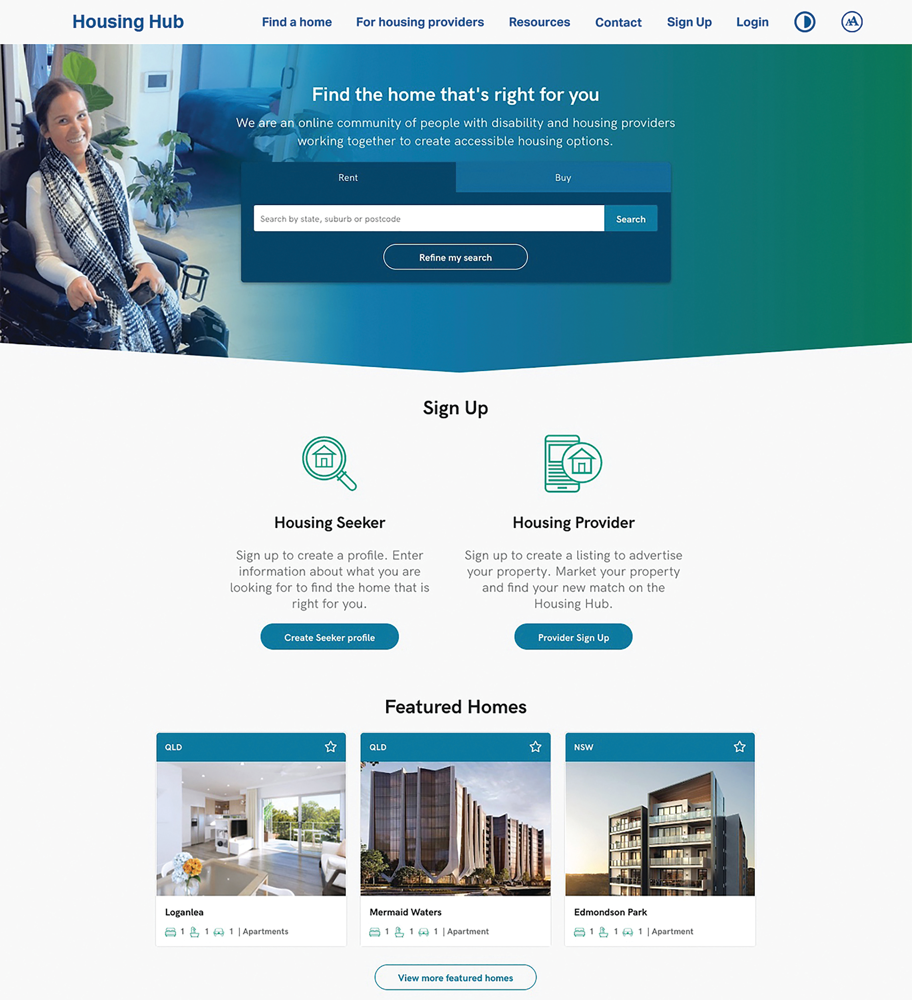
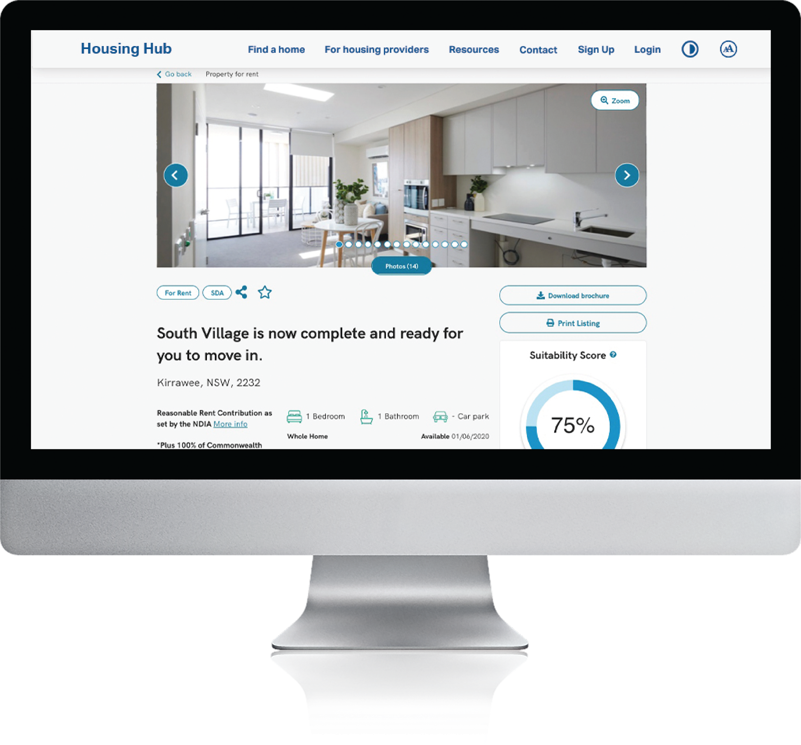
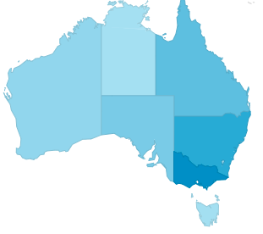
Housing Hub Team
housinghub.org.au
Over 285,000 users since inception
Over 15,000 Monthly users Over 17,000 Monthly property searches
Over 1,200 Housing Providers signed up Over 1,800 active property listings
Property listings in all States and Territories

Slide 6
Housing and the NDIS Support and the NDIS

Slide 7
Changes to housing
1970’s:
Medical, nursing type care
Rigidly rostered staff
Institutionalised routines
1980/1990’s:
Skill development focus
Staff rostered to house
Move towards individual approach within house
2000/2010’s:
Person centred planning
Aspirational
Support provided as required
Flexibility in accommodation
2020’s:
Separation of housing & support
Greater range of housing options & support options
More equitable housing options possible
*Modified from Pearson

Slide 8
Housing PRE & POST NDIS
BEFORE NDIS |  | AFTER NDIS
Highly rationed disability service system |  | Individual funding – choice about where and how to live
Government-directed supply and allocation |  | NDIS-funded supports enable independence, more housing options
Service delivery efficiencies meant congregate care models |  | Well-located housing enables independence and participation
Isolation of people with disability |  | Open market
Poor accommodation settings |  | Phasing out of larger accommodation

Slide 9
Cath’s experience of SDA and SIL
HOUSING vs Accommodation
TENANT vs resident/client/patient
MOVING IN or FINDING HOUSING vs placing someone
DWELLING and BUILDING vs place
ACTIVE LANGUAGE vs passive language e.g. being fed/showered vs eating and showering with support; receiving/giving/allowing vs engaging support
HIGHLY/VERY ACCESSIBLE vs Fully Accessible
24/7 SUPPORT vs describing support need in more detail and support model separately

Slide 10
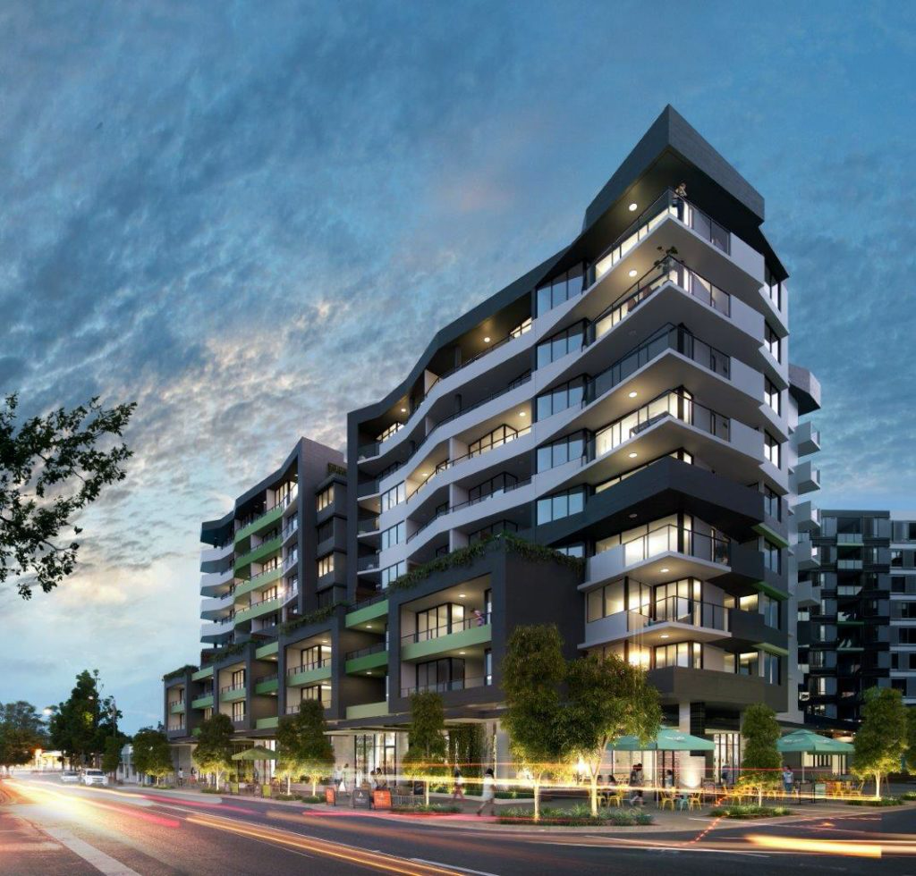
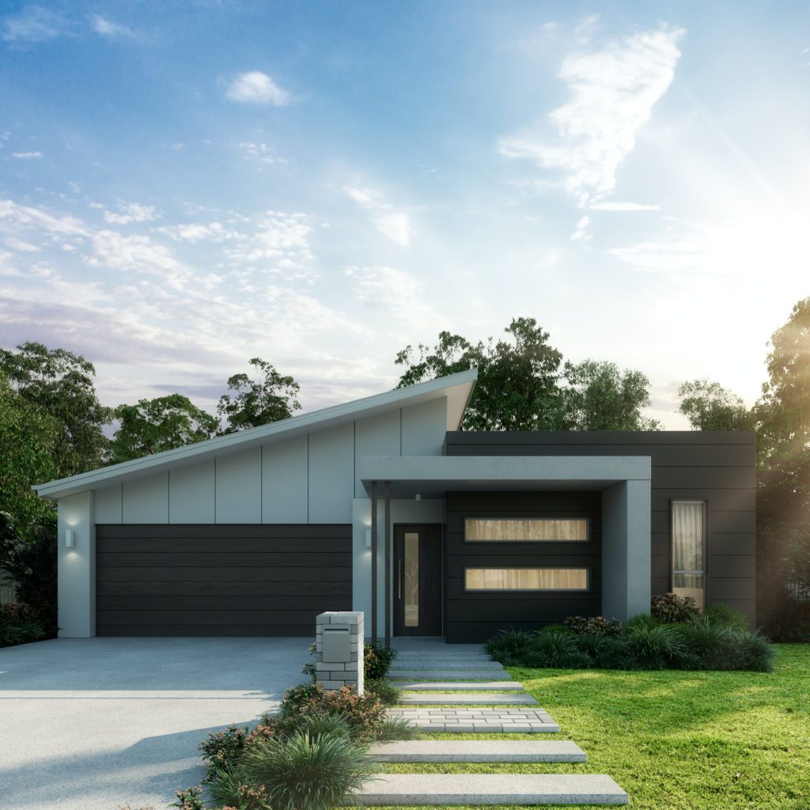
Specialist Disability Accommodation (SDA)
Specialist Disability Accommodation is
housing for people who have an extreme functional impairment or very high support needs.
10

Slide 11
Supported Independent Living (SIL)
Supported Independent Living is the support for a person to live as independently as possible. This support, when called ‘SIL’ is usually shared.

Slide 12
Housing & Support
Housing Support
Housing Provider Support Provider

Slide 13
The question on our minds
CAN YOU “LIVE IN SIL”?

Slide 14
Housing & Support: ‘Mainstream’ + Core Supports
Housing Lives alone or with people without disability Support
Housing Provider Support Provider
1 or more Assistance with Daily Living
1 or more Community Access
Individualised Living Options (ILO)
Own Home/ Private rental/ Public housing/ Community housing/NRAS

Slide 15
Housing & Support: ‘Mainstream’ + SIL support
Housing Lives with other person/people with disability Support
Housing Provider Support Provider
1 Provider: for everyone’s ADLs
Provider(s): everyone could have their own for community access
Own Home/ Private rental/ Public housing/ Community housing/NRAS

Slide 16
Housing & Support: Non-SDA Disability + SIL
Housing Lives with other person/people with disability Support
Housing Provider Support Provider
1 Provider: for everyone’s ADLs; likely is same provider as housing provider
Provider(s): everyone could have their own for community access
Non-SDA disability housing; Shared supported accom; ‘SIL houses’; likely is same provider as SIL provider

Slide 17
Housing & Support: SDA + SIL
Housing Lives with other person/people with disability Support
Housing Provider Support Provider
1 Provider: for everyone’s ADLs
Provider(s): everyone could have their own for community access
SDA Provider

Slide 18
Housing & Support: SDA + SIL + Core Supports
Housing Lives with alone or with people without disability Support
Housing Provider Support Provider
1 Provider: for everyone to have access to 24 hr onsite shared SIL support, not based in anyone’s home
Provider(s): everyone can choose their own planned 1:1 support providers for ADLs & community access
SDA Provider

Slide 19
NDIA Home and Living Policy
The Article 19 of the United Nations Convention on the Rights of Persons with Disabilities (UNCRPD) states:
a) Persons with disabilities have the opportunity to choose their place of residence and where and with whom they live on an equal basis with others and are not obliged to live in a particular living arrangement;
b) Persons with disabilities have access to a range of in-home, residential and other community support services, including personal assistance necessary to support living and inclusion in the community, and to prevent isolation or segregation from the community”
The NDIA is establishing a Home and Living Policy to bring this into effect.

Slide 20
Belinda’s experience with SIL in SDA
Most SDA apartments have a support model that allows the tenant to bring their own supports
Some SDA still use group home models of support
The way support is delivered in SDA, should be up to the tenant.
- daily living supports should be the individual’s choice
Remember that choice and control is of most importance

Slide 21
JL’s experience moving from a Group Home into SDA
Because SDA was fairly new I didn’t really understand the SIL provided in SDA.
I wasn’t sure whether I would be able to have any of the equipment provided in a group home.
I didn’t know whether I could move out of a group home and be financially responsible for everything.
Choosing the location of your SDA is really important to the way you want to live and choosing who you want to live with. (Salt and Pepper Housing)
Since moving into SDA I found that my support team can be a lot more flexible to my needs.
I am no longer living according to group home rules and find I can do whatever I want, whenever I want.

Slide 22
Thank you!

