Slide 1
Gateways and Gatekeepers: An exploration of the issues facing people with episodic mental illness – during transition to the National Disability Insurance Scheme Dr Elizabeth (Liz) Hudson Presentation to Advocacy Sector Conversation Forum 9th June 2021

Slide 2
690,000
64,000
Up to 91% NDIS ineligible
Australians live with severe mental illness
will be NDIS eligible
rely on non-NDIS mental health supports
Notes:
Whilst the NDIS presents opportunity for many eligible people experiencing psychosocial disability, a range of existing services will be replaced by the NDIS, creating a problem for those who are ineligible.
At the national level, three major mental health service programs (PHaMS, D2D living and PIR) will eventually close. Of particular note, is the unique situation in Victoria where under the bilateral agreements all state community mental health services will be replaced by the NDIS – justifying the focus of my research on Victoria.

Slide 3
PROJECT TIMELINE
NDIS Rollout
2017
Dec
2020
2016
2018
2019
PhD candidate
Notes:
Serendipitously, the NDIS commenced the first year of my PhD in 2016 and full roll out happens to coincide with the end of my PhD in 2020. – I would like to say that this is the result of well planned design, but I fear it is the product merely of good luck.
As I focus on the experiences of both eligible and ineligible PEPD as they engage with the NDIS, my research is positioned to shine a spotlight on the impacts of ineligibility at both the individual and societal levels.
My analysis drawn from first-hand accounts—collected from both participants and NDIS practitioners—reveals that for the individual, ineligibility leads to an uncertain future as existing community health supports are withdrawn, negatively affecting mental health recovery and wellbeing.
This also has a broader impact. Structural barriers at the system level and rationing decisions applied by NDIS professionals serving as gateway operators to the scheme -lead to differential pathways and service gaps, raising issues around notions of social justice and fairness in the system.
I expand on this further in the analysis section of this presentation but first I provide an overvirew of my research
Serendipitously, the NDIS commenced the first year of my PhD in 2016 and full roll out happens to coincide with the end of my PhD in 2020. – I would like to say that this is the result of well planned design, but I fear it is the product merely of good luck.
As I focus on the experiences of both eligible and ineligible PEPD as they engage with the NDIS, my research is positioned to shine a spotlight on the impacts of ineligibility at both the individual and societal levels.
My analysis drawn from first-hand accounts—collected from both participants and NDIS practitioners—reveals that for the individual, ineligibility leads to an uncertain future as existing community health supports are withdrawn, negatively affecting mental health recovery and wellbeing.
This also has a broader impact. Structural barriers at the system level and rationing decisions applied by NDIS professionals serving as gateway operators to the scheme -lead to differential pathways and service gaps, raising issues around notions of social justice and fairness in the system.
I expand on this further in the finding section of this presentation but first I provide an overvirew of my research

Slide 4
INTERVIEWS WITH PEOPLE EXPERIENCING MENTAL ILLNESS (n=20)
NDIS eligible (n= 13)
Regional Victoria (n=3)
Metro Melbourne (n=10)
Episodic Mental Illness (n=13)
NDIS ineligible (n= 7)
Regional Victoria (n=2)
Metro Melbourne (n=5)
Episodic Mental Illness (n=6)
Notes:
I recruited a total of 30 interview participants, 20 of whom experience mental illness and 10 who are NDIS professionals. This slide focuses on people who experience mental illness.
NDIS eligible (13) and ineligible (7)
Mix of Regional Vic and metro Melbourne
Episodic mental illness – 19/20, except one who has complex needs – and dual diagnosis of MI and ID and was unclear of the meaning of episodic mental illness

Slide 5
INTERVIEWS WITH NDIS PROFESSIONALS (N=10)
Notes:
I interviewed 10 NDIS professionals. Their role is to help people to get NDIS funding and write their annual funding plan. Local Area Coordinators (LAC): are local ‘community partner’ organisations who work with the NDIS to help people, access the NDIS and develop plans. NDIA Planners have a similar role as LACs but are employed by the NDIS and unlike LACs, they have final approval on the level of funding in a plan.

Slide 6
EXPLANATION OF KEY TERMS
National Mental Health Consumer and Carer Forum (2011)
Larry Davidson (2012)
Episodic
Psychosocial disability
Psychosocial disability highlights the social consequences of disability for people experiencing mental illness, as distinct from psychiatric disability, which focuses on the medically defined illness or impairment.
Personal Recovery
There are two types of recovery—the clinical and personal. Personal recovery emphasises a movement away from pathology and illness, toward that of wellness and personal resilience—that which prioritises recovery as a process over clinical outcome.
Notes:
Key terms- Psychosocial disability is the term that mental health consumers and carers use to describe the disability experience of people with impairments and participation restrictions related to mental health conditions. These restrictions include loss of or reduced abilities to function, think clearly, experience full physical health and manage the social and emotional aspects of their lives. It is also the term used by the NDIS.
Episodic psychosocial disability
In the mental health context, a person’s disability may vary in intensity, fluctuating between periods of living well and not so well .
Personal recovery is the lens I use to guide my research
Recovery is about achieving an optimal state of personal, social and emotional wellbeing, as deemed by each individual. IT IS DIFFERENT FROM CLINICAL RECOVERY which focuses on absence of symptoms.

Slide 7
RESEARCH AIMS
generate insights for future policy and practice by highlighting the consequences of NDIS design, rules and regulations and eligibility determinations for people experiencing mental illness
contribute new knowledge regarding access and equity, choice and control, recovery and social inclusion in the National Disability Insurance Scheme
Notes:
My research aims include generating insight for future policy and practice
And to contribute new knowledge about the NDIS

Slide 8
RESEARCH QUESTIONS
How are people who experience episodic mental illness affected by the NDIS design and governing processes?
How is access to the NDIS negotiated and understood?
What are the barriers to and facilitators of:
- choice and control?
- personal recovery?
What are the social justice implications of NDIS access and eligibility determinations for people experiencing episodic mental illness?

Slide 9
MAIN FINDINGS - have policy implications for the design of the NDIS.
System-level structural barriers and rationing decisions applied by NDIS professionals (who serve as gateway operators to the scheme) lead to different pathways for people experiencing mental illness
one pathway for those who are NDIS eligible is to greater access to choice and control and social inclusion
the other pathway; for those ineligible the future is less certain, as funds are being directed away from existing services toward the NDIS highlighting a service gap.

Slide 10
MAIN FINDINGS cntd
Greater flexible support (which can be scaled up or down) is needed to accommodate episodic nature of illness
Mental health recovery knowledge by NDIS professionals is insufficient
The insurance model design falls short of innovatively meeting the needs of people with mental illness

Slide 11
THEMES -RESEARCH QUESTIONS addressed by 3 emergent major themes
Sub-research question 1
Sub-research question 2
Sub-research question 3
How is access to the NDIS negotiated and understood?
What are the barriers to and facilitators of choice and control?
What are the barriers to and facilitators of personal recovery?
What are the social justice implications of NDIS access and eligibility determinations for people experiencing episodic mental illness?
Theme 1
Navigating the eligibility divide: issues of access and equity
Theme 2
Deconstructing choice and control
Theme 3
Shaping recovery and social inclusion
Notes:
The research questions are addressed by three emergent themes. – access and equity, choice and control and recovery and inclusion.
In the following slides I will expand upon my observations and illuminate my findings according to each of the three themes, but first I explain my analysis process and coding framework.

Slide 12
Theme 1
Navigating the eligibility divide: issues of access and equity

Slide 13
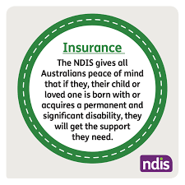

Slide 14
Notes:
To be eligible for the NDIS applicants must:
Have a disability that is attributable to one or more impairments related to a psychiatric condition,
And that the impairment is permanent and affects their capacity for social or economic participation

Slide 15
The NDIS are not taking people like me because I am not mentally unwell enough to qualify. On the flipside, you can’t get income protection insurance or you can’t get travel insurance if you have a disability. So one system is telling you this [you are not disabled enough] the other system is telling you that [ you are too disabled].
(Odette, NDIS ineligible, metro Melbourne)

Slide 16
Elizabeth: Did anyone help you with the NDIS application?
Charles: Yes, but the workers didn’t have any information about what was required. They just said ‘state the worst case scenario’. You talk about the worst not the best.
Elizabeth: How did that make you feel talking about the worst?
Charles: Awful. You really feel disabled after that.
(Charles, NDIS ineligible)
Notes:
This quote illustrates one of the themes discussed in this first chapter of navigating the eligibility divide and is an example of how “being labelled’ effects an ineligible participant’s wellbeing

Slide 17
I can’t see a reason why you wouldn’t give access—the product is only worth $3,000, and people [other planners] laugh at me about that. If it actually gives this family a quality of life, I’m going to agree to it. I’m the delegate; I’m going to put it through.
Erica (NDIA planner, regional Victoria)
We never approve gym membership ever. I mean, it’s expensive. As much as we would love to – and especially I know how much exercise does help mental health-We can’t do it.
(Bree, NDIS Planner)

Slide 18
I’m not looking forward to my assessment review. I’m not sure who’ll be supporting me any more. I just fear that my best interests aren’t being looked at, after. I feel like I’m losing control in my own therapy.”
(Andrea, NDIS eligible, NDIS funding reduced after one year-review)

Slide 19
Assessments – what does the future look like?
Assessment requirements
Current
Independent Assessments
Proposed by NDIS
To be completed by the applicant’s psychiatrist, GP, or their most appropriate clinician.
Assessor:
unknown to the applicant
Isn’t the healthcare professional the applicant usually sees.
standardised assessment tools
Assessment based on the individual’s impairments and needs
knowledge of hospitalisations, impairments over past 6 months (or longer for people with fluctuating conditions)
An independent assessment will take 3 hours.
Notes:
CMHA peaks August 26, 2020
Preamble
only if:
(a) Independent functional assessments (IFA) are conducted by adequately trained staff,
(- Prior to an assessment taking time before an assessment to develop a trust relation is very important as the nature of the PSD can make it hard for a participant to open up to a
stranger.
- The pressure of the significance of the IFA can trigger the participant with a potential for disengagement.
2. Quality of the assessor
- highly skilled and experienced assessor,
- Trauma-informed and recovery focussed
- Cultural aware
- 3. Quality of the assessment
- assessment tool(s) that works for people with PSD
- three hours is not enough to assess the often complex needs of people with PSD and write a comprehensive report.
o - Availability of skilled assessors, especially in remote and rural areas
4. Other – stron argument for not making it compulsory for PSD

Slide 20
Theme 2
Deconstructing choice and control

Slide 21
Deconstructing choice and control
Perceiving control
(Consumers)
Inhibiting choice and control
(Consumers and professionals)
Facilitating choice and control
(Consumers and professionals)
Overwhelming choice
Limited choice
Round peg, square hole
That's not very isurance-y
Practising person-centredness
'Devolving' control (Professionals)
Ceding control
Losing control

Slide 22
Well, at the planning meeting I just felt overwhelmed about the amount of choices I had, the more options that you're given the more unsatisfied you are with your end selection because you think you're missing out on other things
:‘I don’t have control and sometimes I need other people to take control for me. … Then suddenly all this stuff is about … the NDIS and they’re supposed to be helping me but I feel overwhelmed by it.’
(Orania, eligible)
Notes:
Orania (NDIS eligible, regional Victoria) felt unable to identify or capitalise on the resources, supports and opportunities available to her

Slide 23
I think control can sometimes be negative because my illness is highly controlling, so, it’s difficult to work out what is my need for control and what is largely dictated to by the mental illness side of things, which can be maladaptive.
(Esther, NDIS eligible, metro Melbourne)
Notes:
For some of the research participants, a constructive perception of control appeared elusive, owing to deeply embedded understandings of control derived from the social, family context or from mental illness itself. For example, Esther found the notion of exercising control complicated. For her, mental illness is characterised by powerlessness, uncertainty and a loss of agency. By her own account, this has led to poor decision-making and inappropriate responses to challenging environments or stressful situations:

Slide 24
When I came in [to the NDIS] last year I got pretty much everything that I asked for that I needed. I mean, I didn’t ask for a multimillion-dollar home or anything like that, but I got counselling, which is needed.
(Janice, NDIS eligible, metro Melbourne)
We don’t have to provide counselling because it’s already sitting out there. You don’t have to come to the NDIS for that. Well, like, these are your [mainstream] supports that you need to be accessing. You can go around to this one over here or you can use this one over here. Why do we provide counselling? Have you seen your GP? You’ve got Lifeline on the phone. Have you accessed that counselling?
(Joe, planner, regional Victoria)
Notes:
Consumers in this study frequently identified psychological counselling as important. Not only does it provide relief from symptoms relating to mental illness, but also it can facilitate personal recovery and independence. Consumers identified counselling as a strategy for building capacity, supporting greater self-acceptance and improving self-esteem. Despite these improvement outcomes aligning with the principles and objectives of the NDIS, the response to requests for counselling vary and, in some cases, rely on an individual’s capacity for self-advocacy (see Wilbur’s earlier statement in Section 6.3). Response feedback to requests for counselling ranged from supportive to indifference (respectively):

Slide 25
Theme 3
Shaping recovery and
social inclusion

Slide 26
APPROACHES TO RECOVERY
Personal Recovery approach
Clinical approach
Focuses on personal meaning growth & discovery
Focuses on treatment and diagnosis
Values self-empowerment & self-determination
Focuses on absence of symptoms
About the person’s hopes and aspirations
Uses clinical language, is objective not subjective
Recovery is subjectively defined by the person
Is deficit-based & focuses on recovery as clinical outcome
Is strengths-based & focuses on recovery as a process
Based on expertise from professionals
Notes:
There are some key difference between the two types of recovery I mentioned in the previous slide, the role of the recovery coach is to implement personal recovery, the approach illustrated on the left hand side of your screen.
Personal Recovery Clinical Recovery
focuses in personal meaning & growth Focuses on treatment and diagnosis
a process or a continuum an outcome or a state
subjectively defined by the individual Is observable – in clinical language, it is objective, not subjective
means different things to different people does not vary between individuals- absence of symptoms is the indicator
In putting Personal recovery into practice, recovery coaches should be mindful that language is important. Strengths-based language is key and language that puts the person first is important. Prioritising, on a diagnosis to describe the person, places importance on the label and risks seeing someone as a set of symptoms. Focusing on mental illness can lead to losing sight of the person as a human being.
Another important aspect of personal recovery is that each person should be seen as expert in their own life, they therefore have the right to choose what they perceive as the right way to recover.

Slide 27
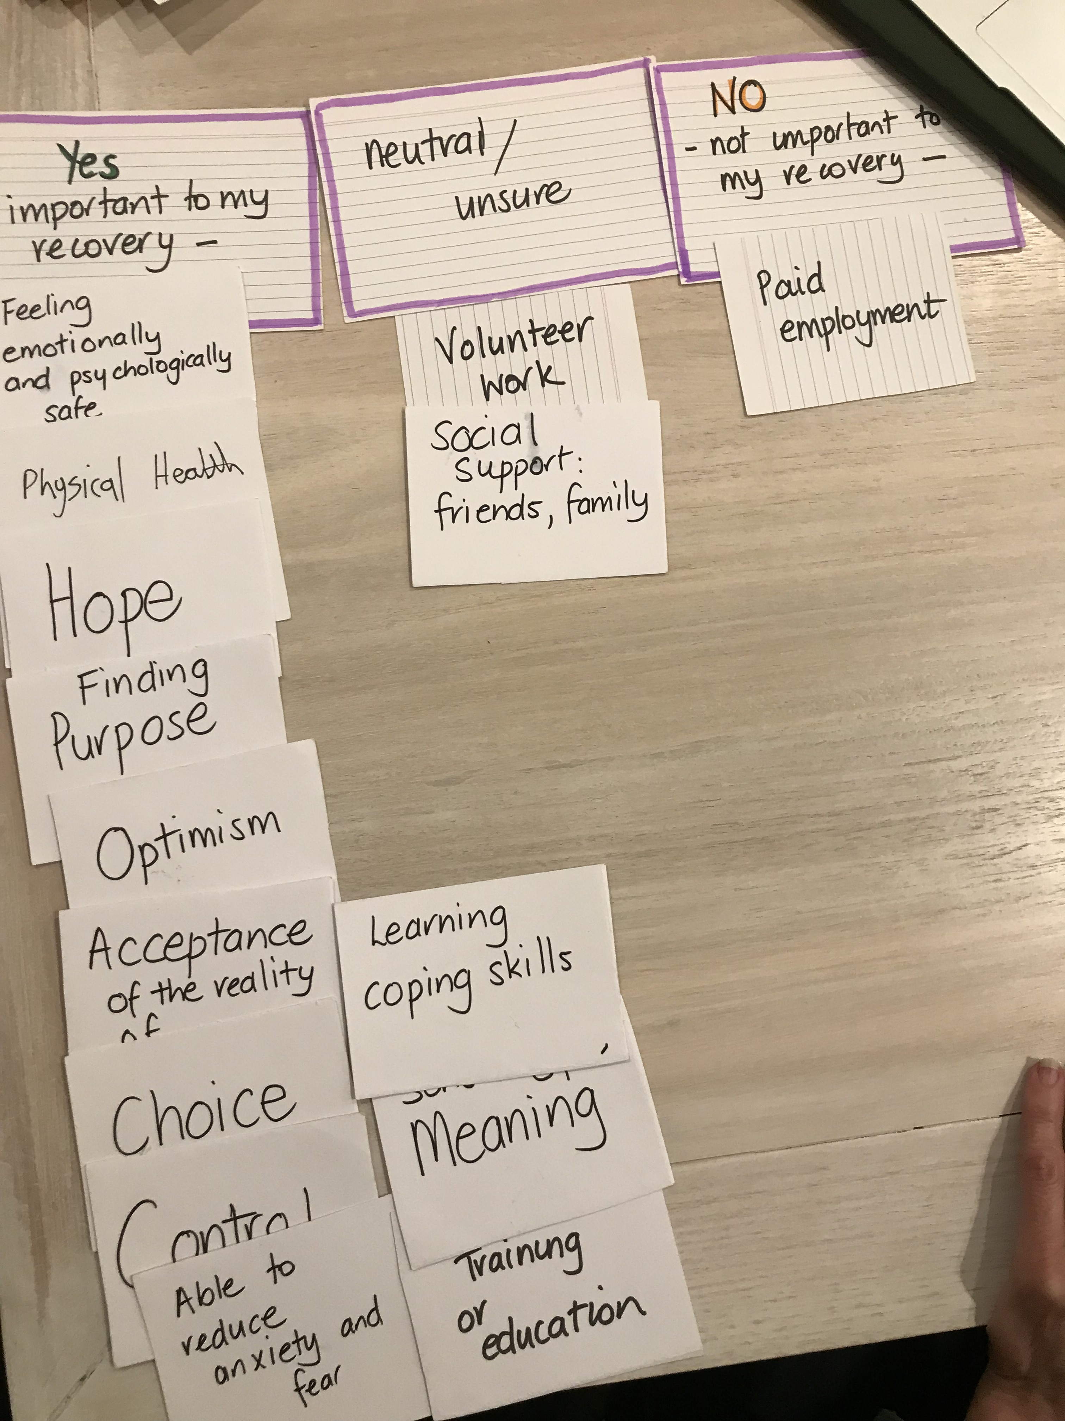
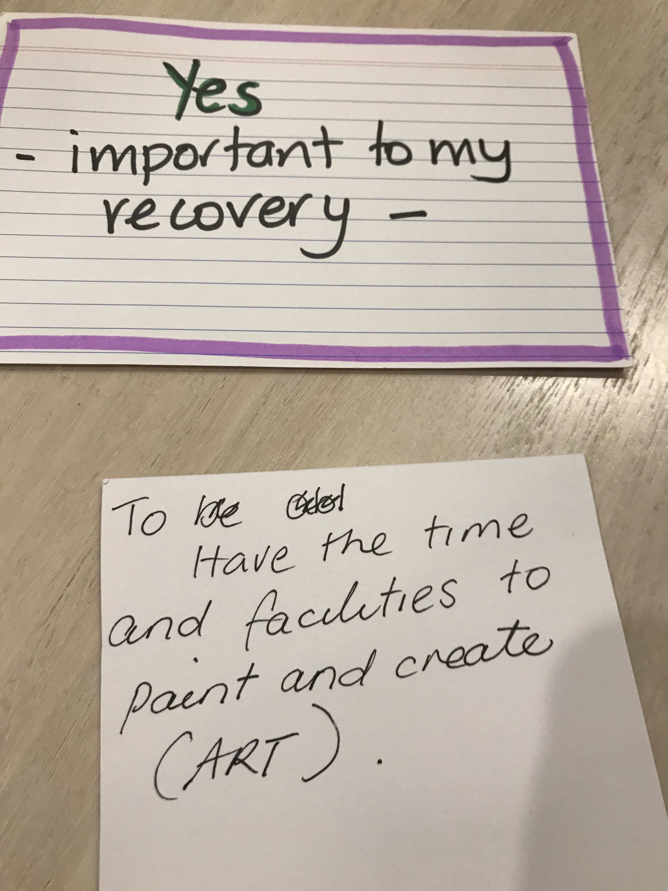
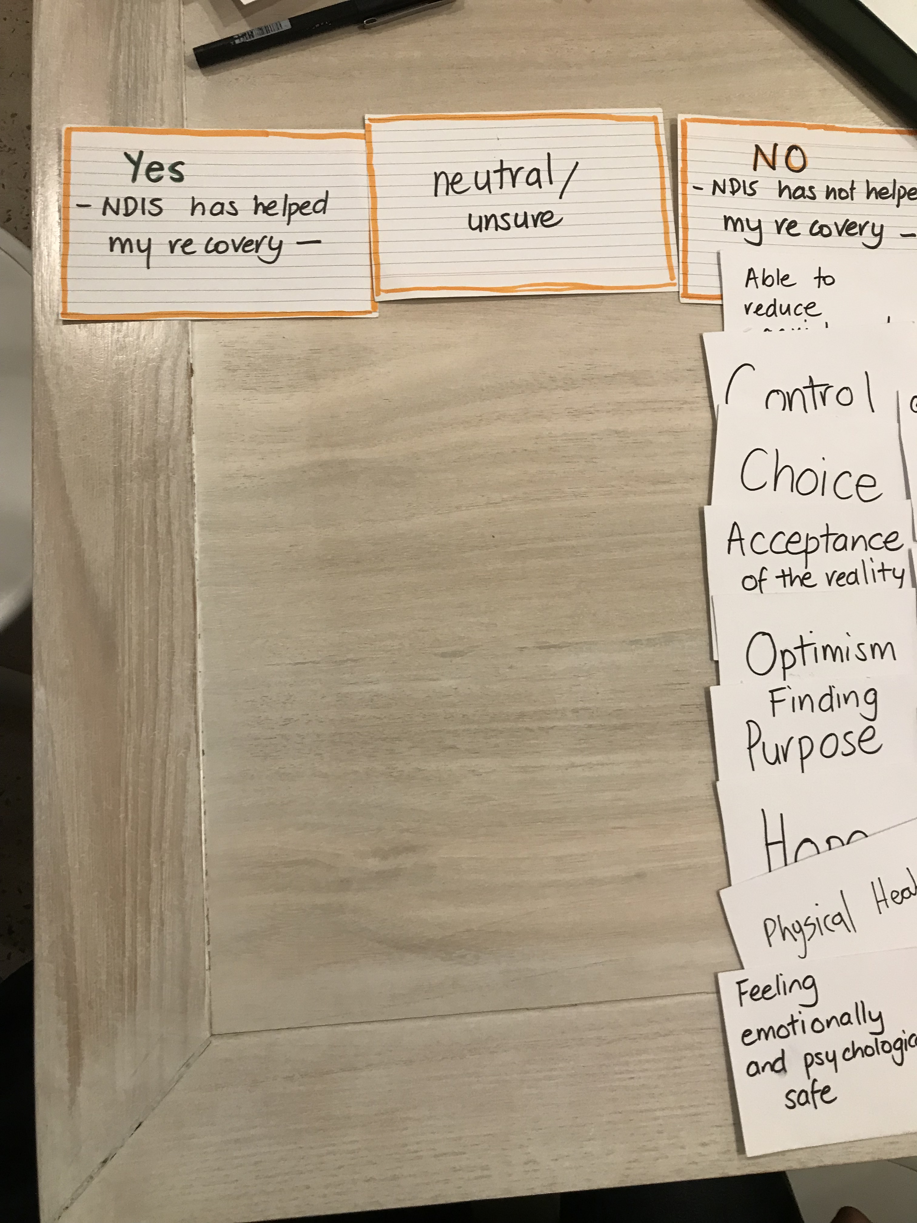
?
Notes:
During the interview, I issued 14 cards to participants, each one representing a different recovery goal.
Participants were then asked to select those important to their recovery.
Next , the participants were asked whether the NDIS supports them in achieving the recovery goals important to them.
In keeping with the subjective and individualised nature of recovery, I offered each participant the opportunity to express recovery in their own words.
12 of the 20 took up the option of choosing their own card and this participant chose Art as an appropriate avenue for recovery.

Slide 28
potential
NDIS ^ impact on participants’ recovery
Notes:
This graph outlines the number of times each of the 14 recovery goals was selected by participants. The orange colour represents responses by ineligible participants whilst the mustard colour represents those who are eligible. The blue line indicates the degree to which the NDIS has had a positive impact on achieving recovery. Interestingly, the NDIS has its greatest impact in the choice and control domains-(perhaps because these concepts are heavily promoted by the NDIS.)
As they made their selections, I asked participants to explain the rationale for their choices.
For example as you can see from this graph 19/20 people selected finding purpose . When I asked Alan (who is eligible) to explain he said: If you don’t have purpose you are not motivated and you are aimless, you are not existing really. You are just drifting.
When I asked another eligible participant what stops him making good choices, He said:
When you are not well, you don’t make good decisions, you are not in the right frame of mind. It’s like a regressive circle. A good decision is—are you able to manage yourself, time, and money and when you are not well, you don’t think about that.

Slide 29
Sub Theme- That’s not very-insurancey
NDIS claims¹
Insurance: The NDIS gives all Australians peace of mind if they, their child or loved one is born with or acquires a permanent and significant disability, they will get the support they need.
Scheme: The NDIS is not a welfare system. The NDIS is designed to help people get the support they need so their skills and independence improve over time.
AAMI - ‘that’s not very insurancey'
The NDIS is based on the following principles²:
It provides universal coverage by pooling risk across all Australians and takes the risk of disability support costs away from individuals;
It creates an innovative and competitive market for disability support, through which participants can exercise choice and control over the planning and delivery of their supports; ■
¹NDIS.gov.au
² Productivity Commission
Notes:
This sub-theme – That’s not very insurance-y’— transcends all three data chapters (access and equity, choice and control and recovery and inclusion) – I draw special attention to this in my thesis.
The label I have given to this sub-theme—That’s not very insurance-y’—is appropriated from an advertising campaign (Ogilvy, 2019) of a major Australian commercial insurance company. By challenging the notion of what insurance can actually be—and delivering insurance in a ‘not very insurance-y way’—this insurance firm uses a slogan to promote their focus on customer needs which they claim is innovative, flexible but also efficient.
Also an insurance model, the NDIS makes similar claims (as outlined in this slide).
I argue that the NDIS falls short of meeting the benchmark elevated by its insurance peers as evidenced in the following quotes from both PEPD and NDIS professionals

Slide 30
MAIN FINDINGS - have policy implications for the design of the NDIS.
System-level structural barriers and rationing decisions applied by NDIS professionals (who serve as gateway operators to the scheme) lead to different pathways for people experiencing mental illness
one pathway (for those who are NDIS eligible) is to greater access to choice and control and social inclusion
the other pathway; for those ineligible the future is less certain, as funds are being directed away from existing services toward the NDIS highlighting a service gap.

Slide 31
MAIN FINDINGS cntd
Flexible support (which can be scaled up or down) is needed to accommodate episodic nature of illness
Mental health recovery knowledge by NDIS professionals is insufficient
The insurance model design falls short of innovatively meeting the needs of people with mental illness

Slide 32
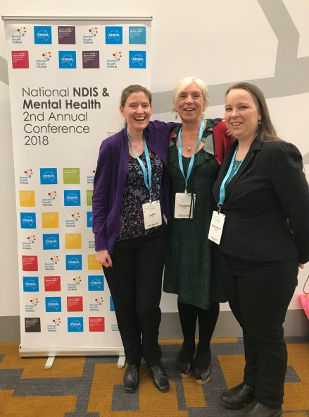
2 x lived experience experts
Research Advisory Panel
Investing in the Value of Lived Experience
“It is our right to be involved in publicly funded research: to have a say in what is researched and in how it is carried out. If research in the twenty-first century is to be relevant, practicable and useful to the furthering of health and social care developments, then surely it has to involve the people who are at the receiving end of health and social care provision”. Mental health service user and researcher, Alison Faulkner (2011, p. 51).
2 x mental health research professionals
1 x NDIS rep
Notes:
Aligning with FSSI value of co-production FSSI funds my research advisory panel which comprises two lived experience experts who have a mental illness
Contributions of the Research Advisory Panel – they have provide meaningful contribution at both practical and conceptual level
Meets quarterly – five panel members
A number of recommendations from the research advisory panel, particularly regarding recovery-oriented interview questioning style have been adopted. They include;
Input into interview guide –
Input into the ‘analysis framework’ by highlighting the importance of identifying significant ‘absent words’ and ‘silences’, from the interview. This has resulted in the amendment of the framework and prompts the researcher to reflect on the meanings attached to silences in the interview data.
Demonstrating empathy that the lived experience contributes, the panel recommend the preparation of cards to be given to interview participant at the completion of the interview. The card includes key contact numbers and a list of support organisations, in case any of the discussion triggered stress or anxiety post-interview.

Slide 33
Notes:
To summarise, the pathway to recovery is often described as a journey. Although the personal recovery approach suggests that recovery is individual and that the the person is the best arbiter of their own recovery, the NDIS recovery coach can walk alongside them, as equal partner, in a relationship that is based on respect.
I believe that the recovery coach could be a real game-changer, by working together to promote a hopeful future and build belief in the possibility of a renewed sense of self and purpose for people with psychosocial disability. Thank you for being here today and showing your commitment to making recovery a reality for people who experience mental illness.

Slide 34
THANKS!
ANY QUESTIONS?
You can find me at:
lizannehudson@gmail.com
Mob: 0400897989

