Slide 1
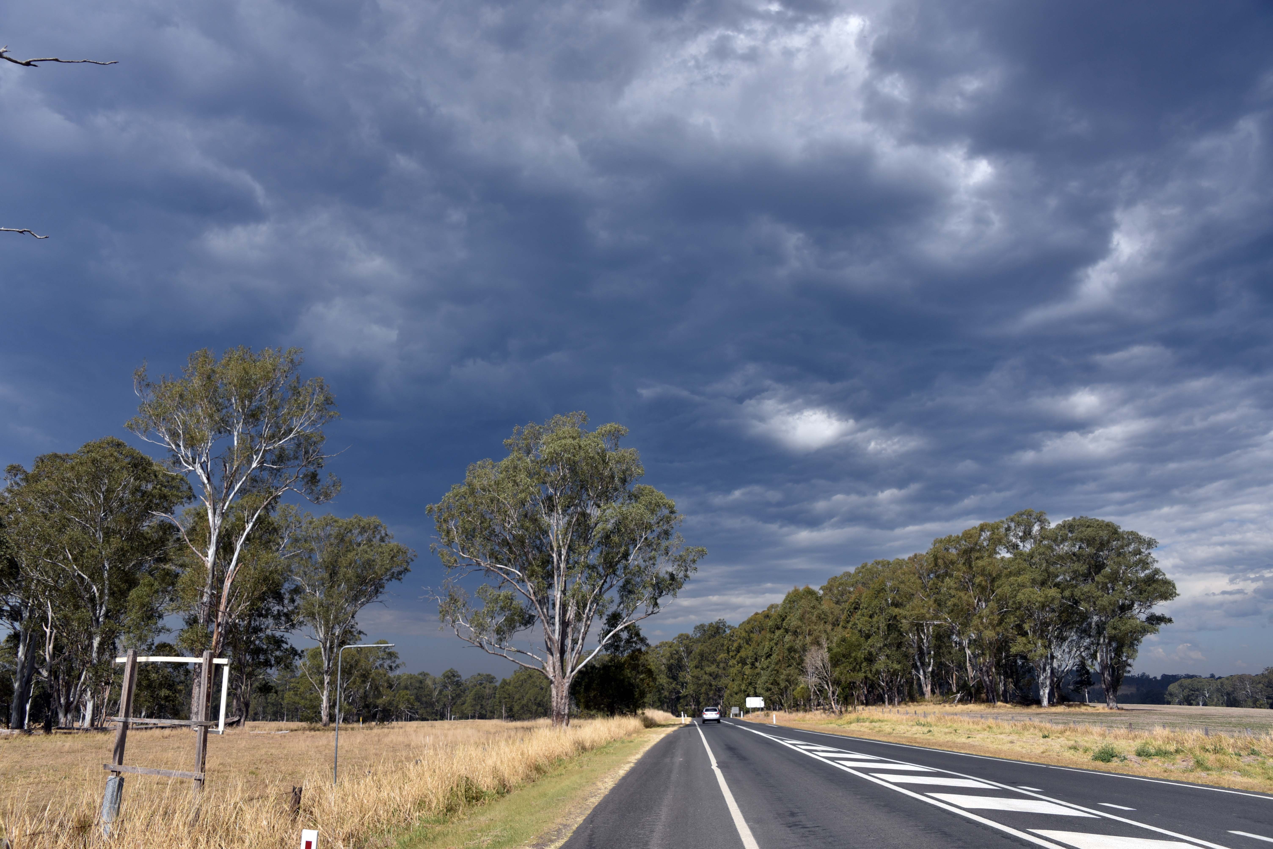
Clearing a path to full inclusion of people with disability in emergency management policy and practice in Australia
Associate Professor Michelle Villeneuve
Centre for Disability Research and Policy
The University of Sydney

Slide 2
Guiding Question
What has to change to ensure the rights of people with disability are embedded in a meaningful way into all government programs, plans, strategies and policies designed to increase the resilience of all Australians to disaster?
How do we clear a path to full inclusion for people with disability in emergency planning to increase the safety and wellbeing when disaster strikes?

Slide 3
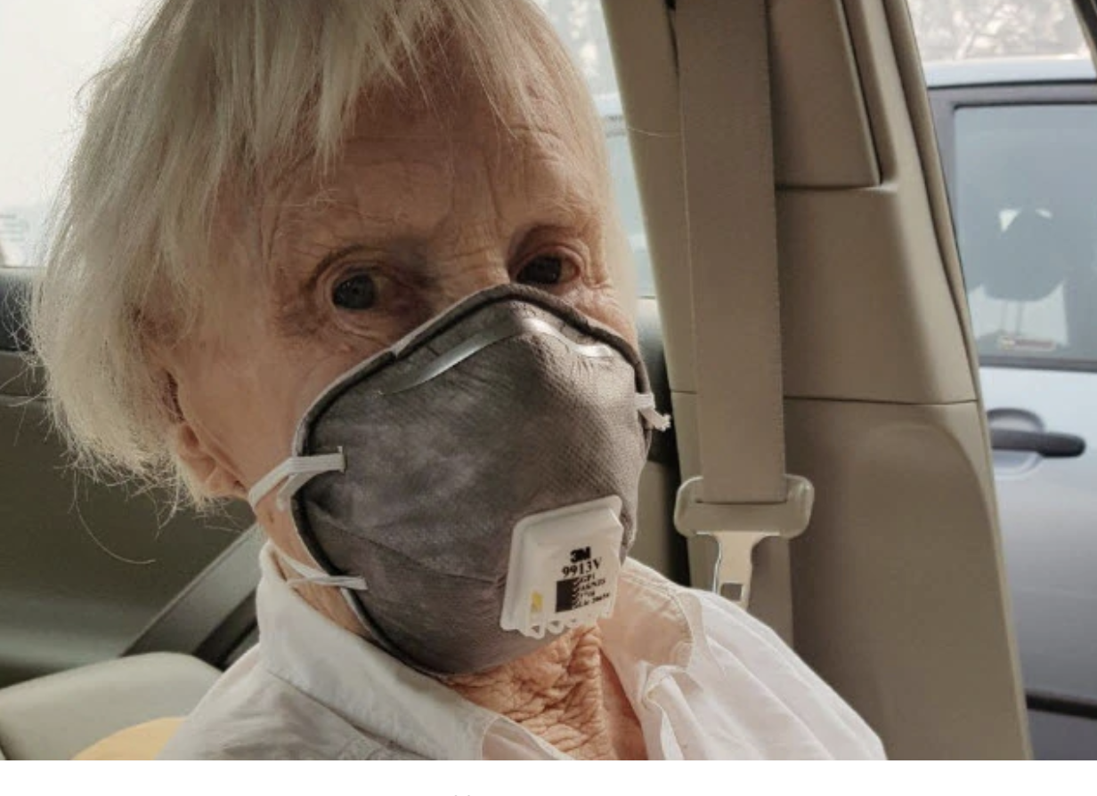
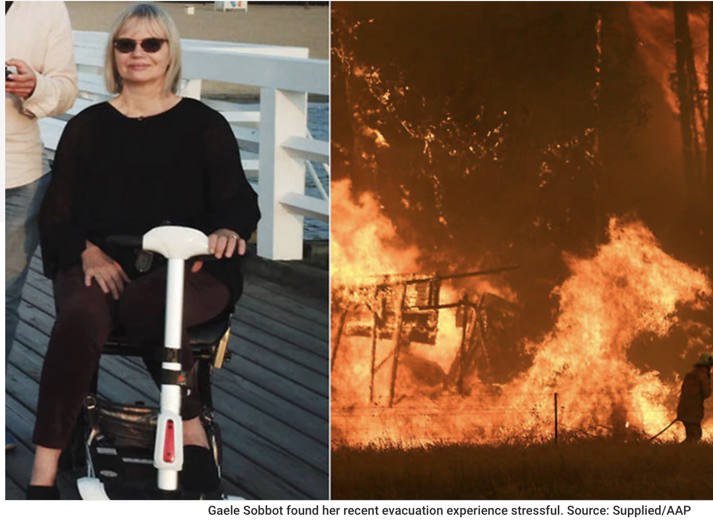
DISPROPORTIONATE RISK
People with disability:
are two to four times more likely to die or be injured in a disaster than the general population.
experience higher risk of injury and loss of property;
have greater difficulty with evacuation and sheltering; and
require more intensive health and social services during and after disaster events
Notes:
Images:
Gaele & Gladys
*bushfire evacuation and disability
https://www.sbs.com.au/news/what-it-s-like-to-experience-a-bushfire-evacuation-while-living-with-a-disability?fbclid=IwAR0Z1PkOEd1X4DTHZ9SiP6rmfVp4h9Y_GOYePf0TQhp7VLODqaU3p271Vvo
References:
Fujii, K. (2012). The Great East Japan Earthquake and Persons with Disabilities Affected by the Earthquake- Why Is the Mortality Rate so
High? -Interim Report on JDF Support Activities and Proposals. Tokyo: Japan Disability Forum
Alexander, D. (2015). Disability and Disaster: An overview. In: Kelman*., Stough L.M. (eds). Disability and Disaster. Disaster Studies. Palgrave Macmillan, London. https://doi.org/10.1057/978113486004_2
Malpass, West, Quaill, & Barker (2019) Malpass, A., West, C., Quaill, J., & Barker, R. (2019). Experiences of individuals with disabilities sheltering during natural disasters: An integrative review. Australian Journal of Emergency Management, 34(2), 60-65
Twigg, J., Kett, M., Bottomley, H., Tan, L. T., & Nasreddin, H. (2011). Disability and public shelter in
emergencies. Environmental hazards, 10(3-4), 248-261. doi:10.1080/17477891.2011.594492
Phibbs, S., Good, G., Severinsen, C., Woodbury, E., & Williamson, K. (2015). Emergency preparedness and perceptions of vulnerability among disabled people following the Christchurch earthquakes: Applying lessons learnt to the Hyogo Framework for Action. Australasian Journal of Disaster and Trauma Studies, 19, 37-46.

Slide 4
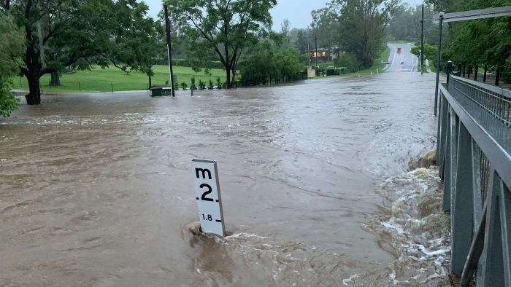
vulnerability

Slide 5
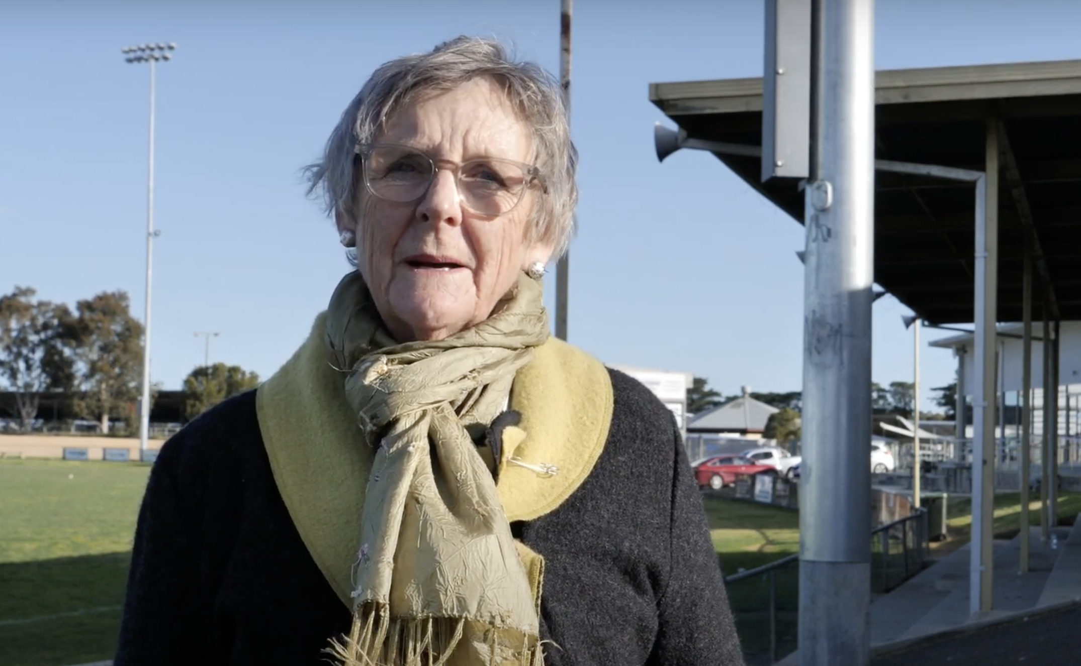
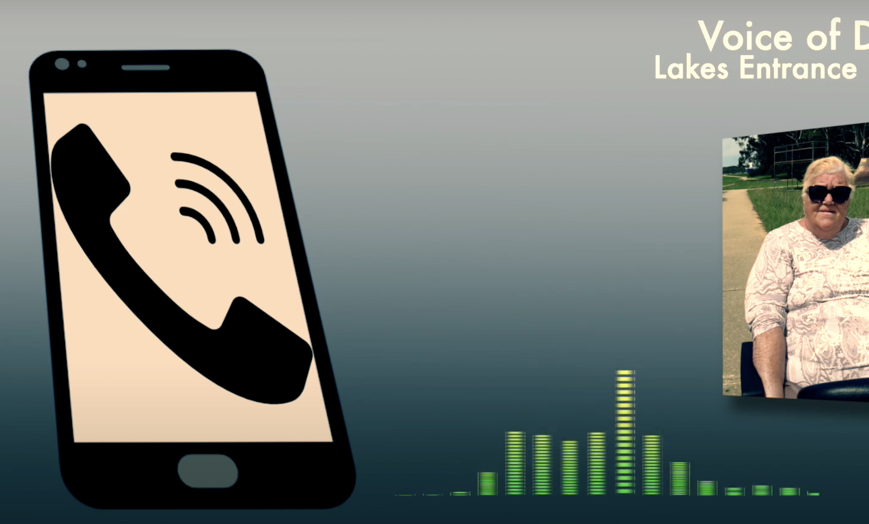
SUPPORTED

Slide 6
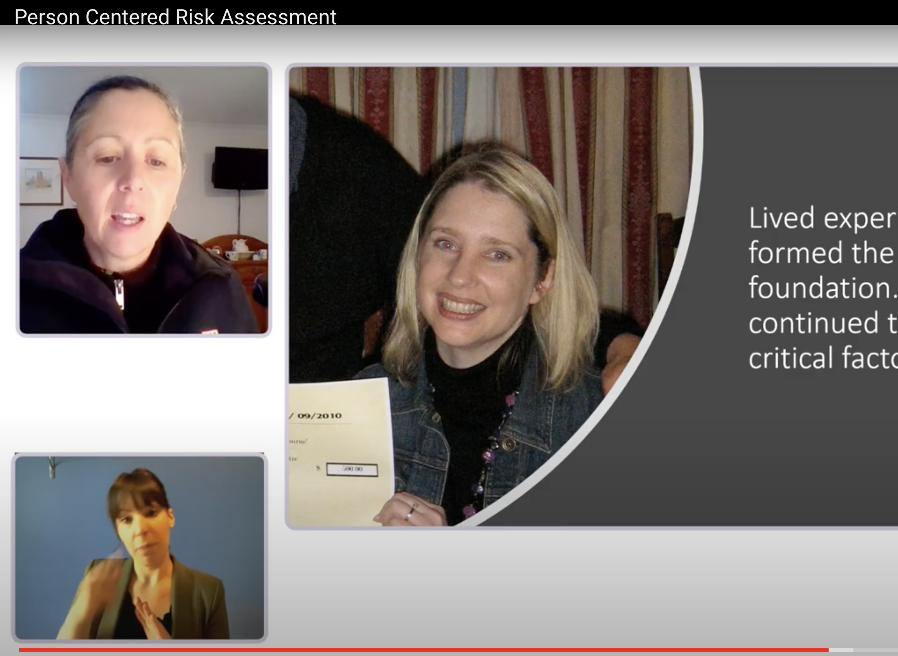
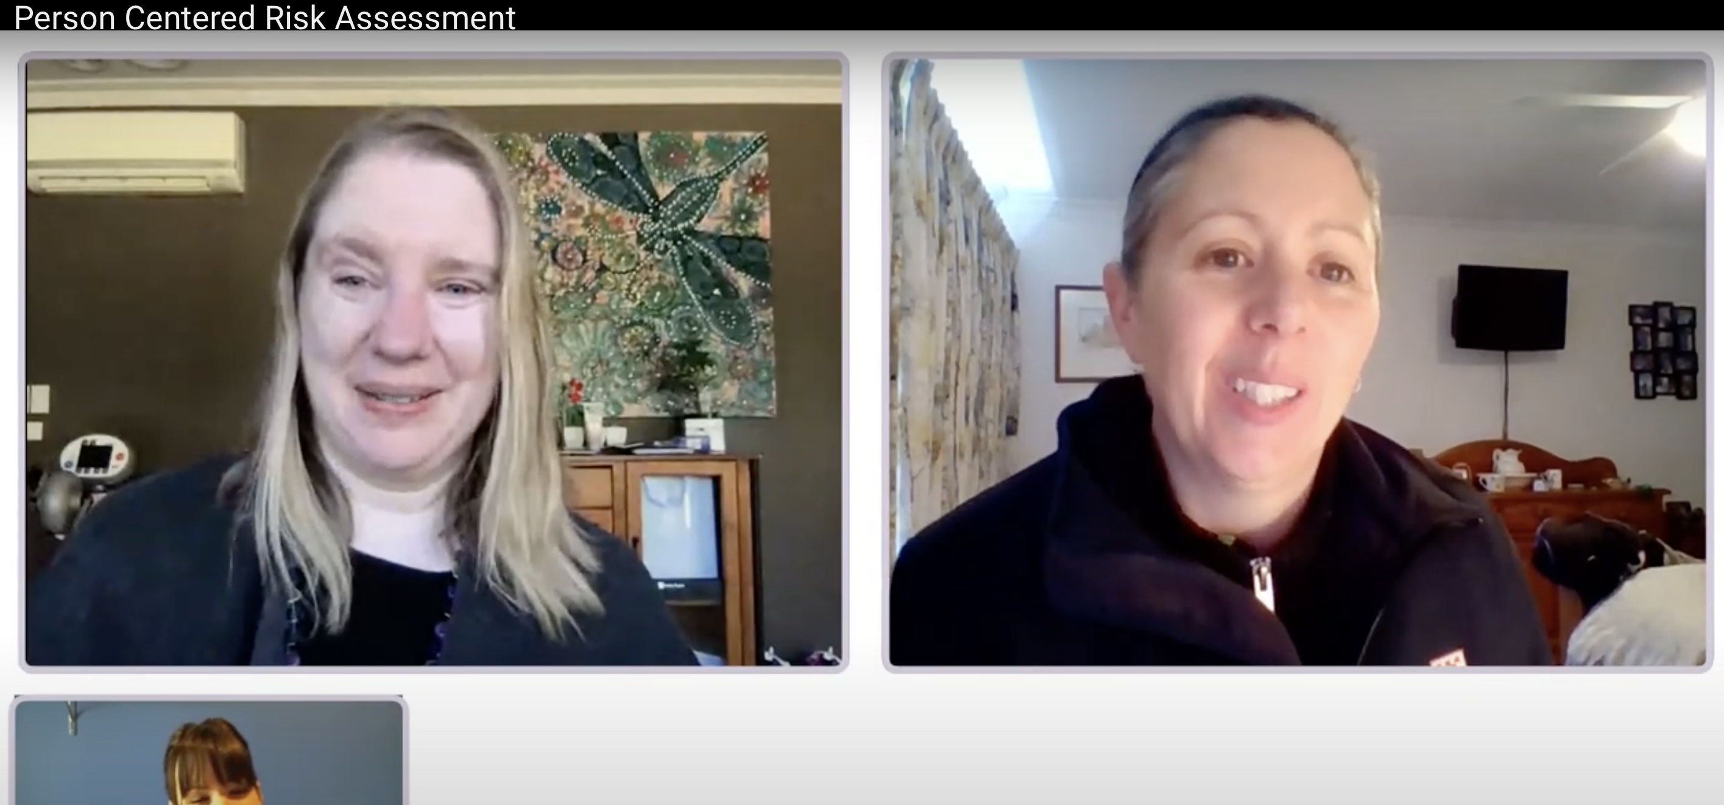
EMPOWERED
Notes:
26.48 – 29.00 – DARU video Toni
Toni’s story
https://www.youtube.com/watch?v=FU_iJzgsBFc

Slide 7
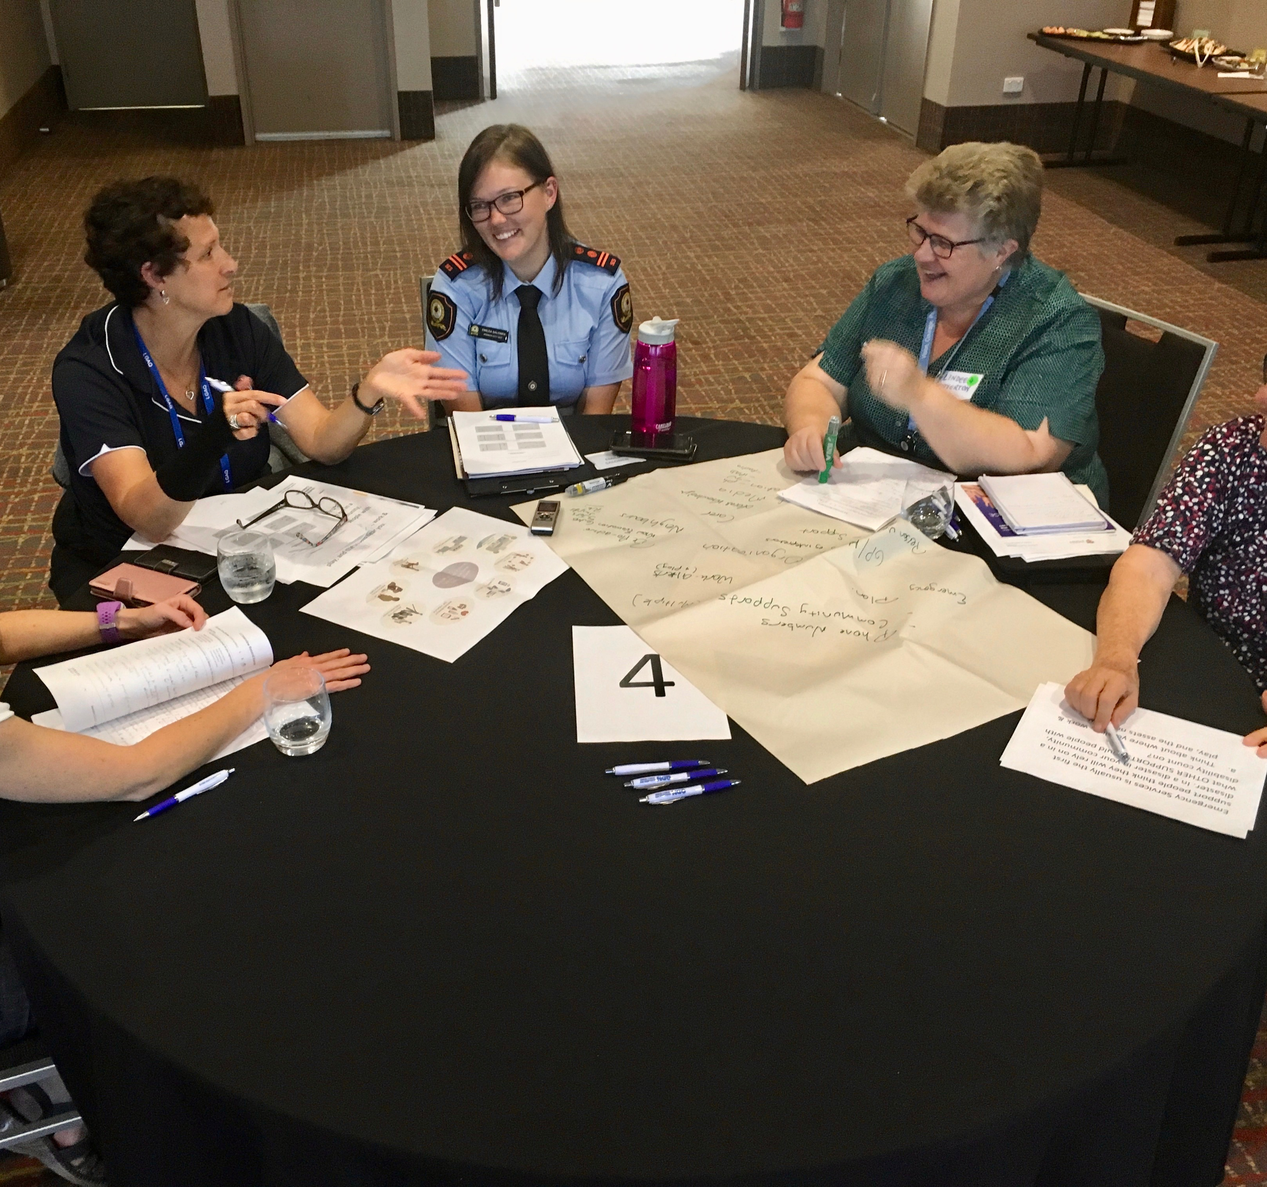
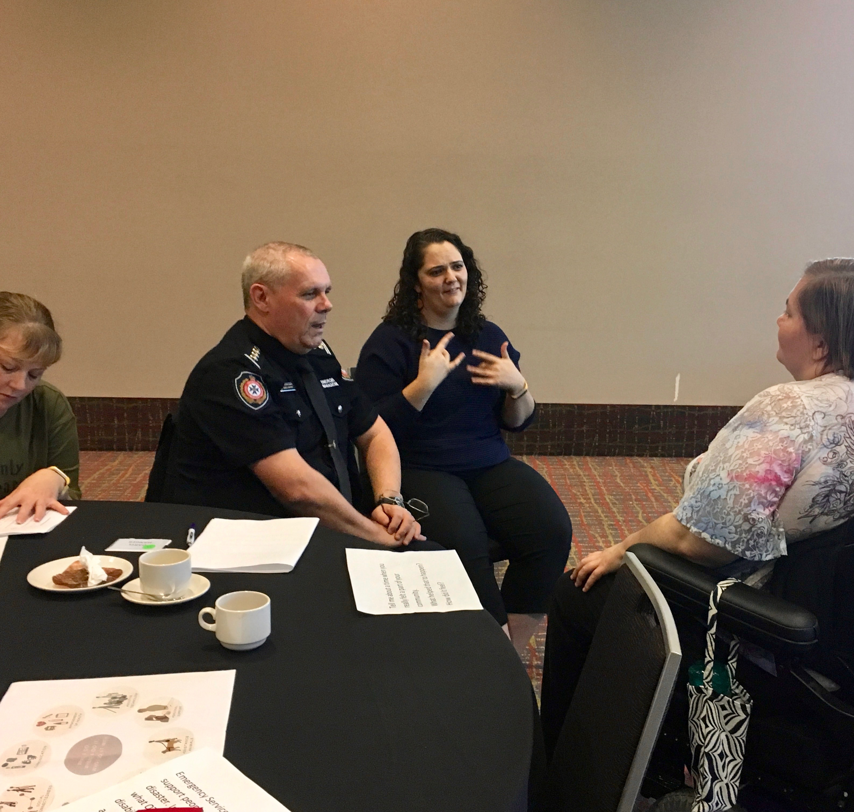
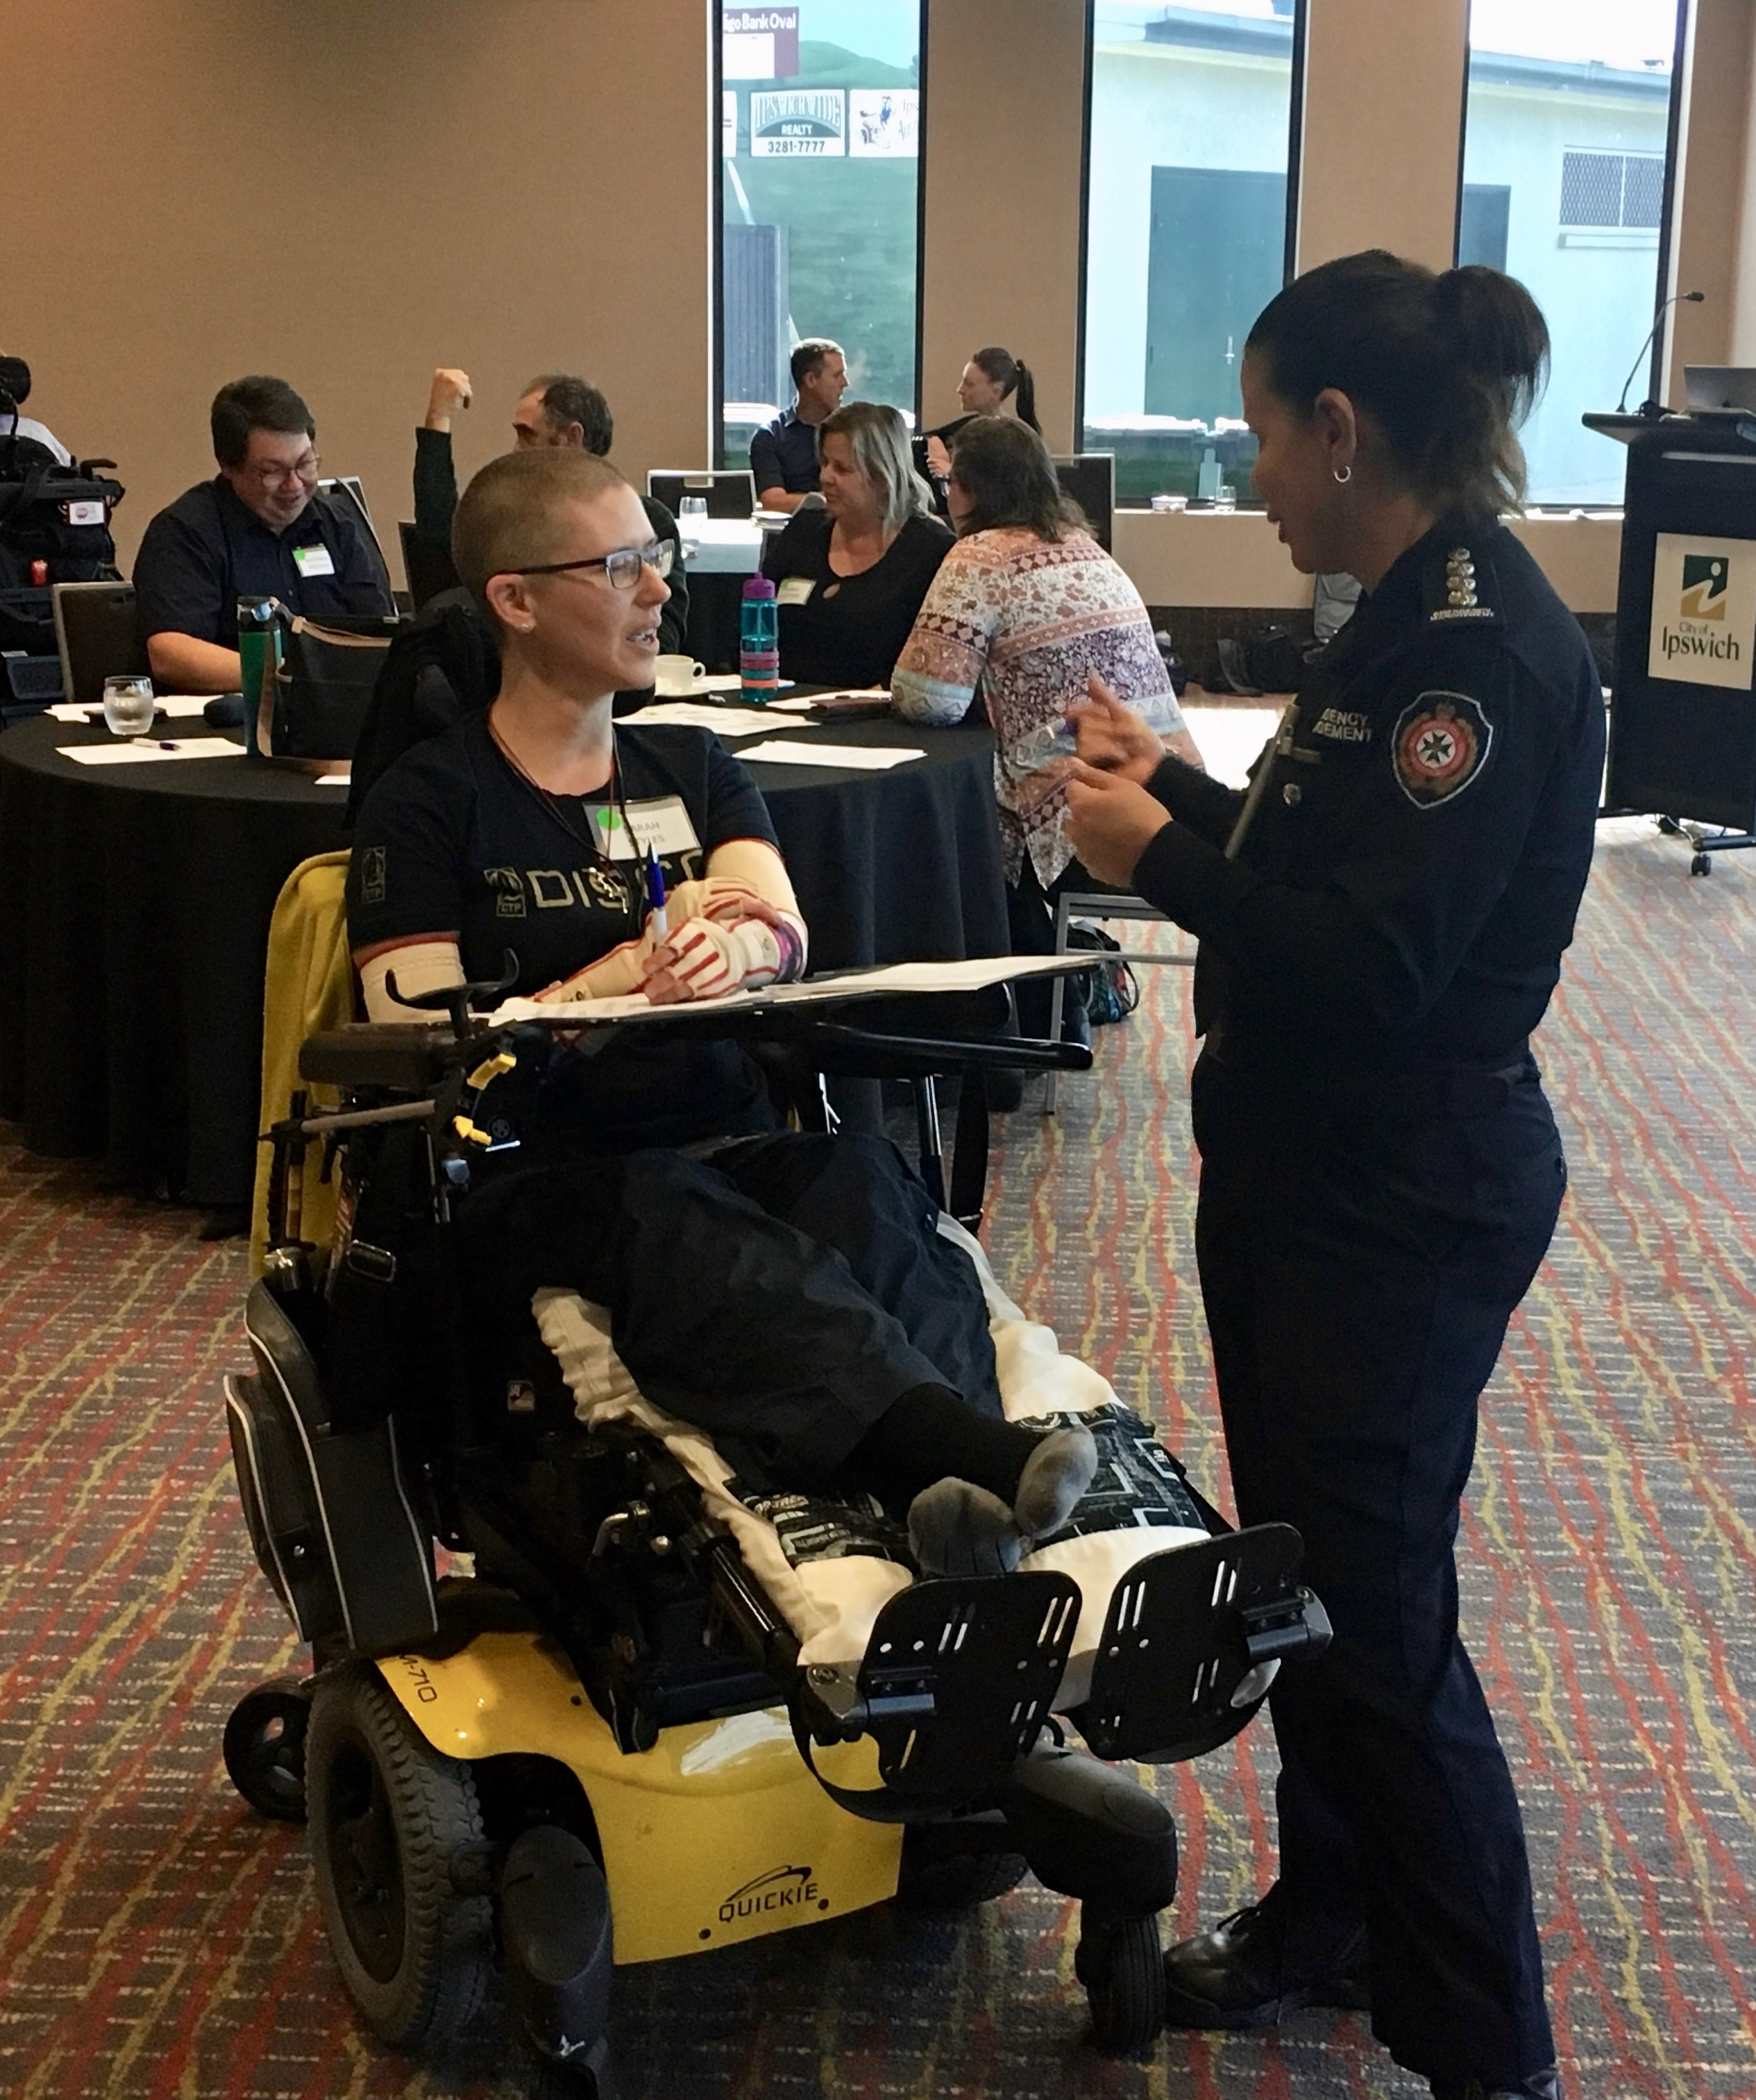
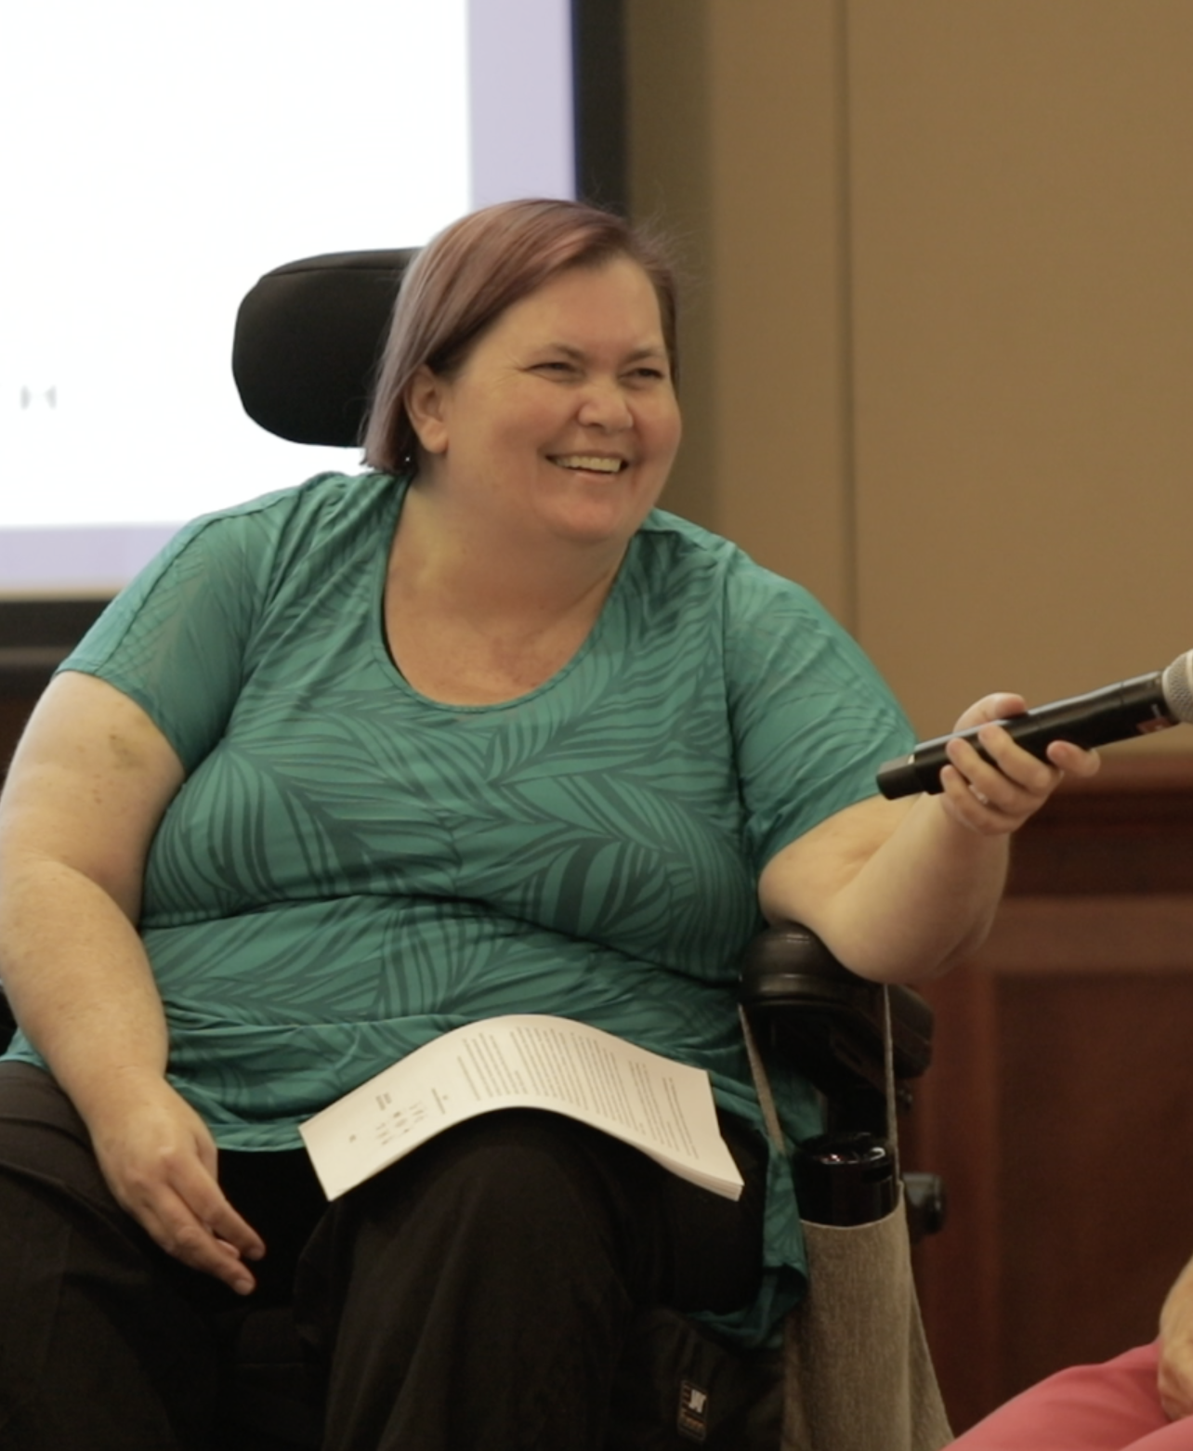
CAPABILITY
Notes:
The following principles guided the development of this issues paper and recommendations:
People with disability are experts in their own needs – what they need are the right tools, time, supports and opportunities that that enable them to optimise their self-reliance and planned reliance on others in emergencies.
Meaningful participation of people with disability enables more effective emergency management practice that is responsive to the support needs of people with disability in emergencies. There is no question that people with disability must be included in disaster management planning, response and recovery decision making. What is needed is direction to entities with responsibility for emergency management on how ensure the rights of people with disability to adequate protection, full inclusion and meaningful participation in emergency management programs, plans, strategies and policies.
Disability inclusion in emergency management requires cross-sector collaboration. Ensuring that nobody is left behind in disasters requires cross-sector engagement and meaningful collaboration to address the barriers that increase risk for people with disability before, during and after a disaster.

Slide 8
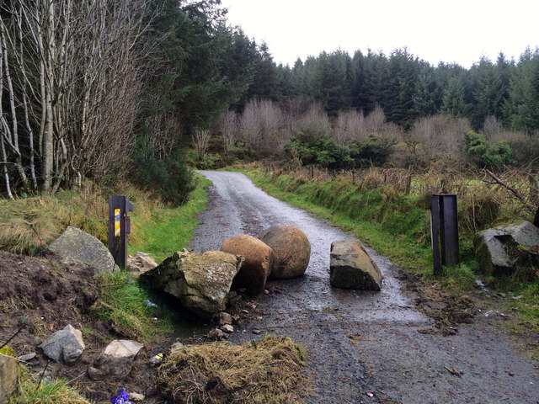
Roadblocks
Overlooked, Excluded
Higher Demands, Fewer choices
Underprepared Support Services
Extra Supports and Equal Access to the Same Supports
Shared but Defined Responsibilities
This Photo by Unknown Author is licensed under CC BY-SA
Notes:
The solutions are embedded inside these issues

Slide 9
A way forward
Representation
Co-design
Access and support
Capacity building
Responsibility

Slide 10
Overlooked, Excluded
Where the needs of people with disability are mentioned, they:
are assumed by non-disabled professionals without adequate consultation;
focus narrowly on one aspect of disability (e.g., physical impairment);
are limited to the response phase of emergency management with limited attention on preparedness and recovery phases;
emphasise doing for, not with people with disability.
Notes:
This perpetuates inequality for people with disability and increases their vulnerability to disaster because the full diversity of their support needs is not understood or responded to before, during and after a disaster event.
References:
https://www.unisdr.org/2014/iddr/documents/2013DisabilitySurveryReport_030714.pdf; Stough & Kelman, 2017; Villeneuve et al., 2019
Pyke, C., & Wilton, R. (2020). Planning for inclusion? An assessment of Ontario’s emergency preparedness guide for people with disabilities. International Journal of Disaster Risk Reduction, 51, 101888
Stough, L. & Kelman, I. (2017). People with disabilities and disasters. In H. Rodriguez, J. Trainor, W. Donner (Eds.), Handbook of disaster research, second ed, Springer, Cham Switzerland, pp. 225 – 242 https://link.springer.com/chapter/10.1007%2F978-3-319-63254-4_12
Casey-Lockyer & Myers, S. (2016). Disability integration throughout the disaster cycle of prepare, respond and recover. Journal of Business Continuity & Emergency Planning, 10(3), 249 – 257.
https://collaborating4inclusion.org/wp-content/uploads/2019/11/DIDRR_Framework_document_FINAL.pdf

Slide 11
Afterthought
“Too often, people with disability are an afterthought and only included as an appendix in disaster management plans.”
(Council Emergency Manager)

Slide 12
Higher Demands, Fewer Choices
Personal emergency preparedness:
renew every time support needs or situation changes
backdrop of changing policies, systems and services
(re)negotiation with others
multiple service providers operating across distributed networks; each with varying capacity
information, resources and warnings not available in accessible formats that people can understand and use
brings to the surface barriers that restrict choices for people with disability and that impact their sense of safety and well-being
Notes:
Personal preparedness is one of the most important things that people can do to reduce their risk and increase resilience to disaster.
We must recognise that emergency planning places high demands on people with disability, particularly for those who rely on others to assure their safety and well-being the face of disasters and other emergencies.

Slide 13
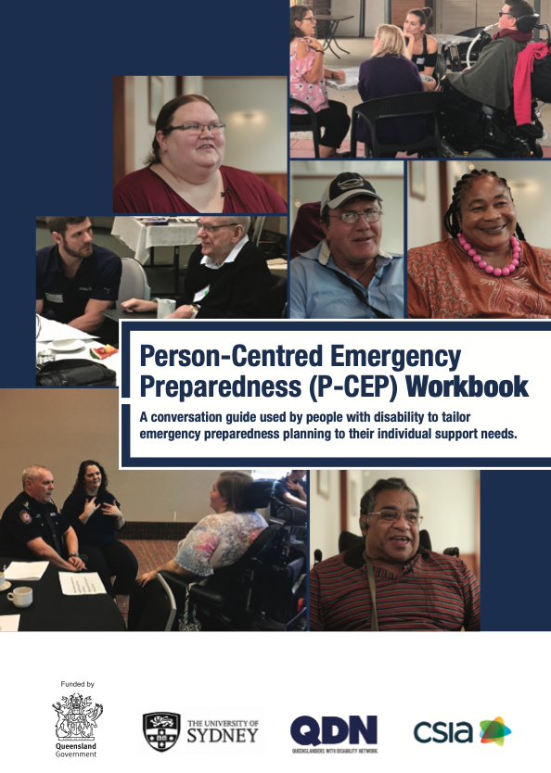
The P-CEP:
brings emergency personnel together with people with disability and the services that support them to address the factors that increase risk for people with disability.
provides the tools that people with disability need to optimise their self-reliance and planned reliance on others.
enables people with disability, family and carers to assess their level of preparedness and learn about their disaster risk.
enables emergency managers to personalise risk and preparedness information so that it can be better understood and acted upon.
Notes:
Keeps people with disability and their support needs at the centre of emergency planning!
The P-CEP has three components:
a capability framework consisting of eight elements to support self-assessment of strengths and support needs;
three principles guiding the joint effort of multiple stakeholders to enable tailored emergency preparedness planning; and
four process steps enabling the developmental progression of preparedness actions and facilitating linkages between people with disability, their support services and emergency managers.
www.collaborating4inclusion.org/pcep/

Slide 14
Under-prepared Support Services
An untapped local community asset:
Not integrated into emergency planning
Not intentionally resourced to fulfil potential role
No explicit policy guidance for development, implementation, evaluation of role
Notes:
Australian service providers are arguably well-positioned to enable the people they support to be active engaged participants in emergency preparedness:
They are on the frontline of community-based care and support. This relationship equips providers with an intimate knowledge of the functional needs of the people they support.
Service providers are often seen as the link between people with disability, their families and the wider community.
They form a crucial component of an individual’s support network.

Slide 15
Roles for service providers
Person-Centred Emergency Preparedness
enabling preparedness in the people they support
Organisational Preparedness
ensuring continuity of services and supports

Slide 16
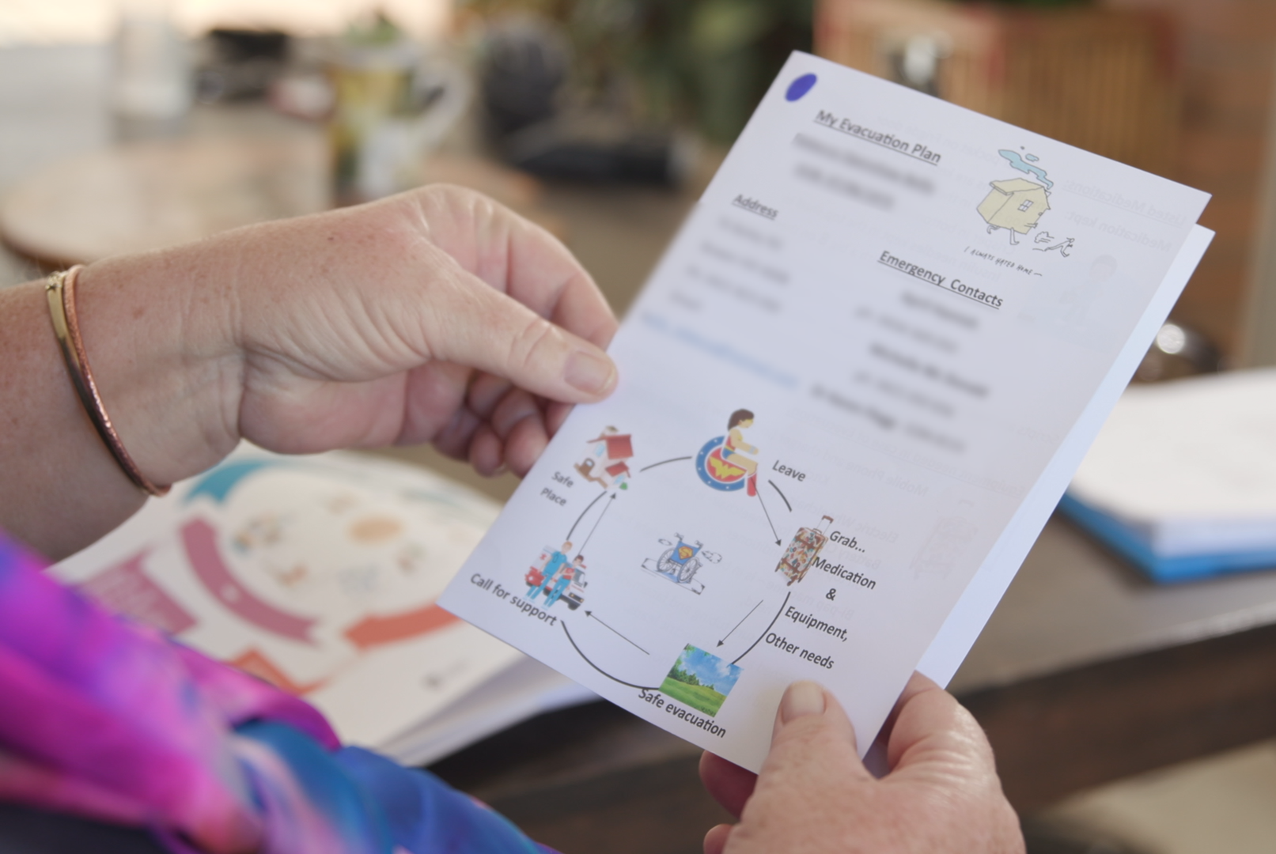
Challenges, Opportunities & Risks
Notes:
Exemplars of good practice
Case studies
Webinars

Slide 17
Extra Supports and Equal Access to the Same Supports
“We’ve got to do more work ourselves to raise awareness because people with disability are not considered or are last to be considered. Local knowledge is key. Local knowledge can be used to stimulate the systems into caring.”
(Disability Advocate)

Slide 18
Data and information for informed planning
If the tools that support planning are not inclusive of people with disability, then people with disability will be overlooked in planning processes.
This requires consideration at both the individual and community level.

Slide 19

Guide for Inclusive Emergency Planning
Well before
Prior to an event
During an event
After an event

Slide 20
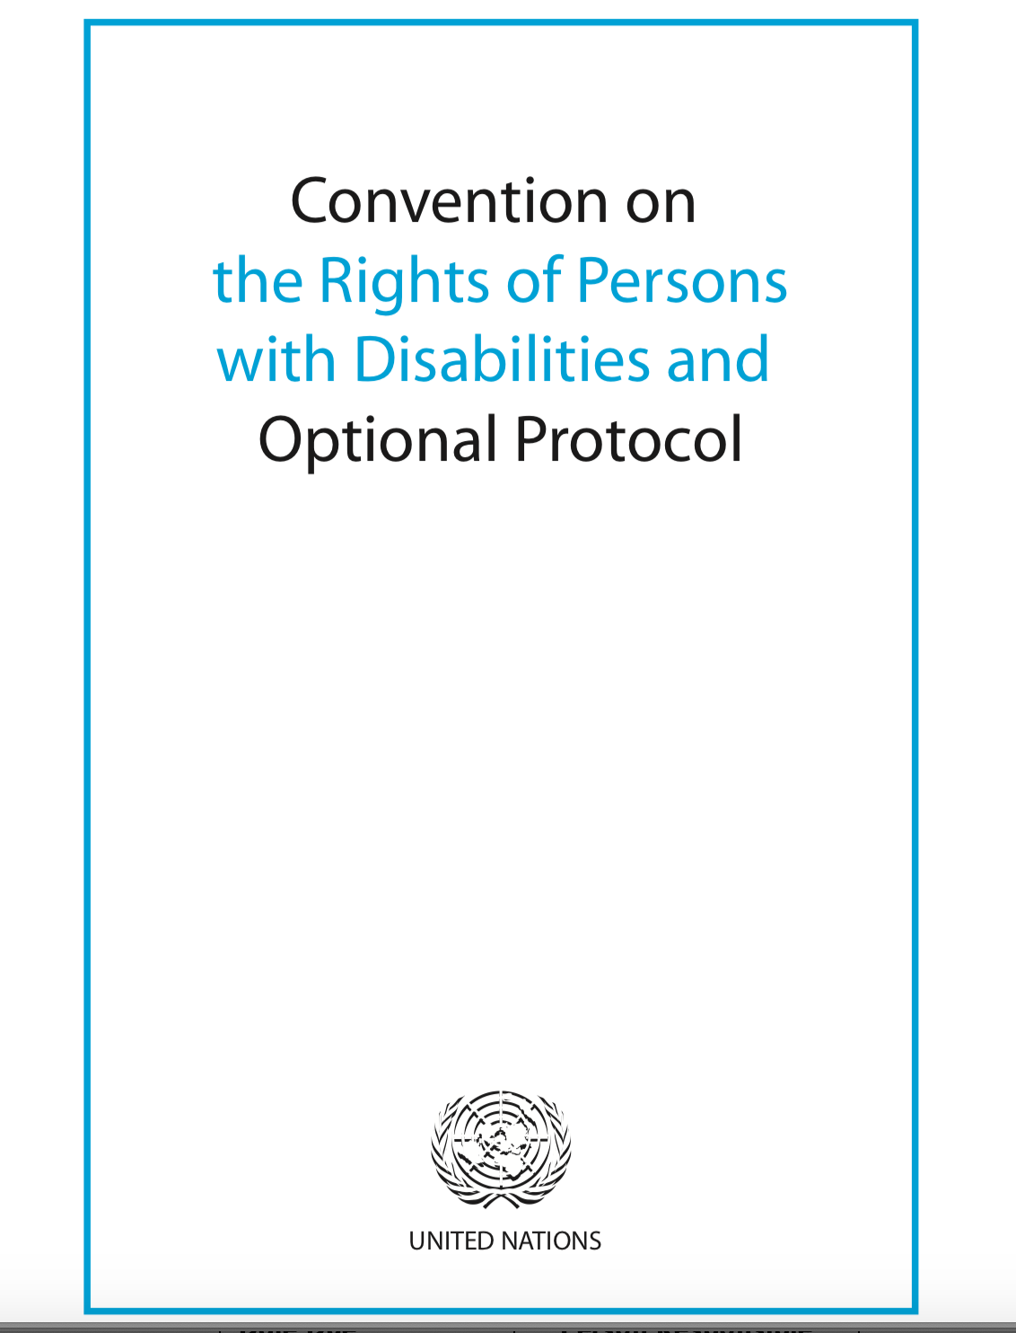
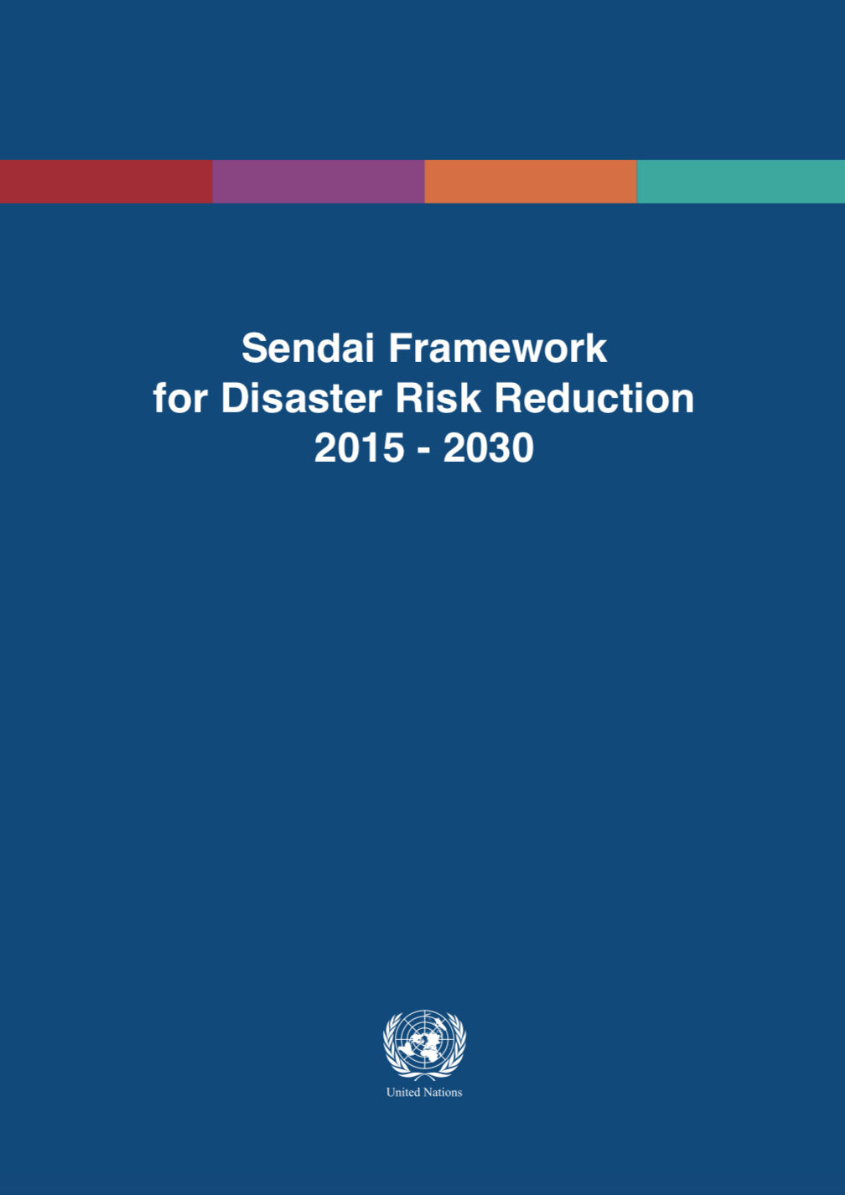
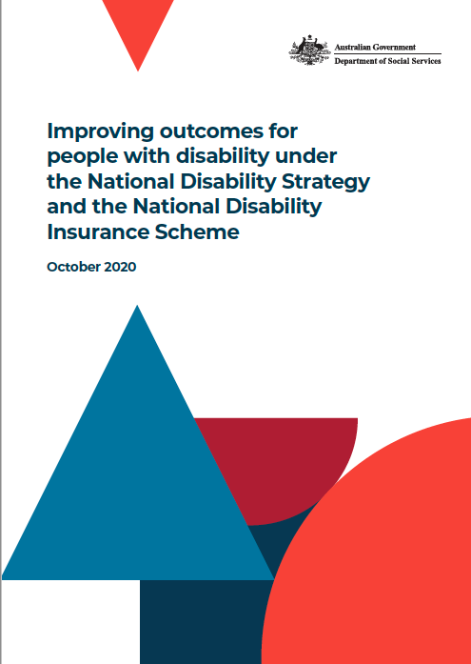
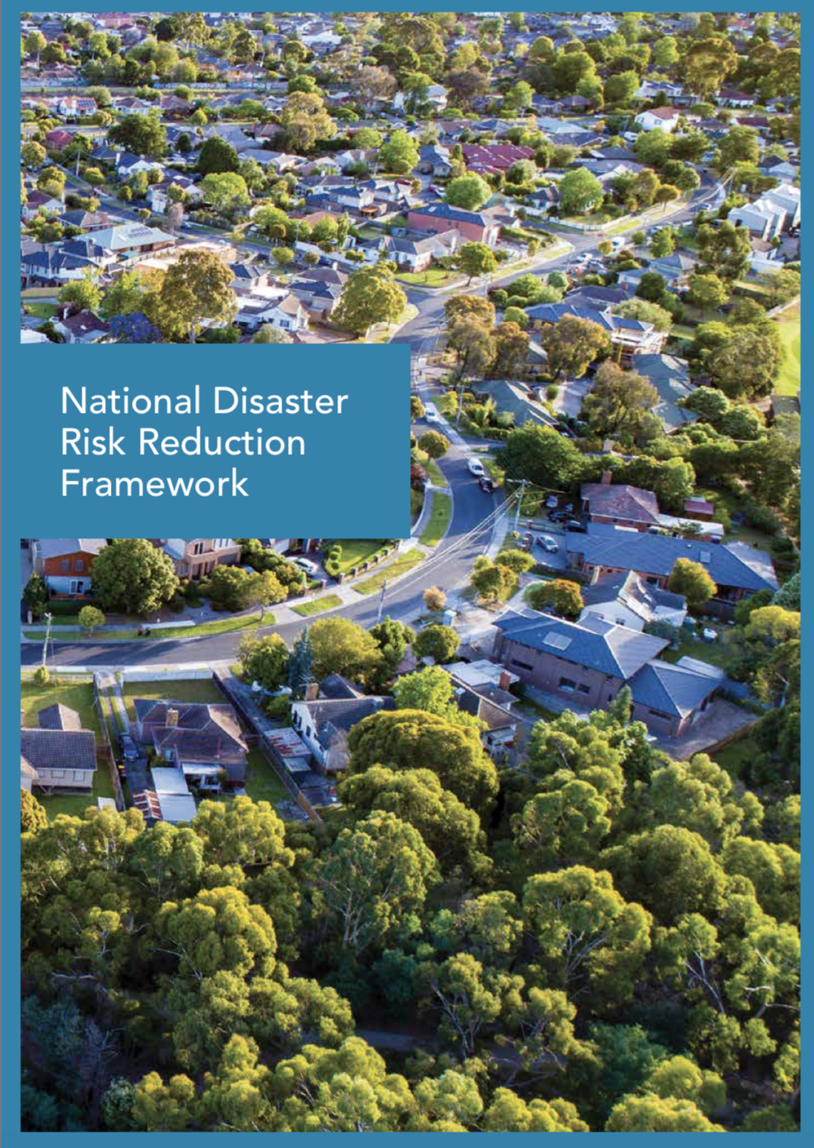
Shared but Defined Responsibilities

Slide 21
Shared but Defined Responsibilities
Individual level capability for emergency preparedness
Inclusive emergency management policy and practice
Organisational level capability for service continuity

Slide 22
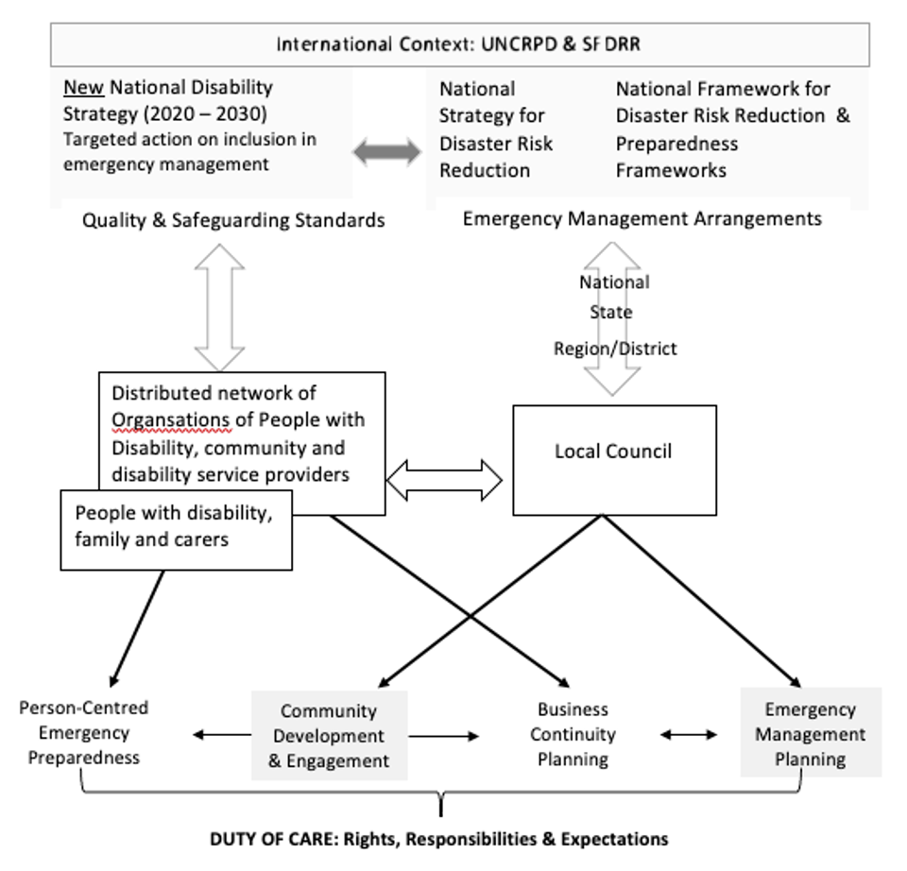
Policy Context
Practice Context

Slide 23
Disabled People’s Organisations
REPRESENTATION
MEANINGFUL PARTICIPATION
SUPPORT
ADVOCACY

Slide 24
Key Messages
Choice, access and opportunity
Data and evidence-informed planning that includes disability representation
Shift thinking from vulnerability to capability
Coordinated, cross-sector collaborative working
Person-centred approaches

Slide 25


Capability
Resources
Enabling Factors
Safety and well-being in emergencies

Slide 26
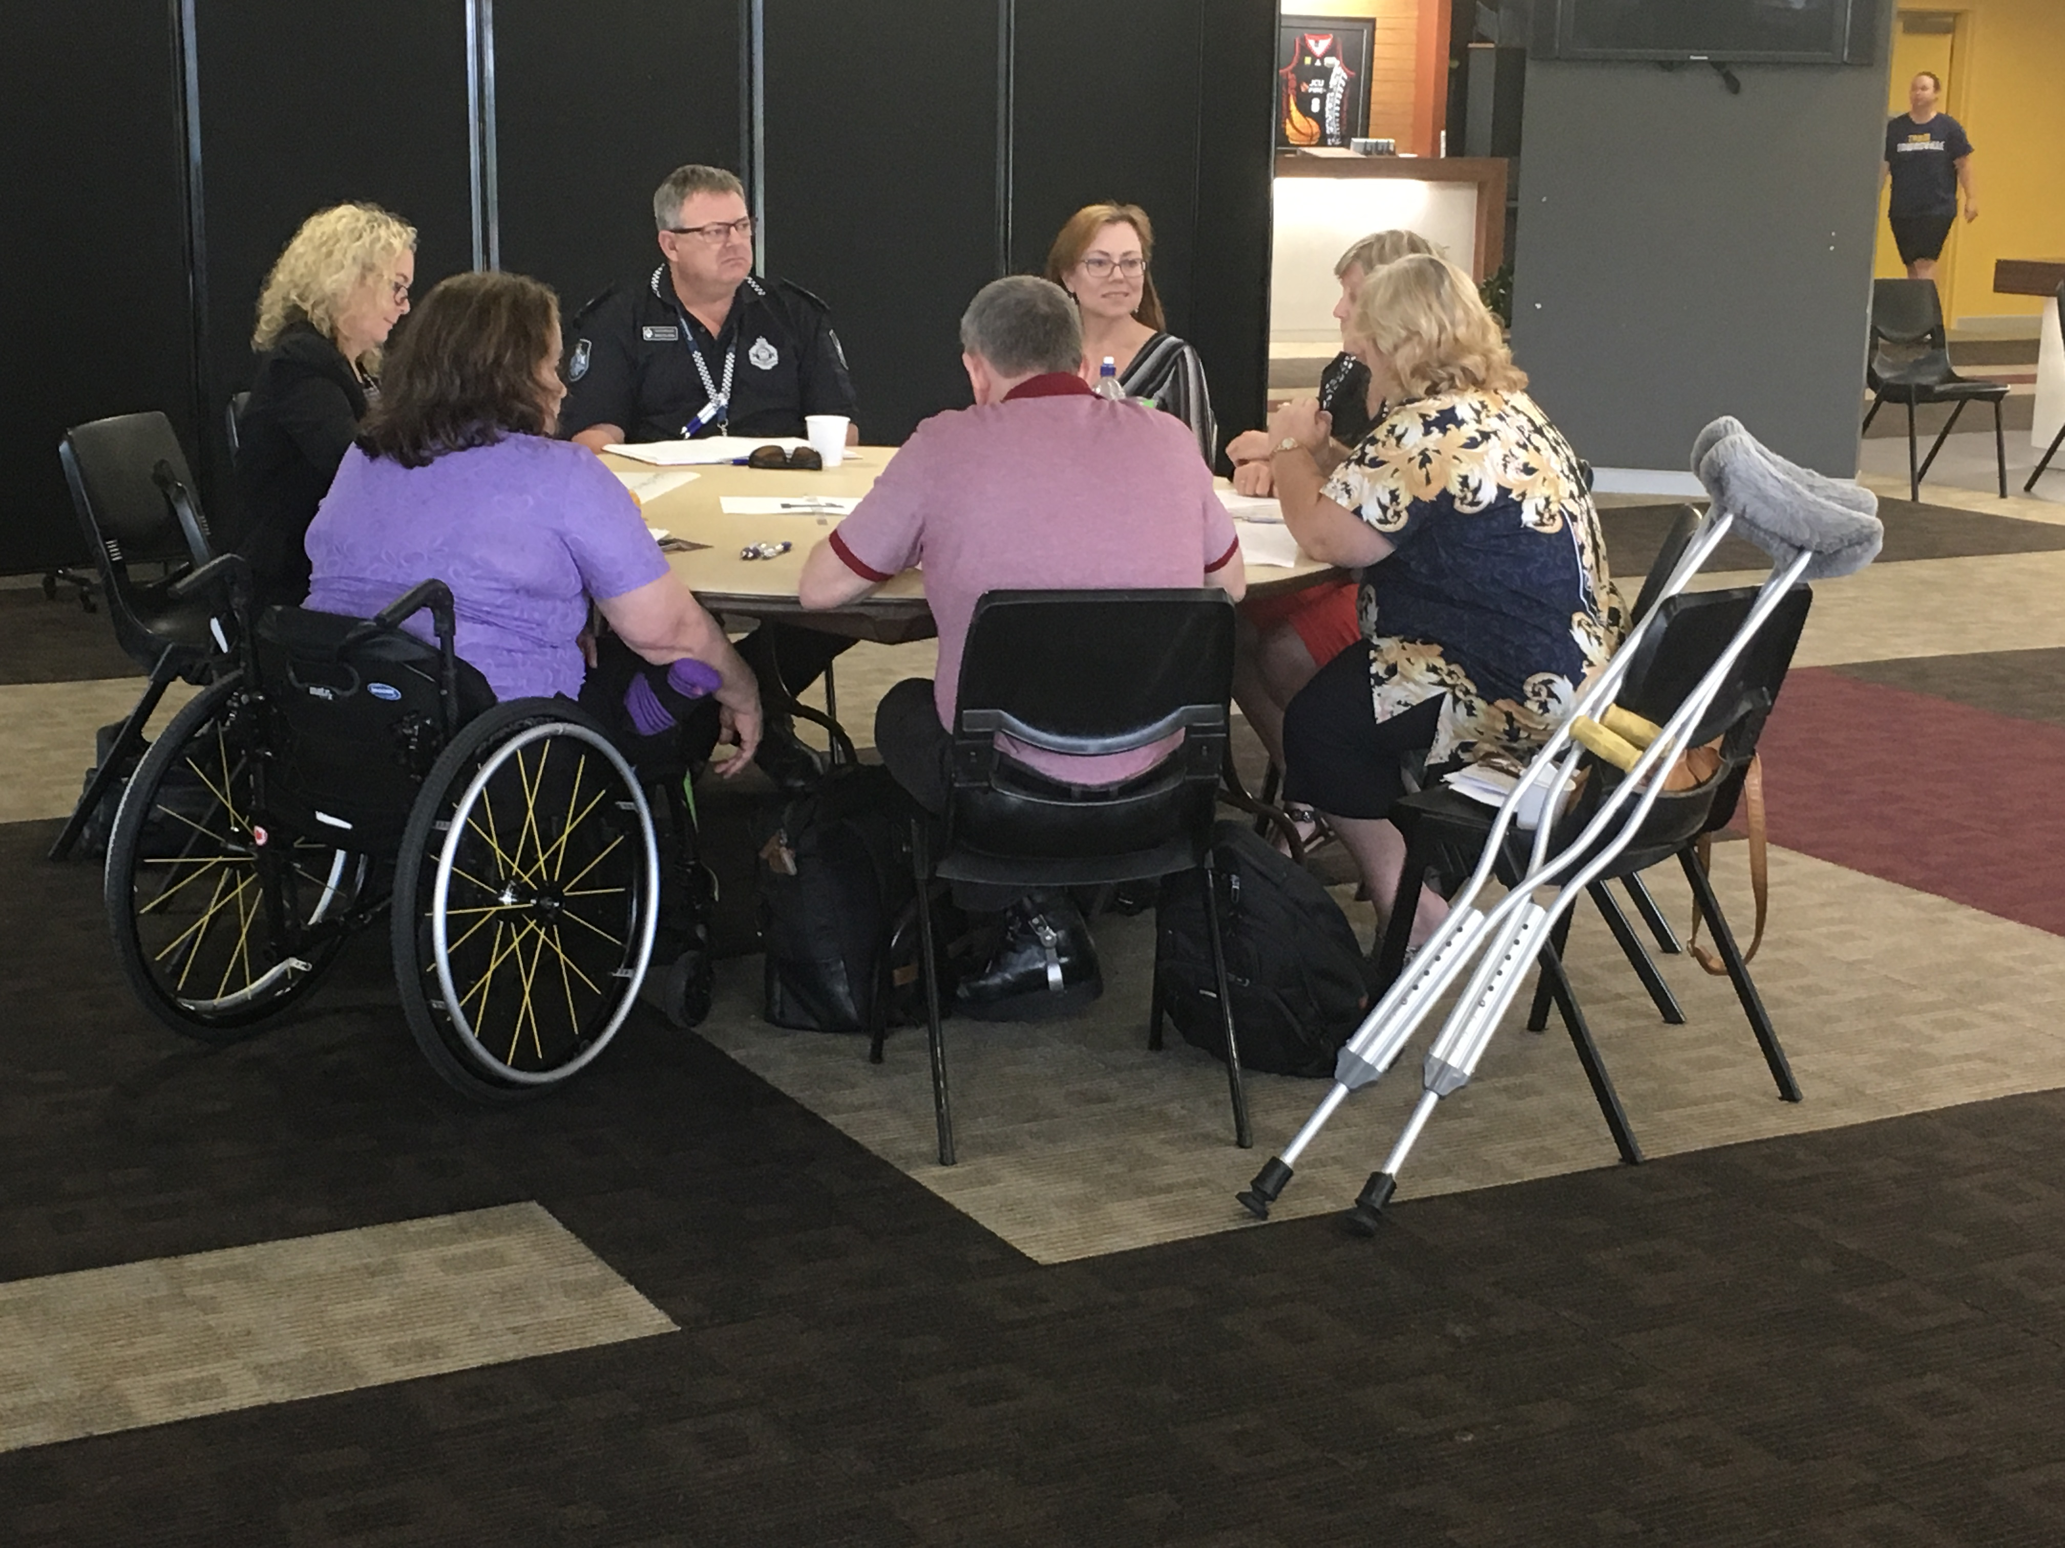
Enablers
Representation
Co-design
Access and support
Capacity development
Responsibility

Slide 27

Recommendation 1
Build nationally consistent standards for including disability representation into all emergency management arrangements at all levels of government.

Slide 28

Recommendation 2
Actively engage with people with disability in research to co-design tools for:
Gathering data and evidence on the extra support needs of people with disability in emergencies,
Planning for how extra supports will be resourced, supported and managed,
Evaluating the impact of those extra supports on the safety and well-being of people with disability in emergencies

Slide 29

Recommendation 3
Provide resources, funding/support, and advocacy where needed for people with disability to self-assess their risks and tailor emergency preparedness to their support needs and situation.

Slide 30

Recommendation 4
Develop a nationally consistent approach to capacity development for service providers in person-centred emergency preparedness and service continuity planning.

Slide 31

Recommendation 5
Provide explicit policy guidance on:
who takes responsibility for the extra support needs of people with disability in emergency situations,
how that support should be organized before, during and after disaster, and
how the responsibilities of different stakeholders will be guided, and outcomes measured.

Slide 32
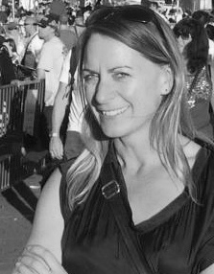
Thank you
Contact:
michelle.villeneuve@sydney.edu.au
www.collaborating4inclusion.org

