Slide 1
East Gippsland and North East Bushfires
Department of Health and Human Services

Slide 2
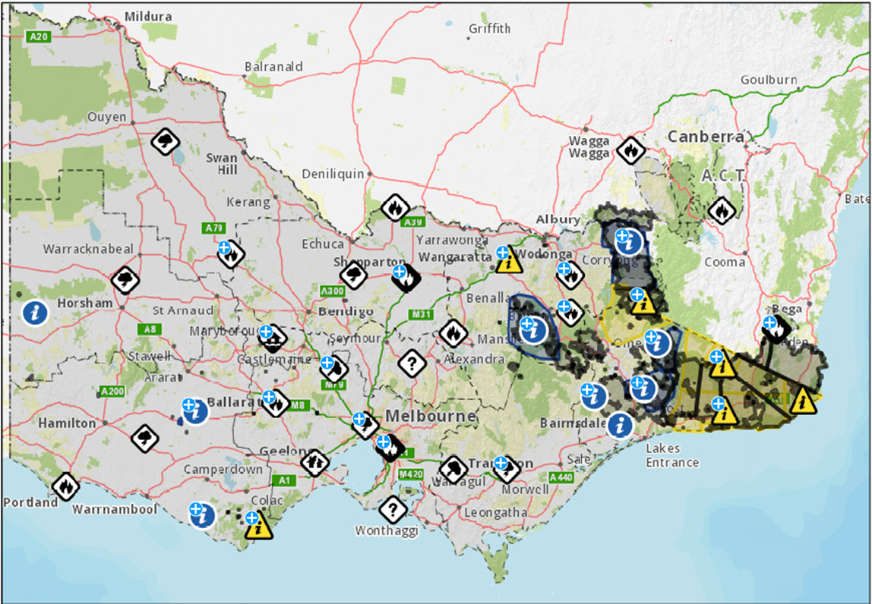
Current situation
There are still three significant fires going across Victoria which have burnt more than 1.5 million hectares

Slide 3
Current status….continued
Initial impact assessment data has told us that 405 residential and 653 non-residential structures have been damaged or destroyed by fire
It is likely this number will increase following secondary impact assessments which are now underway
Poor air quality in impacted areas remain a concern
14,366 relief payments and 49 re-establishment payments, totalling over $14 million have been paid under the Personal Hardship Assistance Program
The Victorian Bushfire Case Support Program 1800 560 760 has received a total of 1327 calls
Notes:
Secondary impact assessments involve building surveyors, environmental health officers and others visiting each property within the fire scar to verify the impacts to the property.
Re-establishment payments are insurance and income tested.
Victorian Bushfire Case Support Program provides a single point of contact for people who need help to understand and access supports available – which is very complex during these larger emeregncies.

Slide 4
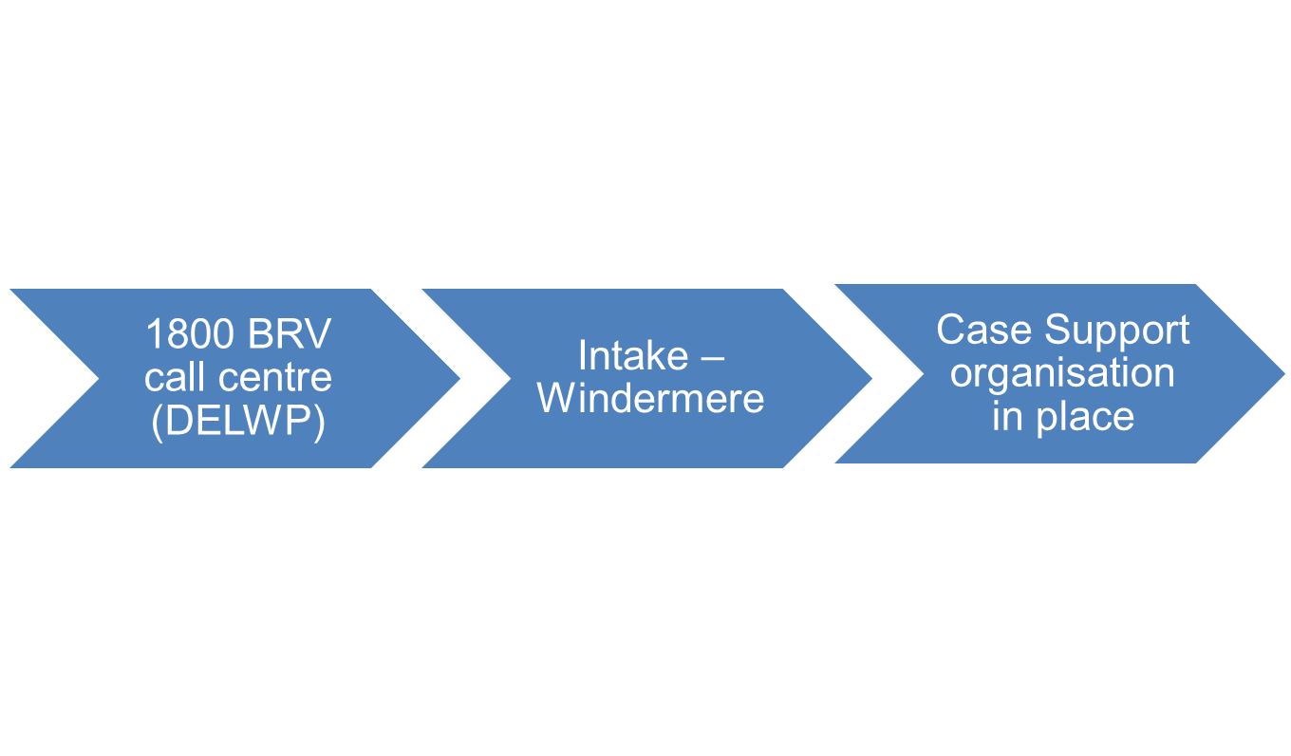
Case Support Program for people affected by the bushfires in Gippsland and NE Victoria​
Victorian Case Support Program – Intake process
Support coordinators are a single point of contact for those who need it, working with local residents to link them directly with vital support ​
Help to access information​
Assistance with completing applications for grants and other assistance ​
Provide psychosocial support​
Financial counselling​
Register for recovery programs such as clean up grants​
Support is scalable based on the recovery needs of the person and their capacity to meet their needs

Slide 5
The shift to recovery
Communities are in various stages of the emergency
Some communities are requiring relief services:
Re-supply of food and essentials as road access still limited in some areas
While others are starting to plan for recovery:
temporary accommodation
clearing debris from properties
and considering rebuilding
In addition to mobile pop-up recovery sessions, recovery centres at Bairnsdale, Corryong and Tallangatta are open

Slide 6
The shift to recovery…..continued
Housing and accommodation
The department is providing immediate interim accommodation support (for up to twelve weeks), including rental assistance and bond loan support to displaced residents.
Support is also available for public housing tenants with interim accommodation needs.
Community Recovery Committees
At a pace set by community, Bushfire Recovery Victoria is working to establish community recovery committees
Assisting communities with the clean up
A clean up program has been established to assist with the demolition and disposal of buildings that are beyond repair

Slide 7
Bushfire Recovery Victoria
A new permanent and dedicated agency​
Working closely with bushfire affected communities - including local Community Recovery Committees - in the development and delivery of local recovery projects​
Current priorities are the clean up program and the case support program
Managing the Victorian Bushfire appeal fund
BushFireRecoveryVictoria@dpc.vic.gov.au​
​
​

Slide 8
Future work
Increasing the resilience of people with disability in emergencies
Project to co-design a new model for engaging people with disability to undertake emergency planning.
Components of a new model may include establishing:
mechanisms to access existing self-assessment and emergency preparedness planning tools and resources
options and pathways for assistance to develop emergency preparedness plans where needed
strategies to increase the voice of people with disability in local and community-led emergency preparedness planning
connections to the touch points where people with disability can access information about emergency preparedness planning
accessible and inclusive public information and resources

Slide 9
Reviews and research
Review of the use and purpose of the Vulnerable Person’s Register?
Research expected soon from Morwell that will cover secondary affects of the fires, recognising there will be a difference between the events and their effects, it may be a model for mapping and analysing secondary effects.
Following up with researchers who are putting in submissions for research projects involving disability and disasters such as Claudia Marck

Slide 10
Other information
Bushfire recovery information can be found at:
The Better Health Channel: https://www.betterhealth.vic.gov.au
VicEmergency Relief Recovery: https://emergency.vic.gov.au/relief/
Bushfire Recovery Victoria: https://www.vic.gov.au/bushfire-recovery-victoria

Slide 11
Discussion
Keen to hear
The experiences from advocacy groups that have been actively supporting families in relief centres and in to recovery. How can we support this work?
NDIA role in supporting clients during evacuations in Victoria during Dec/Jan – and any outcomes from this experience
Actions taken to ensure service continuity for NDIA participants impacted by evacuation and bushfires and any issues or areas for improvement

