Slide 1


with Jax Jacki Brown & Jess Mattar
Notes:
JAX

Slide 2


Acknowledgement of Country
I would like to acknowledge the Wurundjeri people who are the Traditional custodians of the land we meet on today. I pay my respects to both Elders past and present on the Kulin Nation and extend that respect to any Aboriginal and Torres Strait Islander people here today. I would like to take this opportunity to pay tribute to the incredible strength and resilience of Aboriginal People in their journey towards healing.
Notes:
JESS

Slide 3

Introducing ourselves
Jax Jacki Brown (They/She)
Project Coordinator
Jess Mattar (They/She)
Project Researcher
Thanks to our Co-design Team and DARU
Notes:
Jax and JESS

Slide 4
Safety messages
Be aware how we share
Be respectful and non-judgmental
Change names or de-identify people when you share a story
Think about what you are saying before you say it – it might be something you can ask one of us about afterwards or in the break.
Words and terms are important – when we make a mistake we will apologise and correct it.
Notes:
JESS

Slide 5
Today’s workshop
We have 1 hour to present to you some of our project work so far.
We aim to leave time for discussion at different points during the workshop.
At the end of the workshop you will leave with:
An overview of the project, who is involved and the planned outcomes between now and June 2020.
A comprehensive understanding of the terms and language used within the LGBTIQ+ communities including of the terms sex, gender and sexuality.
Reflect on current practice in your disability advocacy organisation and identify areas for improvement.
What our project thinks are important things to consider to become a more LGBTIQ+ inclusive organisation – you get to watch a video and get a tipsheet!
Notes:
JAX

Slide 6
1. An overview of the project, who is involved and the planned outcomes between now and June 2020.
Notes:
JAX

Slide 7
Advocacy at the Intersections
Our project aims: to provide advocacy training on the experiences and needs of LGBTIQ+ people with disabilities
Welcome Damian & Melissa from DARU
Welcome Jade Mailo from YDAS, she is on our Co-design Group for this project
Notes:
Jax
DARU is partnering with queerspace in this project, to provide expertise on disability advocacy and the disability advocacy sector and to provide skills and resources to build the online module

Slide 8
Queerspace
Melbourne’s health and wellbeing service for lesbian, gay, bisexual, trans, intersex, questioning and queer (LGBTIQ+) people and families.
queerspace provides a safe and supportive space to obtain counseling and support aimed at improving health and wellbeing for queer people, families and communities
Part of Drummond Street Services with locations in Carlton, Coburg, Hoppers Crossing and across the north-west metro regions of Victoria.
Notes:
JESS

Slide 9
Damian Cavenagh DARU
Notes:
JAX

Slide 10
Damian- What's it been like to be part of this project?
Other comments/reflections
Notes:
Damian

Slide 11
Co-design group – who is in it and why.
Five representatives from disability advocacy organisations:
  Women with Disabilities Victoria
  Youth Disability Advocacy Service
  Leadership Plus
  Melbourne East Disability Advocacy (MEDA)
  Grampians disAbility Advocacy
Three representatives from the LGBTIQ+ communities with lived experiences of disabilities.
Three representatives from LGBTIQ+ community groups and organisations.
Cross representative between this project and the Thorne Harbour Health project so we don’t replicate the work or ask our community Co-design members to replicate their work and time on both groups.
Notes:
JESS

Slide 12
Jade Maiolo YDAS
Notes:
JESS

Slide 13
Jade- What's it been like to be part of the codesign group?
What do you think its important for advocacy services to know to be LGBTIQ+ inclusive?
Notes:
Jade

Slide 14
Project Outcomes
Develop and deliver an online module for training for the Disability Advocacy sector
Present ten face-to-face training sessions to the LGBTIQ+ communities including LGBTIQ+ groups and organisations
Develop 5 short videos
Develop Tipsheets explaining key issues
Resources to be hosted in DARU website
By June 2020.
Notes:
JESS

Slide 15
Let’s talk about language & terms
Common issue between LGBTIQ+ communities and disability communities is that language is contested, challenged and changes over time.
Words change over time, sometimes reflecting a legal or government focus and other times reflecting a community focus.
Some of us use person-first language such as people with disabilities, some of us use identity first language such as disabled people.
Understanding Intersectionality is important – for more on this see our Accessibility Tipsheet.
Notes:
JESS

Slide 16
We don’t have time to talk about this but after today’s session we invite you to think about:
What language or terms do we use to describe ourselves?
Why do we use the language or terms we choose to use?
Do we use different language or terms at different times?
Notes:
JESS

Slide 17
2. A comprehensive understanding of the terms and language used within the LGBTIQ+ communities including of the terms sex, gender and sexuality.
Notes:
JESS

Slide 18
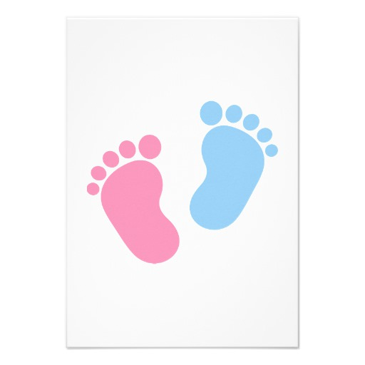
Sex
How do we define Sex?
Biology ?
Legally?
Structurally?
Notes:
JESS
Let’s talk about how we define Sex. How do we define it ?
Biologically – Reproductive organs, hormones, chromosomes, genitals,
Legally – Birth certificate, Legislation, marriage act
Structurally – Intake forms, membership documents, passports
Who here has had a chromosome check? I know that I can’t see all of your genitals, and I am sure you can’t see mine, so what are we doing, what are we seeing and what assumptions are we making?
We either see secondary sexual characteristics, might be hair, physical appearance. We might hear a person's tone of voice and make an assumption. In fact there are over 20 different sex variations in the human population. It makes saying male and female a little limited sometimes doesn’t it.

Slide 19
Intersex
People with intersex variations are born with congenital atypical sex traits (whether chromosomal, hormonal or anatomical). Many have two or more variations.
It is estimated that 1–2 per cent of the population have intersex variations but these estimates may be conservative because of the physical invisibility and failure to diagnose some intersex variations.
Most people with intersex variations identify as female or male while a smaller number may identify as non-binary (neither female nor male) or both male and female.
Having an intersex variation does not determine or restrict an individual’s gender identity or gender expression.
Health and wellbeing of people with intersex variations.
March 2019. Victoria Government
Notes:
JESS

Slide 20
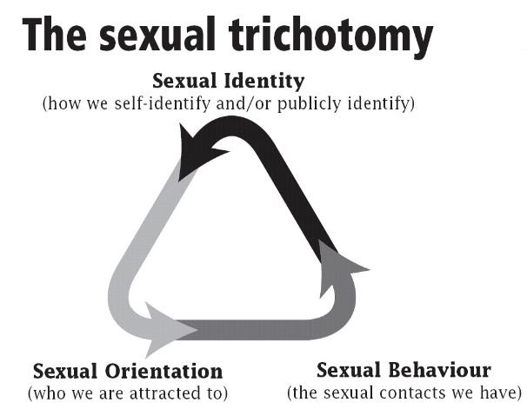
Sexuality
Notes:
JESS
What are some examples of sexuality.
Go through examples of each sexual identity, orientation and behavior.
When we often offend someone, it is because we are not respecting one of these (go through examples of each)

Slide 21
Gender
Gender identity: Gender Identity = How a person, in their mind, thinks about themselves. This is based on a society’s expectation about how people should look, think, and act as someone of a specific gender. Examples are Woman, Genderqueer, Transgender, and Man.
Woman: A person who was assigned female or male at birth and feels and lives their life as a woman.
Gender Queer: A person whose gender identity is neither man nor woman but between or beyond traditional genders.
Transgender: A person whose gender identity is different from the gender they were assigned at birth.
Man: A person who was assigned male or female at birth and feels and lives their life as man.
A person's sex is not necessarily consistent with their gender
Notes:
JESS
Gender: the social roles or a personal identity or cultural expectations: the meanings and behaviours socially assigned to or expected of people.
Lets give some examples of gender identity: “Cis Gender” A person whose gender identity and/or expression is the same as the sex they were assigned at birth.

Slide 22
Gender
Gender Expression = The way a person presents (shows) and communicates their gender identity through actions, dress, behaviors, and speech. Examples are Feminine, Androgynous, and Masculine.
Feminine: Having qualities traditionally associated to women
Androgynous: Having both masculine and feminine qualities (or neither)
Masculine: Having qualities traditionally associated to men
Notes:
JESS
Activity here on people identifying their own sex, sexuality and gender identity.

Slide 23
Respectful Language and why it is important
Notes:
JAX

Slide 24
Respectful Language
Avoid assumptions.
Clarify the relevance, if any, of asking someone about their sex, sexuality and/or gender identity.
Use “assigned at birth” instead of “born”.
Ask “Who is in your family?” or “What words do you sue to describe all the people in your family” - use open ended questions.
Transgender is an adjective. Transgender can be shortened to 'trans'. Do not use 'transgendered' – it's not a verb. Do not use 'a transgender', it's not a noun.
Notes:
JAX

Slide 25
Respectful Language
Affirming someone as transgender means you accept that their gender identity (male, female or something else) is innate and separate from physical characteristics. It means you accept that (unless they tell you otherwise), they always have been the gender with which they identify now.
Ask about which pronoun they prefer to use. “They/Them” can be tricky but persist or use name.
When you use the name, pronouns and words of a client or colleague has asked to be called you are validating their humanity and sense of self.
Notes:
JESS

Slide 26
Pronouns – a quick check in
Notes:
JAX

Slide 27
Intersectionality
Intersectionality reminds us that everything about us is inter-linked. Intersectionality was first coined by Kimberlé Crenshaw in 1989 to understand how racism and sexism are coexist in the lives of black women.
Our sex, sexuality and gender make up some, but not all, of who we are.
Race, class, socio-economic status, age also make up parts of who we are.
For example you may be:
Aboriginal or Torres Strait Islander
Multi-cultural, of diverse races and multi-faith.
live in rural and regional communities
Some of us are disabled, some of us are neuro-diverse and some of us have children who live with disabilities.
We may have support from our family of origin.
Notes:
JAX

Slide 28
Summary
Your sex assigned at birth is not necessarily consistent with your gender.
Your gender is not related to your sexuality
Your sexuality is not related to your sex assigned at birth
Using the correct language and terms is important - including people’s names and pronouns.
Understanding intersectionality is important
It is OK to make a mistake - always apologise and try again.
Notes:
JESS

Slide 29

‘’You don’t need to agree with someone's language to mirror it’’
‘I have to choose between two different services, either ones that meet my LGBTIQ needs and identity or disability services, and I can not find services who include, respect and respond to the whole of me’.
Quotes from CoDesign members 2019
Notes:
JAX

Slide 30
3. Reflect on current practice in your disability advocacy organisation and identify areas for improvement
Notes:
JAX-Now in groups of 3 or 4 you are going to think through a scenario

Slide 31
Group Activity
Scenario 1- Misgendering client
You are in a meeting with another person and your client, and this person is consistently misgendering your client. They know your client’s real pronouns and gender but are not using them. Your client is visibly uncomfortable and becoming more distressed as this continues. Before the meeting, you asked your client whether or not you should say something if this happened, and they said yes.
You: (pick as many or as few correct answers)
Do nothing. If your client actually wanted to be referred to with these terms, they’d correct other people themselves.
Wait for them to do it again and then correct them once.
Correct them every time they do it.
Say ‘I notice that you keep misgendering my client. Please use [correct pronouns] and [correct gender].’
Yell at them. How dare they disrespect your client like that?
Notes:
JESS

Slide 32
Group Activity
Scenario 2- Misgendering by services
A client has been referred to a job support provider by Centrelink. She identifies as a woman and her name is Jane. She has been living as a woman her whole life.
Her assigned gender at birth was male and her name given at birth was James.
As Centrelink do not recognise a preferred name, or the gender someone identifies with, Jane has been filed under the name of James.
This has transferred over to the job provider which claim they are unable to change it in their system. Anyone who has not met Jane yet would think they are meeting a man named James for their appointment.
Their systems does not have somewhere for a preferred name, title and gender, and they have not changed the name at the top of all papers referring to Jane.
How do you support Jane? What changes can be put into place?
Notes:
JESS

Slide 33
Group Activity
Scenario 3- Advisory group
You work at a disability advocacy organisation. Part of your job is to hold regular meetings of an advisory group of disabled people. One of the advisory group members is trans, and other group members frequently misgender them and make transphobic comments.
Do you (select as many or as few as you think are correct):
Seek out more trans people to be part of the advisory group
Tell the trans person that if these comments are distressing they can talk to a staff member and ask them to be patient because many disabled people have a harder time with pronouns
Pay a disabled trans activist to run a mandatory workshop on trans rights for all staff and advisory group members
Say nothing- if the trans person wanted anything to happen they would speak up, and you don't want to push them into a confrontation if they aren't ready for it
Remind the advisory group of your organisation's anti-discrimination policy and explain that if members continue to make transphobic comments they'll be asked to leave
Notes:
JESS

Slide 34
Group Activity
Scenario 4- Group home
You are visiting John, a man living with an intellectual disability, who resides in a group home.
When you ask John if he likes attending his day service, he replies that he does because “Bill is there and I loves Bill”.
John repeats that he loves Bill and Bill loves him.
When you ask the supervisor of the group home whether John and Bill are in a relationship, the group supervisor laughs and says “I don’t think so! Those type of people don’t have relationships, especially relationships like that!”
What do you do? Discuss

Slide 35
Group Activity
Scenario 5- Carer choosing clothing
Fatima is living with intellectual disabilities and is getting ready to go to a family wedding.
Fatima usually wears gender neutral clothing.
When you arrive to visit her, you find she is very distressed because her carer is dressing her in a very frilly dress.
The carer says “I know she doesn’t want to wear it, but it’s just for the photos, the family want her in a dress and she won’t really know where she is anyway.”
What do you do?

Slide 36
Group Activity
Scenario 6- Lack of services in rural areas
Your client is a transgender woman with a chronic illness and a complex psychosocial disability.
She is unable to access medical care as the closest medical clinic that understands the medication and care she requires as a trans woman is an hour away.
She does not drive and is unable to take public transport. This has left her ill, socially isolated and she is unable to cope with symptoms of her illness in public.
Her symptoms would be treatable if she could access a trained medical professional. Ararat only has one doctor that accepts bulk billing which is important when you’re on a Disability Support Pension, however the doctor is male and your client is not comfortable visiting him.
What do you do?

Slide 37
4. What our project thinks are important things to consider to become a more LGBTIQ+ inclusive organisation – you get to watch a video and get a tipsheet!
Notes:
JESS

Slide 38
We try to model good LGBITQ+ inclusion
Employed Project Coordinators who have lived experiences of being LGBTIQ and people with disabilities
Developed a Co-design team with a mix of people from our target communities
Always use pronouns
Use a venue that has a ramp, large doorways and gender-neutral toilets
Survey participants on their access, dietary needs and how they are feeling about the meetings
Provide cab charges and reimburse Uber
Reimburse volunteers $100 per meeting.
And we could do a lot more…
Notes:
JESS

Slide 39
In summary…
‘Accessibility isn’t an optional extra’.
‘If you don't have people with disabilities accessing your service that is not because they don't want to engage with it, it’s because they are encountering access barriers’.
‘I have to choose between two different services, either ones that meet my LGBTIQ needs and identity or disability services, and I can not find services who include, respect and respond to the whole of me’.
Quotes from CoDesign members 2019
Notes:
JESS

Slide 40
LGBTIQ+ 101 Video
Notes:
JAX

Slide 41
What is one thing you will take away with you today?
Notes:
JAX

Slide 42

jaxjacki.brown@ds.org.au
jess.mattar@ds.org.au

Slide 43


