Slide 1
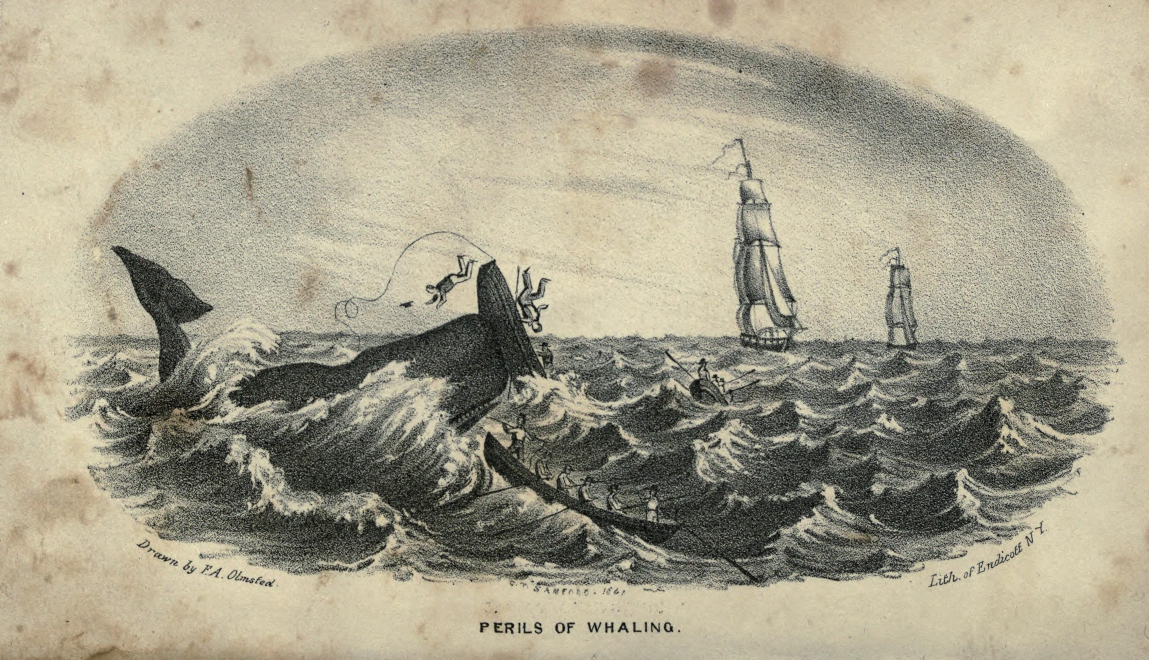


Addressing Burnout
Balancing Resilience with Improving Worklife
Michael P. Leiter, PhD, Professor of Organisational Psychology
School of Psychology
Deakin University
https://mpleiter.com
Notes:
Objectives
1. Generate Conversations
Get to Solutions by Minute 30
Touch on SCORE project

Slide 2





Background
Causes of Burnout
  Demands over Resources
  Value Conflicts
Areas of Worklife
  Manageable Workload
  Control
  Reward
  Community
  Fairness
  Values
Positive Perspective
  Work Engagement as Goal
mpleiter.com

Slide 3
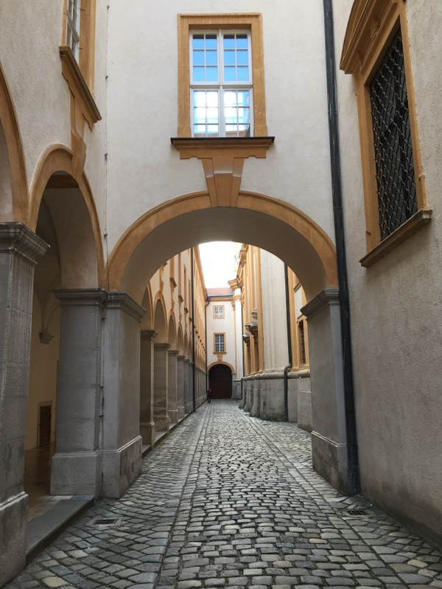
Outline
What is Burnout?
What are Neighboring States?
What Leads to Burnout?
Whatever Can Be Done About It

Slide 4

Burnout to Join ICD-11
“Burn-out is a syndrome conceptualized as resulting from chronic workplace stress that has not been successfully managed.”
Three-Part Syndrome
  Exhaustion
  Cynicism
  Inefficacy
Exclusively “phenomena in the occupational context”
Not a Disease
“Occupational Phenomenon”
  Risk Factors for Disease
Contrast with Depression
  Depression already in the ICD
  Depression is a disease
  Depression is not exclusively occupational
Implications:
  Intervention Support
  Disability Rationale
https://www.who.int/mental_health/evidence/burn-out/en/

Slide 5
Engagement with Work
Energy
Involvement
Efficacy

Slide 6

Burnout and Neighboring Profiles
Exhaustion
Unmanageable Demands
Inadequate Recovery
Cynicism
Value Conflicts
Disrespect
Inefficacy
Lack of Recognition
Impossible Standards
Emotional Distance
Lack of Control
Over-
Extended
Disengaged
Ineffective
Burnout
Notes:
Points:
Exhaustion includes
subjective lack of energy
Not only the burden of demand but also compromised capacity to recover
Cynicism: Escape, value conflicts
Efficacy Lack of Agency, loss of intrinsic and extrinsic reward

Slide 7
7%

Slide 8
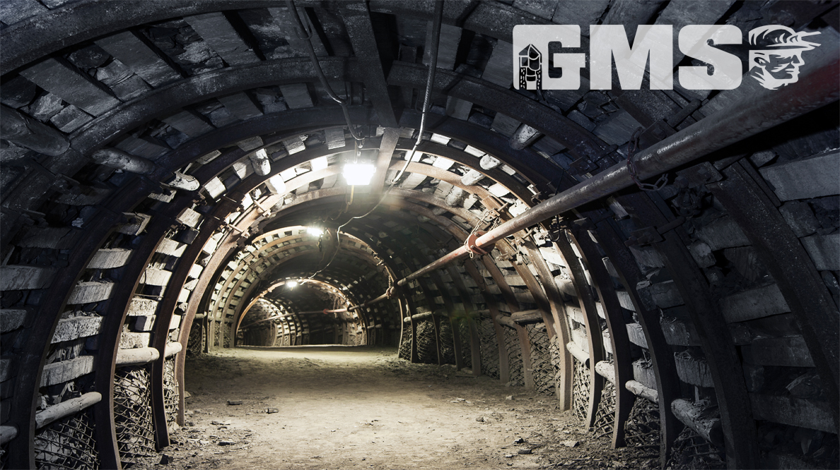

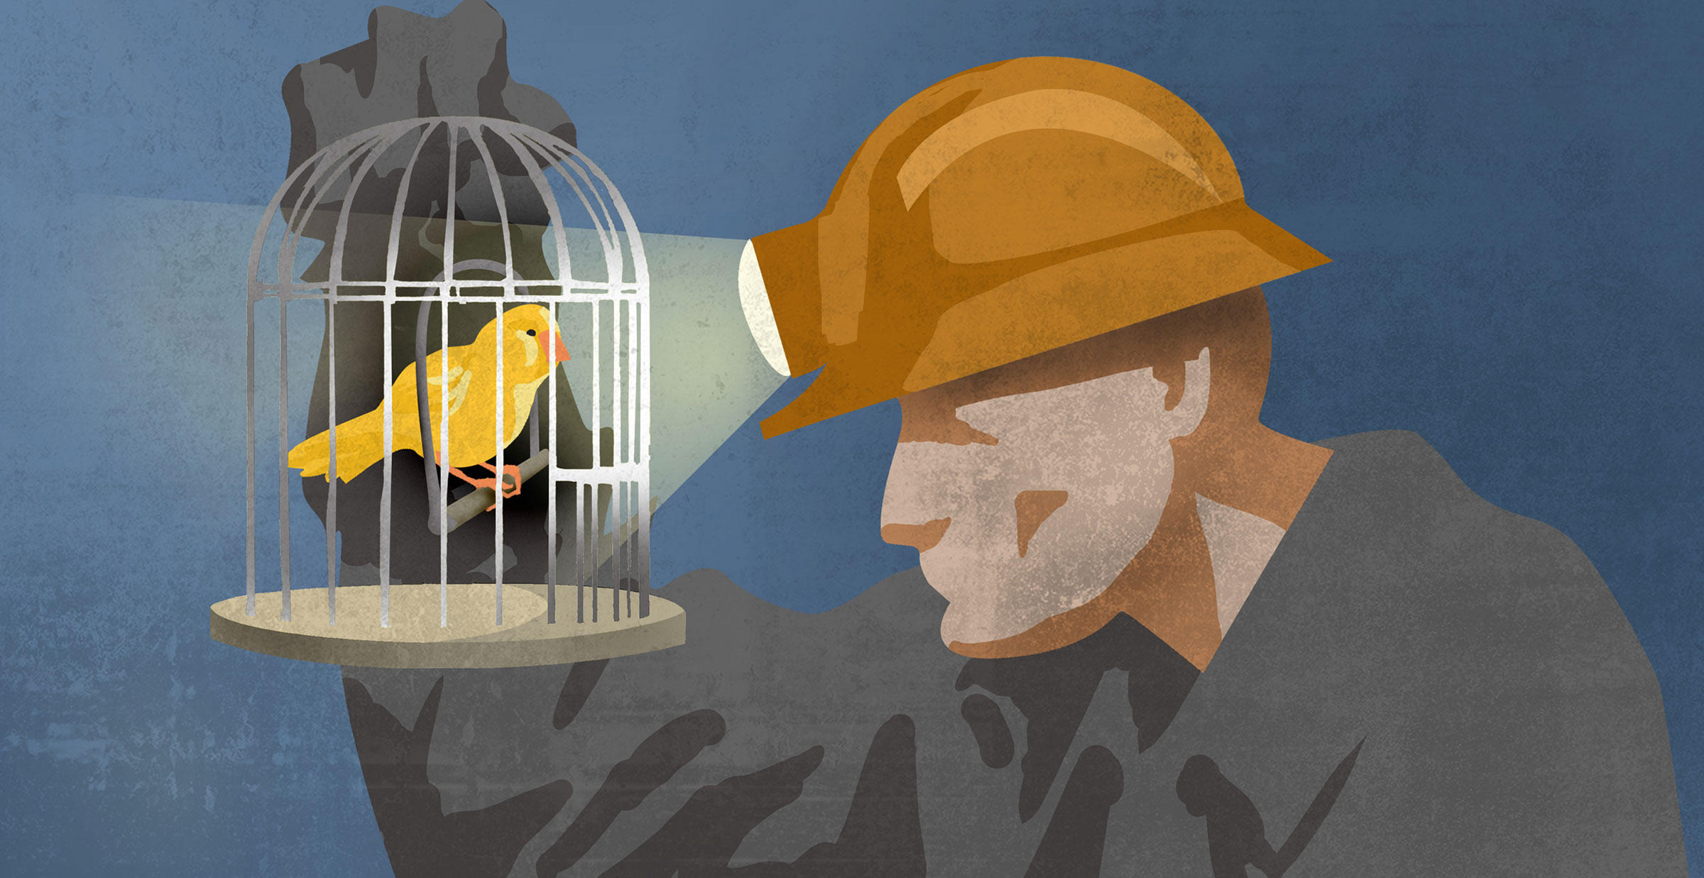
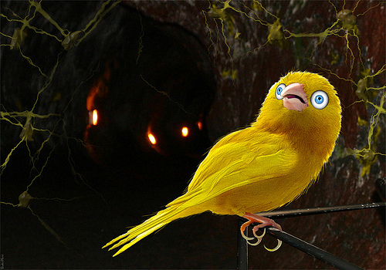
Responding to
Burnout
Burnout: Canary in the Coal Mine
  Vulnerable Sectors
  Demand/Resource Balance
  Alignment w Employee Aspirations
Response
  Get Tougher Canaries
    Resilience
    Coping
  Improve the Coal Mine
    Improve Demand/Resource Balance
    Improve Workplace Community

Slide 9

Self-Perpetuating Burnout
Burnout
Overextended
Exhaustion: Lacking Energy
Cynicism: Closed; Lack of Trust
Inefficacy: Discouraged
Exhaustion: Lacking Energy
Involved: Open, Trusting
Efficacy: Confident

Slide 10
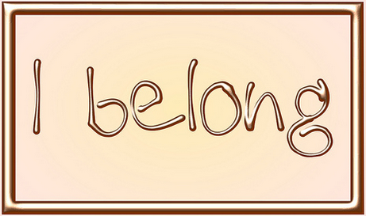
Areas of Worklife
Workload
Control
Reward
Community
Fairness
Values
Pacing & Recovery
Decision & Autonomy
Recognition, Pay
Respect, Belonging
Justice, Opportunity
Aspirations, Principles

Slide 11
Areas of Worklife
Mismatch | OK I Guess | Match
Manageable Workload
Control
Reward
Community
Fairness
Values

Slide 12
Profiles and Areas of Worklife

Slide 13
Two Processes of Burnout
Exhausting Demand Process
  Demands Exceeding Resources
  Inadequate Recovery at Work and at Home
  Contribution to Burnout and Overextended
Frustrated Values Process
  Conflict of Personal & Workplace Values
  Disconnected Team Dynamics
  Contribution to Cynicism, Disengagement, Inefficacy,
  and Burnout
Notes:
Note the Extent to which ideas offered in the previous discussion map onto there processes

Slide 14


Unmanageable Workload
Tasks cannot be Completed in the Time Available
  Overtime at Work or at Home
  Incomplete or Insufficient Quality
Excessive Effort
  Exhausting Physical, Mental, Emotional, Social Capacity
  Insufficient Pacing, Breaks
Tedium
  Illegitimate Tasks: Disorganized, Busywork,
  Admin Nonsense
  Tasks Disconnected from Values
Social Discord
  Thwarted Relatedness
  Incivility, Disrespect, Intimidation

Slide 15


Values, Motives, Aspirations
Work as a Job v Work as a Calling
  Expecting Too Much?
  Tolerating Too Little?
Core Motives at Work & Elsewhere
  Belonging
  Autonomy
  Accomplishment
Aspirations
  Career Trajectory
  Fulfilling Current Job

Slide 16

Taking Action
Prevention has lots of advantages over a cure

Slide 17


Action Strategies
Energy Process: Work Demands
  Pacing
  Recovery
Values Process: More Fulfilling Work Design
  Autonomy, Control
  Reward and Recognition
  Community
  Fairness, Justice
  Value Alignment
Notes:
Energy Process Necessities
Performance Quality of Teaching
Work/Not Work Boundaries
3 Domains: When is Enough of What?
Note Six Areas of Worklife Model

Slide 18

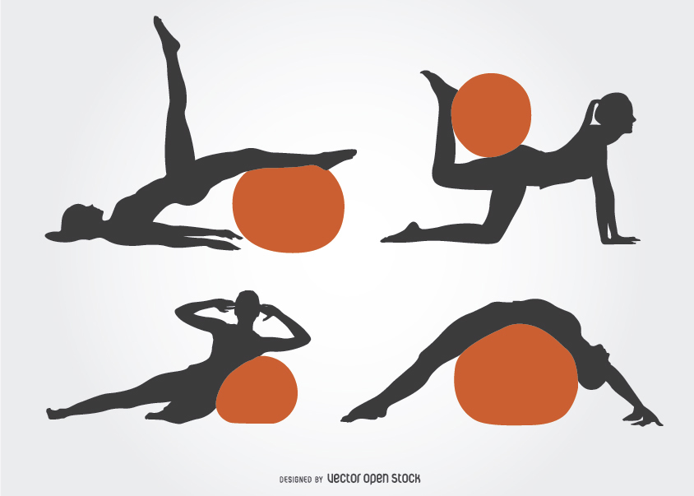

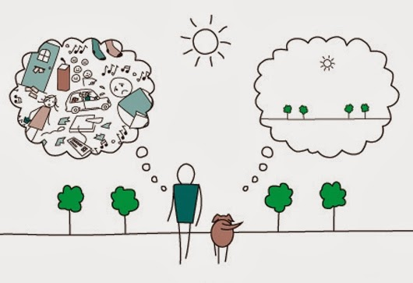
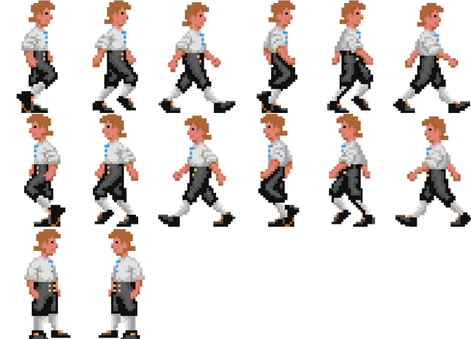

Energy: Recovery
People
Balance Lifestyle
Enjoyable Activities
People, Community, Family
Physical, Mental, Social, Spiritual Wellbeing
At Work as Well as At Home
Fitness
Food
Mindful
Move
Sleep
Notes:
The main idea here is that doing all those things you should do will help.
BUT
You do not need to do them all.
AND
The challenge is fitting them into life while contending with all of life’s demands
Question: What have people found to be Effective?

Slide 19
Social Encounters at Work

Slide 20
Social Encounters and Profiles:
Positive & Negative
Civility
Incivility

Slide 21
Domain of Negative Social Encounters
Bullying
Incivility
  Low Intensity
  Negative Social Behaviour
  Of Ambiguous Intent
  Rude
  Contrary to Social Norms
Civility
  Acknowledging
  Accepting
  Appreciating
  Accommodating
+ Power
Annoying
Abuse
Intensity
Incivility
Intention

Slide 22
Taking Action
Job Crafting
Improving Relationships
Improving Work Flow

Slide 23
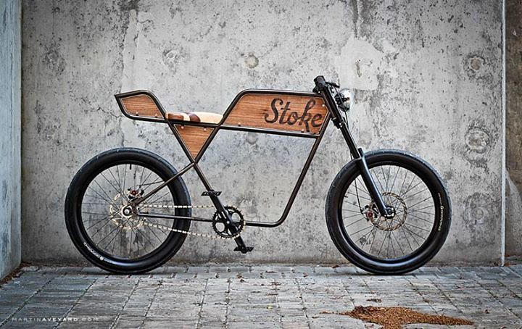
Job Crafting
Self Reflection: Track for a Few Weeks
  Favorite Work Activities
  Least Favorite Work Activities
  Features
    Time
    Intensity
    Social
Nudge
  Do a bit More of Favorite
  Do a bit Less of Least Favorite
Note any Reaction to the Plan

Slide 24



Improving Relationships
Strengthening a Culture of Respect & Engagement
SCORE

Slide 25


SCORE Process
Insight
Practice
Protocols
Sustain
Intuitively
Inconsiderate
Rational Problem Solving
Intuitively
Considerate
FAST
SLOW
FAST
Notes:
Driving in Australia Story
Pitfalls of System 2: Rationale for System 1 Shortfalls

Slide 26
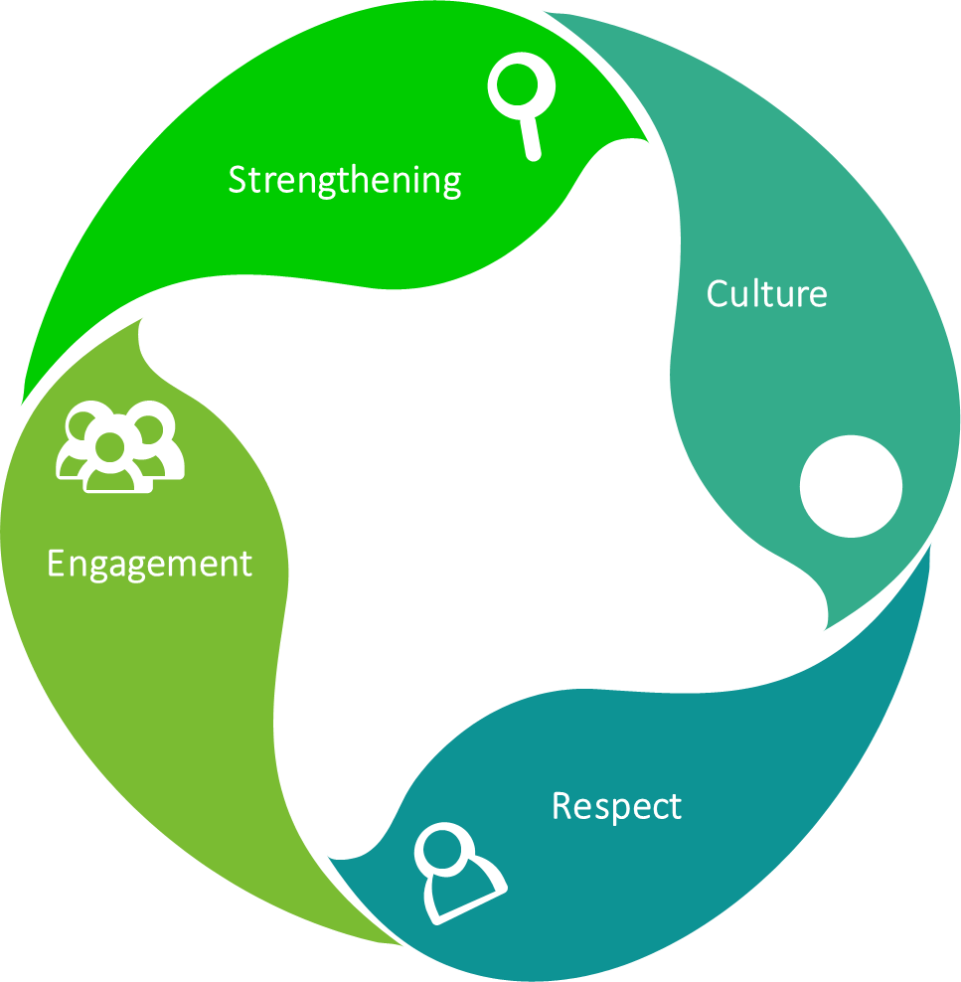

SCORE Sessions
5. Integrating Respect into Worklife
4. Working Regardless of Respect
3.Responding to Disrespect
2.Promoting Respect
1. Acknowledging Respect
5 Sessions
90 Minutes
2-4 Weeks Apart
Leiter.cord@gmail.com mpleiter.com

Slide 27
Improving Work Flow
Shared Initiatives

Slide 28
Scope of Workplace Action
Individual
Colleagues
Workgroup
Organisation
Job Crafting,
Coaching
Shared Job Crafting
Workgroup Initiatives
Policy, Procedure Changes
Authority
Scope of Participation and Impact

Slide 29

Better Work Design
Clearer Shared Expectations
  Focusing Employee Time & Energy
  Emphasizing Core Mission
Eliminating Waste, Tedium, & Illegitimate Tasks
  Job Crafting
  Proactive Performance Evaluation
Community
  Improving Strained Workgroup Cultures: SCORE
  Deepening Unit Managers’ Capacity to Lead Workplace Environments
Notes:
Can Anyone identify a Work Demand that Consumes Energy while Failing to Contribute to the Mission?
And everybody wastes time

Slide 30



Qualities for Shared Resolution
Responsive
Flexibility
Listening

Slide 31

Leadership
Setting The Tone for a Workplace

Slide 32
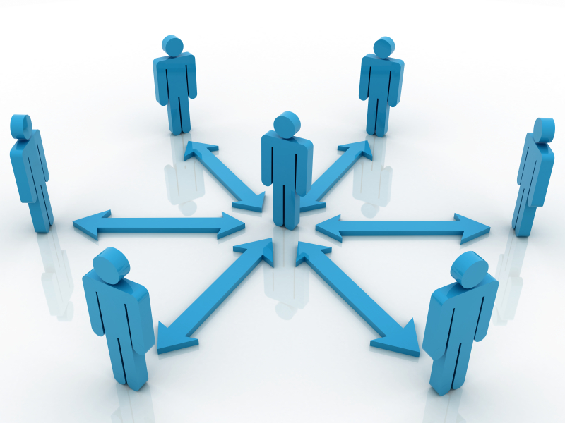
What Can Leaders Do?
Managing Workload
  Clarifying Expectations
  Emphasize Long-Term Career Development
Shared Decision Making, Supporting Autonomy
Recognition
  Often
  Meaningfully
Modelling Workplace Civility
Open, Fair Decision Making
Value-Driven Leadership
Notes:
Leader Strategies
Attending to Staff: Warning signs re exhaustion, cynicism, discouragement
Reducing as well as adding tasks
Value Salience and Congruence
Note Six Areas Model

Slide 33

Conclusion
Engaged: Overall Positive Connection with Work
Ineffective: Lack of Agency and Recognition
Distressed But Distinct
  Overextended
  Disengaged
  Burned Out
Action: Improve Areas of Worklife
Two Strategies
  Realigning Imbalances
  Overcoming Frustrations
michael.leiter@deakin.edu.au
https://Mpleiter.com

Slide 34
Things to Read
Leiter, M. P. & Maslach, C. (2016). Latent burnout profiles: A new approach to understanding the burnout experience. Burnout Research, 3, 89-100.
Malseic, J. (2016). The 40-Year-Old Burnout. The Chronicle of Higher Education.
  http://www.chronicle.com/article/The-40-Year-Old-Burnout/237979
Maslach, C., Schaufeli, W. B., & Leiter, M. P. (2001). Job burnout. Annual Review of Psychology, 52, 397-422.
Maslach, C. & Leiter, M. P. (1997). The Truth about Burnout. San Francisco, CA: Jossey Bass.
michael.leiter@deakin.edu.au
mpleiter.com

