Slide 1
Progress towards an inclusive education for children and young people with disability in Australia

Slide 2
Overview
CYDA
Current experience
Policy Framework/Major initiatives
Other activity
Where to from here?

Slide 3
About CYDA
National representative persons organisation for children and young people with disability, aged 0 to 25 years – direct experience represented at all levels of the organisation – Board and Operational
Work to ensure the direct experiences of children and young people with disability informs policy and practice - Key activity is systemic advocacy
Rights based/work reflects the social model of disability
Established in 2009

Slide 4
About CYDA
Core funding through the Department of Social Services
5500 members nationally
Not for profit
Extensive information is available at www.cyda.org.au
Additionally find us on Facebook at www.facebook.com/CDISAUS or Twitter @CDA39

Slide 5
Experience of students with disability
Education is one of the most significant issues of concern for children and young people with disability and their families.

Slide 6
Education experience
Poor experiences and poor outcomes are common place in relation to students with disability in relation to access and participation in education in Australia. SwD frequently experience:
limited opportunities;
low expectations;
exclusion;
inadequate resourcing;

Slide 7
Education experience
Inadequate access to expertise (support staff, teachers, behaviour support, allied health etc);
bullying;
discrimination; and
Increasing incidents of restraint and seclusion

Slide 8
Ongoing direct experiences
Some positive experiences & pockets of good practice reported to CYDA
+ve experiences dependent on vigilant family advocacy & the stars aligning
Many families think compromised education experience/outcome is part of the lot of being a child with disability so therefore complicit with an inadequate system
The positive experiences/practices seen are transient – never become embedded and contribute to long term systemic change

Slide 9
CRPD – Article 24
State Parties recognize the right of persons with disabilities to education. With a view to realizing this right without discrimination and on the basis of equal opportunity, State Parties shall ensure an inclusive education system at all levels and life long learning directed to:
…………

Slide 10
Inclusion in education — Issues paper
Draws on 170 research papers.
Discusses the considerable body of evidence that demonstrates the benefits of inclusive education for all students.
Rights based approach.

Slide 11
Inclusion in education — Issues paper
Available in hard copy from CYDA
Electronic version available at CYDA website http://www.cyda.org.au/cda-issue-papers

Slide 12
Inclusion in education — Issues paper
What is inclusive education?
Outcomes of inclusive education
Barriers to inclusive education
Capacity building

Slide 13
What do the statistics say?
7.7% of children and young people aged 0 to 24 in Australia have a disability
41% of people with disability have completed Year 12, compared to 62.8% of people without disability;
17% of people with disability have completed a Bachelor Degree or higher compared to 30.1% of people without disability;

Slide 14
What do the statistics say?
In 2015 15% of students with disability attended special school –Compared to 11% in 2003
In 2015 26% of students with disability with “severe or profound limitation” attended a special school (2003 22%)

Slide 15
What do the statistics say?
Bullying is a common experience – No specific stats on SwD - Held Back report – students with disability were 3 times more likely to be bullied than the general population and 2/3 experienced bullying or harassment

Slide 16
CYDA National Education Survey - 2017
Limited data/stats on education experience of SwD so CYDA commenced annual survey. First survey being completed in 2015
Results no surprise to students and families but have played a strong role in raising broader community and political awareness

Slide 17
CYDA 2017 National School Education Survey
766 participants (students and families)
68% of respondents thought the support received by the student was inadequate
47% reported that families had paid personally for specific supports or equipment to enable access & participation
73% of SwD reportedly had an IEP

Slide 18
CYDA 2017 National School Education Survey
38% of SwD were excluded from events or activities at school in the last year
56% of SwD had experienced bullying in the last year

Slide 19
CYDA 2017 National School Education Survey
19% of SwD had experienced restraint at school in the last year
21% of SwD experienced seclusion at school in the last year
17% of SwD had been suspended in the last year

Slide 20
Ongoing direct experience - examples
My son is currently doing open access at home due to bullying and being pushed to the ground at school by a year 12 student. This caused a disc prolapse
My child is allowed to attend 9.00am to 12.15pm, 4 days per week. She often gets sent home prior to 11.00am (at least twice a week)
The Principal phoned to say that the classes were settled and they did not want to unsettle them with an ADHD child and so no offer of enrolment would be forthcoming

Slide 21
Ongoing direct experience - examples
I never get told about trips such as their annual Anzac Day tour, or next year a trip to Canberra. I just see the photos of these trips with happy, smiling kids enjoying themselves…and know my son was never considered part of the group
Segregated into a spot on the carpet which was a black square with her name written on it in chalk
Excluded from interschool sport because of “behaviours”. She came first in age group for running but they sent the child who came second instead
Cyberbullying including suggestions to commit suicide

Slide 22
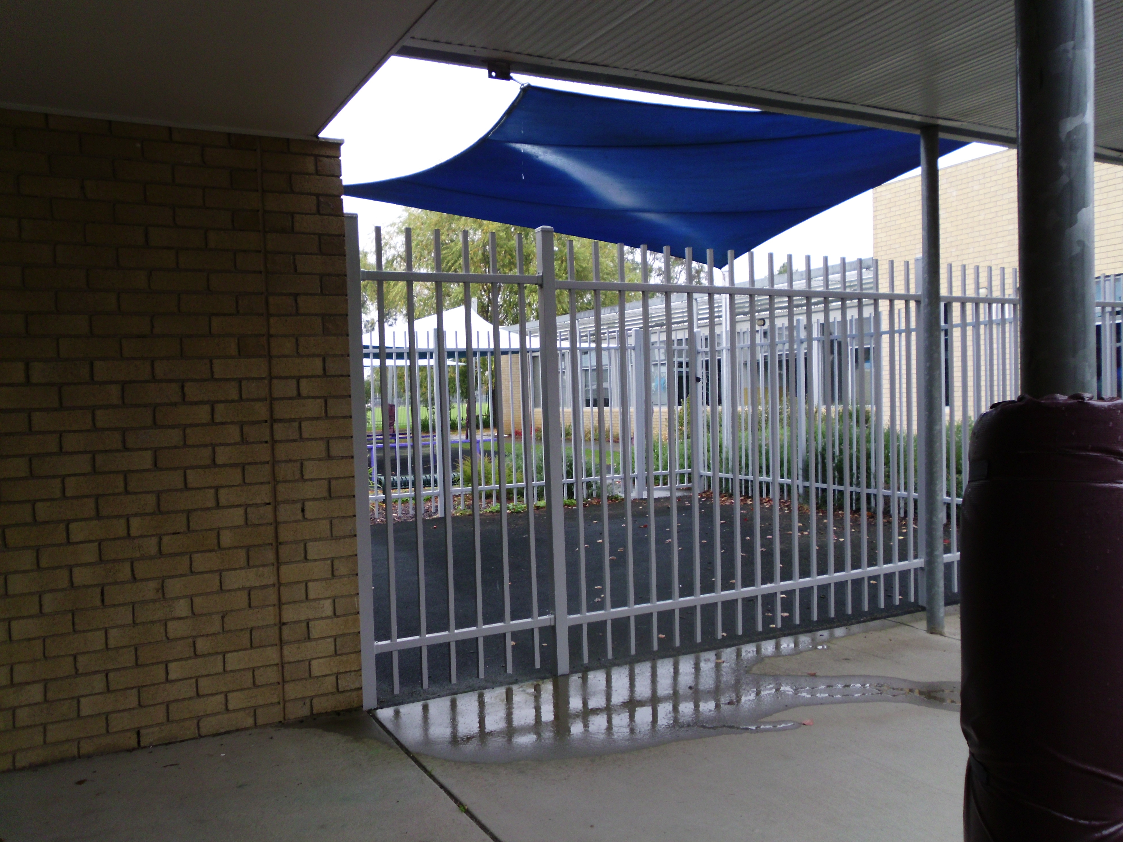

Slide 23
Ongoing direct experience - examples
Fairly constant harassment from other students. Verbal nastiness inside and outside of class, has had food thrown at him during lunchtime, and has had a student intimidate him and follow him home from school. The student filmed his frightened reaction and uploaded it to Snapchat, so other kids at school could make fun of him

Slide 24
Ongoing direct experience - examples
They build a Perspex cubby that had nothing in it, with no windows or access out, and my child was put in their daily
They have fenced off cage areas that they put my son in for time outs if he is not “obeying” the teachers
Spent most of his days in an isolated classroom with only 30 minutes or less being spent in the mainstream classroom. Also seclusion at recess & lunchtimes because the Principal decided it would be too overwhelming for him to be with his peers

Slide 25
National Policy Framework/Major Initiatives
The National Disability Strategy
National Reviews of Education (“Gonski 1 & 2”)
Nationally Consistent Collection of Data of Students with Disability (NCCD)
NDIS - not the magic wand for all issues of concern re disability
Number of state inclusive education policy/positon papers established

Slide 26
Other activity
Research – Australia has a formidable body of highly respected inclusive education academics – strong voice and keen to advocate for change
Social media – communication/agitation/support between students/families, Facebook discussion pages/twitter
Great work happening by state disability advocacy organisations/lobby groups/other stakeholders

Slide 27
Other activity
Numerous inquiries
From 2013-2017 CYDA has responded to the following education related inquiries
the Senate Inquiry into Teaching and Learning – Maximizing our Investment into Australian Schools (2013); School Workforce Productivity Commission Draft Report(2013); Inquiries into the Australian Education Bill (x3)(2013); the Office of the United Nations High Commissioner for Human Rights on Human Rights Resolution 22/3 – “The Work and Education of Persons with Disabilities;” (2013); Productivity Commission Inquiry into Childcare and Early Childhood Learning (2014);

Slide 28
Other activity
The Senate Inquiry into the Immediate Future of the Childcare Sector in Australia (2013); Senate Inquiry into the Delivery of Quality and Affordable Early Childhood Education and Care Services (2014); Senate Select Committee Inquiry into School Funding (2014); Consultation on the removal of the command and control features of the Australian Education Act (2014); Teacher Education Ministerial Advisory Group (2014); the Review of the National Curriculum (2014); CRPD General Discussion on the Right to Education for Persons with Disabilities (2015);

Slide 29
Other activity
Convention on the Rights of the Child Day of General Discussion on the Rights of Adolescents (2015); Disability Standards for Education Review (2015); Senate Inquiry into Current Levels of Access and Attainment for Students with Disability in the School System, and the Impact on Students and Families Associated with Inadequate Levels of Support (2015); SA Select Committee Access to the Education System for Students with Disabilities (2015); CRPD Draft General Comment on the Right to Inclusive E ducation (2016); Senate Select Committee on School Funding Investment (2016); Productivity Commission Inquiry into the National Education Evidence Base (2016);

Slide 30
Other activity
ACARA consultation on the inclusion of data on students with disability on the MySchool website (2016); UN Special Rapporteur on the Rights of People with Disability on abuse of students with disability in Australian schools (2016); and House of Representatives Inquiry into Educational Opportunities for Aboriginal and Torres Strait Islander Students (2016); Senate Education and Employment Legislation Committee Inquiry into the Australian Education Amendment Bill (2017); Victorian Department of Education and Training, Education and Training Reform Regulations Review (2017);

Slide 31
Other activity
General Purpose Standing Committee No 3 Inquiry into students with disability in NSW schools (2017); Standing Committee on Employment Education and Training Inquiry into school to work transition (2017); Review to achieve excellence in Australian schools (2017); Literacy and Numeracy Check Consultation (2017).

Slide 32
Other activity
A range of stakeholders saying very clearly we need to do much better in educating students with disability – CYDA has worked hard, as have others, to work with unions, school associations, educators, parents associations, peak bodies etc etc to create greater understanding of experience and a demand on governments to do better
Media – more interest, attitudes are shifting after Hervey Bay – Tate in the cupboard
Despite all of this though the direct experience is NOT radically changing STILL THE EXPERIENCE OF INCLUSIVE EDUCATION ELUDES MOST STUDENTS WITH DISABILITY

Slide 33
The way forward?

Slide 34
The way forward?
The UN General Comment clearly articulates the pathway forward to recognizing the right to an inclusive education for students with disability
Australia needs a national plan for students with disability
This should include:
A blueprint for embedded & systemic reform
Clearly articulated vision & aims
Measurable outcomes
A program for reform which is grounded in a strong evidence base & research regarding best practice

Slide 35
The way forward?
A national plan for students with disability
A timeline & objectives that would ensure commitment from governments and education systems to the ongoing reform with built in and clearly articulated roles for education sectors, students & families
The disability loading & funding arrangements
The creation of robust accountability measures including a monitoring, evaluation & reporting & improvement framework with commitments to regularly release info on implementation

Slide 36
The way forward?
A national plan for students with disability
Specific and focused actions to address and prevent current seclusion and restraint of students with disability within school settings
CYDA will lead a national campaign that aims to address the lack of community and political will to afford students with disability their right to an inclusive education. This year CYDA will be reaching out to all interested to assist with articulating the campaign, collaborating, speaking out and taking action

Slide 37
Student with disability
“School would be a much better place for kids with disability if everyone thought about their attitudes to disability. Disability doesn't mean 'not normal' and it does not mean less ability. It's just a different ability. We are all different so it shouldn't be such a big deal”

