Slide 1
Disability Advocacy by the Numbers 2012-16
Llewellyn Reynders
Policy Manager, VCOSS

Slide 2
About the Reports
Two reports
Disability Advocacy by the Numbers 2012-2016
Data Integrity Supplementary Report
From Quarterly Data Collection, aggregated and de-identified
Presents data, and links to UNCRPD and State Disability Plan
Supplementary report examines inconsistencies and gaps in the data, and QDC form, with options for consideration to improve data collection.

Slide 3
Disability Advocacy By the Numbers 2012-2016
Key findings:
Over 800 people receiving services in any given 3-month period
Around half were new clients
Slightly more men and boys than women and girls
Rising numbers of young people with disability
Around 4% were from an Aboriginal or Torres Strait Islander background
Around 10% were from a Culturally and Linguistically diverse background.

Slide 4
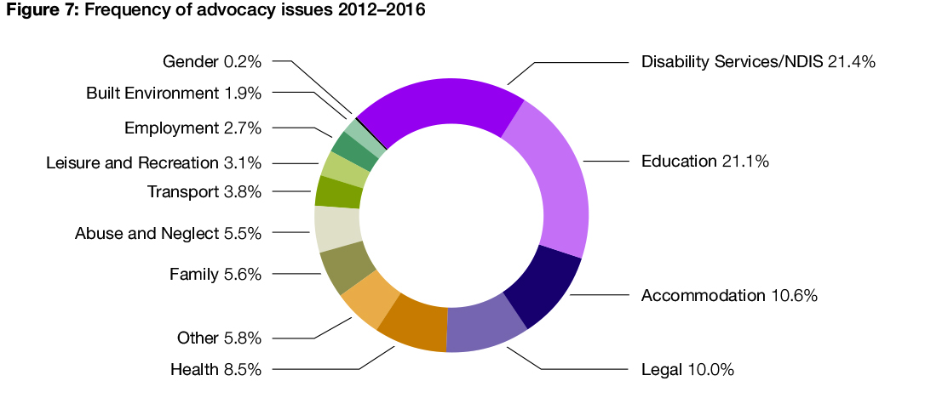
Disability Advocacy By the Numbers 2012-2016

Slide 5
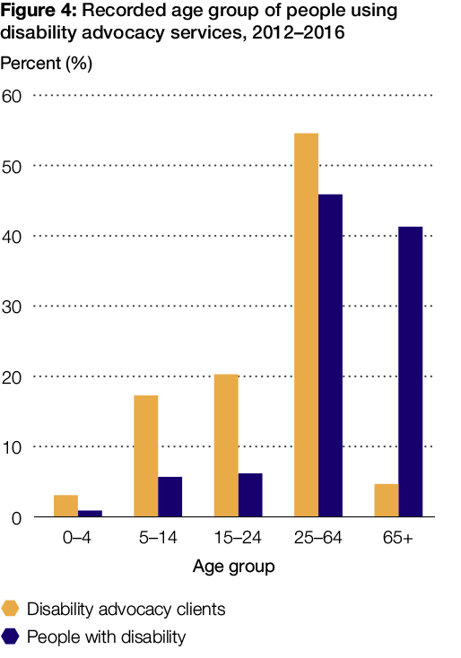
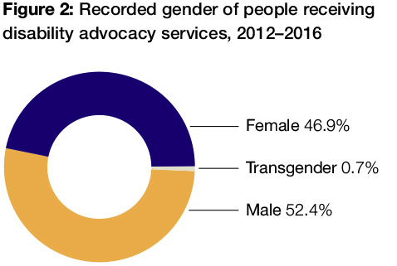
Disability Advocacy By the Numbers 2012-2016

Slide 6
Disability Advocacy By the Numbers 2012-2016: Data Integrity Supplementary Report
We have produced a second report looking in more detail at the quality of the data being collected.
The review of the Disability Advocacy Program and the Government response to the Abuse and Neglect inquiry both identify better data collection as important directions for disability advocacy in Victoria.
We have an opportunity to change the process to generate better information about disability advocacy and simplify reporting

Slide 7
Disability Advocacy By the Numbers 2012-2016: Data Integrity Supplementary Report
Key data integrity issues:
There is a lot of missing data, for example, we don’t have the gender of 44 per cent of clients, or the age of 40 per cent of clients
We are collecting data on the same people over and over again, which makes the data difficult to analyse
Some of the questions are difficult to provide good data for
We don’t know if organisations are interpreting the questions in the same way

Slide 8
Disability Advocacy By the Numbers 2012-2016: Data Integrity Supplementary Report
Overarching directions identified:
Clearly understanding the purpose of collecting data and what it will be used for
Providing clearer data requests that reduce confusion and misinterpretation
Avoiding asking for the same information multiple times
Improving data integrity and consistency of reporting

Slide 9
Disability Advocacy By the Numbers 2012-2016: Data Integrity Supplementary Report
Key questions:
What information do we want to know about disability advocacy?
How do organisations get the data for reporting now, and can this made easier?
What information should be made public?
How do we write questions that are easy to answer and will be completed by organisations?
How do we report systemic, group and self-advocacy?
How do we measure demand and outcomes?

Slide 10
Next Steps
Opportunity exists because:
The Victorian Disability Advocacy Program has recently been reviewed
The Victorian government had made specific commitments to improving the administration and management of the program, including:
more effective measurement of demand and outcomes
building stronger links with other safeguarding mechanisms, and
simplifying administrative requirements for funded organisations.
DARU looks forward to working with the Office for Disability and funded disability advocacy organisations to discuss these issues and help improve measurement and data collection in the future.

